Slide 1
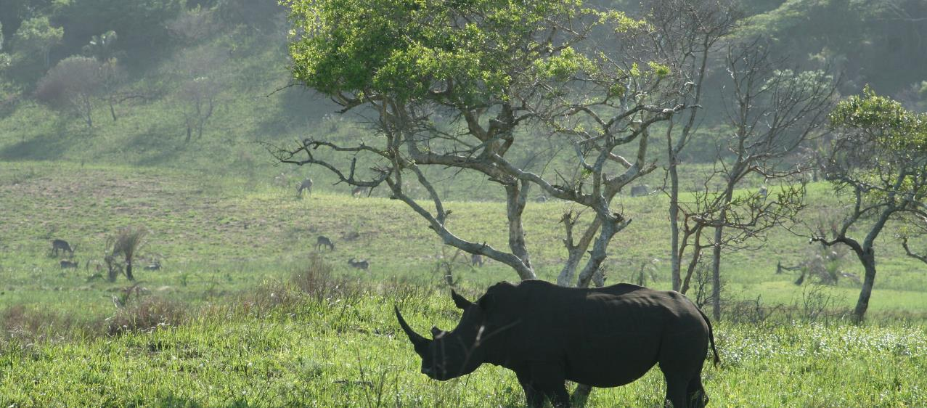
BIOPAMA IMET TRAINING
Session 2 : Exploring the IMET Tool
Bertille MAYEN

Slide 2
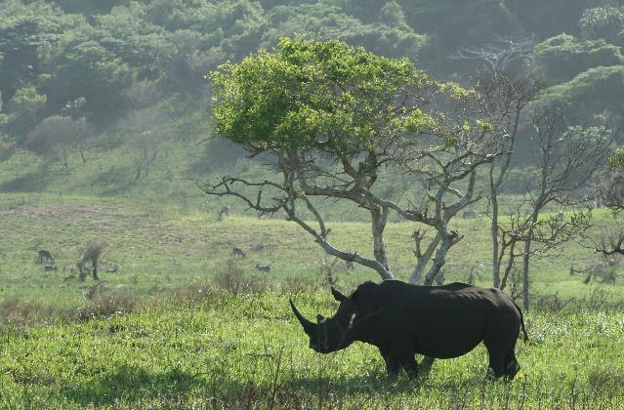
LEARNING OBJECTIVES
INTRODUCTION 2 IMET
Why a new tool? For who? For what? Main features?
At the end of the session, participants will be familiar with :
Brief history of IMET development process;
IMET usefulness / purpose;
Key characteristics of the IMET form
Notes:
The divider works as an overlay. To change the images in the background, select the main layer (the top shape) and right click “send to back”. Replace/Change the image. Then click “send to back” on the image you have added.

Slide 3
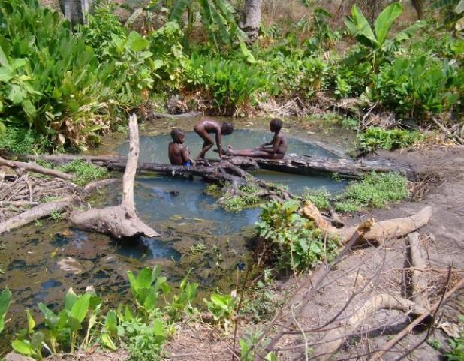
Brief history of IMET development process
IMET is part of the wider BIOPAMA programme. Started in 2011, it will run until 2023 with funds from the EU.
IMET aims to address threats related to biodiversity in African, Caribbean & Pacific countries while reducing poverty in communities living in and around PAs.
Implemented by IUCN, EU's Joint Research Centre and Regional Observatories.
Some key milestones
2013: Central african countries requested a tool that can give a clear picture of the status of a PA management effectivenes and also help in decision making during the Phase 1 of BIOPAMA;
2014-2015: Pilot and development of the first version in excel format in Central Africa and others countries.
2015 : Training of 25 coaches from 11 countries in Central and West Africa (using the version in the excel format )
2016: Roll out the first IMET campaigns in 100 PAs located in 15 countries.
The process is ongoing : developing new modules, improving the tool

Slide 4
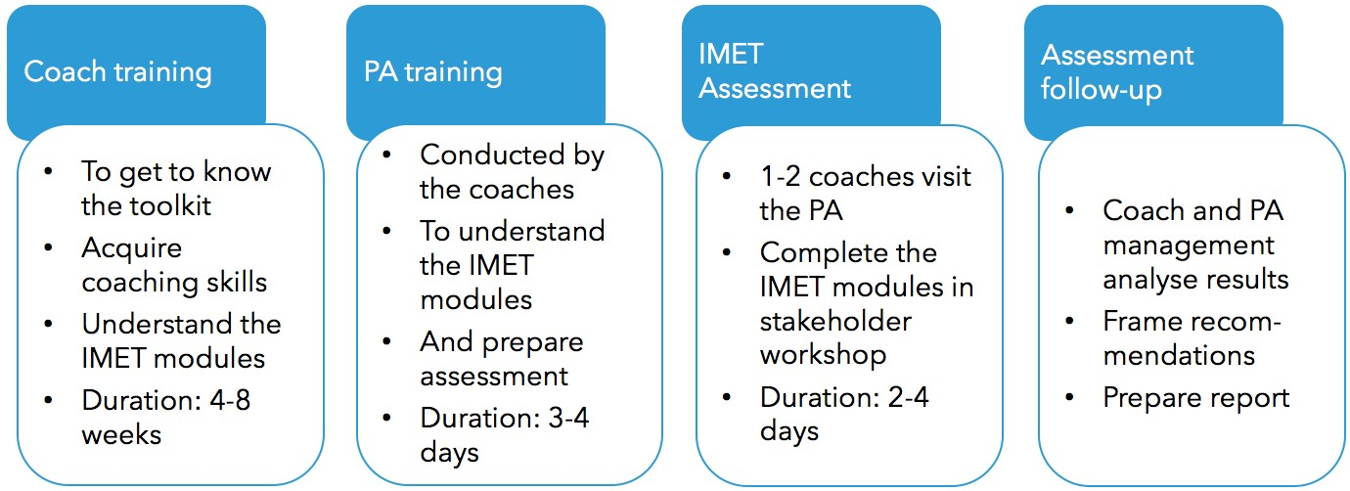
IMET usefulness / purpose
IMET goes way beyond assessing management effectiveness, it’s a comprehensive tool to support PA planning, to support decision making, to regularly conduct monitoring & evaluation.
Since its creation, the IMET has been used in various PAs across African, Asian and Caribbean countries . The graph outlines process for applying the IMET.

Slide 5
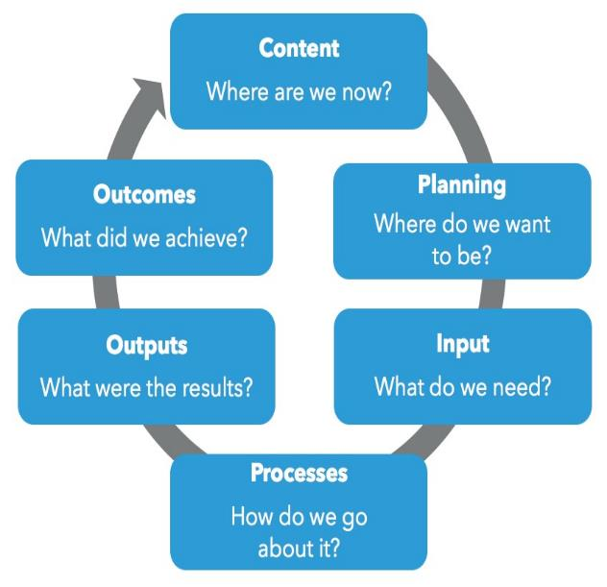
IMET is useful in ensuring the good management of a PA;
The conceptual basis for assessing management effectiveness is grounded in the IUCN framework comprising six elements of an adaptive management cycle.
The framework:
provides a basis for assessment;
gives guidance about what to assess & contains broad criteria for assessment,
presents key elements for designing a PA management objectives , monitoring the trends & evaluating the way in which the PA is managed.

Slide 6
IMET Key Features | Composed of 3 modules that can be completed online or offline: Evaluation of the state of the intervention context , Assessment of PA management effectiveness (Visualization of the produced elements) Analyses and reporting to support decision-making The form should be completed in a workshop set up with stakeholders; Through BIOPAMA, the IMET process is supported by coaches who train PA managers and assist in completing the form; IMET takes into account other methodologies (METT and EoH) and enables PA Managers to establish functional links between different levels of management - from the site to landscape and ecosystem, regional or national network.
Purpose | Contribute to improving protected area management and meet conservation targets
Challenge | IMET original version has evolved to the current Version 2.08. The developers of the tool are still working to improve the IMET experience based on practitioners’ feedback
Strengths | The tool goes beyond management effectiveness and supports PA planning & monitoring. It provides automatic visualization of data collected, gives a quick overview of results . In addition the online form allows for centralized data collection thus contributes to improved reporting on PAs

Slide 7
EVALUATION OF THE STATE OF A PA INTERVENTION CONTEXT
To evaluate the intervention context of a PA , one has to look at the following 7 areas of the PA
CTX.1. General information about the protected area
CTX.2. Surface area, limits and shape index, level of control of the PA
CTX.3. Human, financial and material resources of the protected area
CTX.4. Key aspects of the land and marine protected areas: i) flagship, threatened, endemic species; ii) habitats; iii) changes in land cover; and iv) resource management
CTX.5. Pressures and threats to the protected area
CTX.6. Climate change and conservation
CTX.7 Ecosystem services and dependence of the protected area communities on these services
With regard to the management context, data will be collected on the 4 main areas bellow
C1 Values and significance ; C1.1 Governance; C1.2 Classifications; C1.3 Key species; C1.4 Habitats; C1.5 Climate change; C1.6 Ecosystem services
C2 Constraint or support by external political and civil environment
C3 Threats
C4 Determining conservation objectives and indicators that match the protected area management

Slide 8
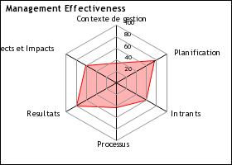
IMET Form : Results Visualisation

Slide 9
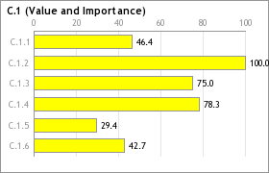
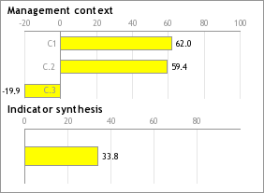
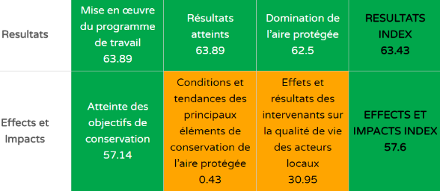
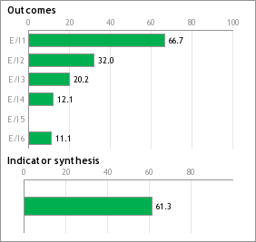
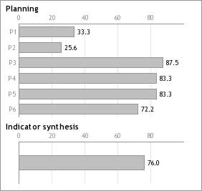
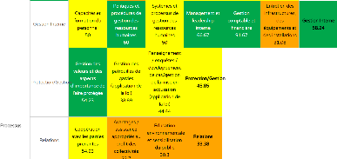
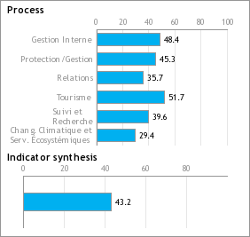
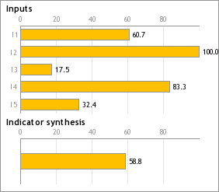
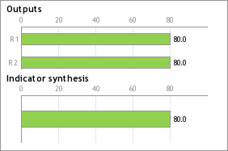
IMET Form : Results Visualization

Slide 10
THANK YOU

