Slide 1
Integrated Management Effectiveness Tool (IMET) Training
Kigali, Feb 2020
Domoina Rakotobe

Slide 2
SESSION 8 - Organizing an IMET assessment/ campaign

Slide 3
Objectives of the session
At the end of the session, participants will be able to:
Identify key steps and requirements to implement an IMET assessment or a campaign
Understand roles of coaches, IUCN and national stakeholders in an IMET campaign

Slide 4
Implementing an IMET assessment / campaign
What is the difference of an assessment and a campaign?
How does it work? how long it takes? How much it costs?
What and How could a country asks or implement an IMET campaign
The coaching mission: what is a coach? What does he do?
Experiences from Central and West Africa

Slide 5
IMET assessment / campaign
Additional analysis
PA site-level
IMET assessment
PA assessment
Information & Interests on IMET
PA assessment
Integration in Planning & Monitoring
PA assessment
Coach Training
Validation & peer reviewed workshop
National conservation strategy
COACH

Slide 6
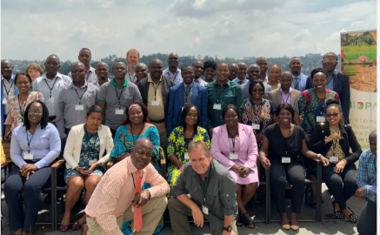
Expressing interests
Can be expressed by an individual or an institution for a PA, national agency or NGO
No strict procedures ….but
BIOPAMA wants to know where IMET assessments are done
Information & Interests on IMET
For West and Central Africa: Tanya Merceron: tanya.Merceron@iucn.org
For Eastern and Southern Africa: Sue Snyman: sue.snyman@iucn.org
Leo Niskanen leo.niskanen@iucn.org

Slide 7
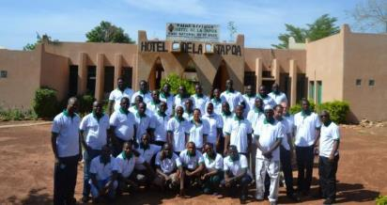
Coach & coach training
Coach Training
Coach: a PA expert that receives an intensive training on IMET, especially on the analysis aspects
Roles
Introduce IMET to national agencies and interested organisations
Lead national IMET training workshops
At PA-level, aid management teams to use IMET and analyse the results
Help management teams and host institutions to draw up proposals for improving management, monitoring and planning
Ensure proper reporting of the process
Share experiences and best practices to the IMET community of practices
COACH

Slide 8
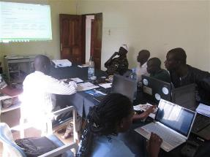
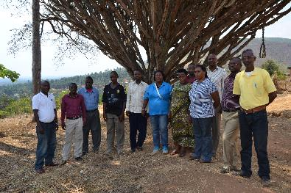
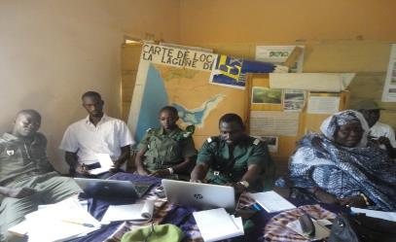
Site-level PA assessment
Preparation & communication : site selection, collect information, arrange logistics, administrative procedures, finding partners
Duration: 3-4 days
When / Time: depend on many factors
Logistics: workshop, computers (2 at least), projector
Budget
PA site-level
IMET assessment

Slide 9
Restitution
For accountability and transparency process
To promote further discussions with head of institutions, technical and financial partners
Validation & peer-reviewed workshop
What’s the next steps after the validation workshop?
Who to invite?
What’s the message?
When to do it?

Slide 10
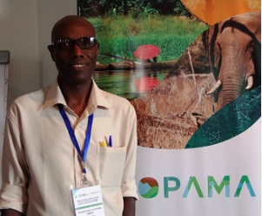
Next steps
Additional analysis
Need people (and supporting institutions) to drive the next steps
With analytical skills
Passionate about it
At site-level : challenges to integrate into Planning, Monitoring and Evaluation systems
At institutional level: strategic discussions
At national level: policy discussions and developement
Integration in Planning & Monitoring
National conservation strategy

