Slide 1
Integrated Management Effectiveness Tool (IMET) Training
Kigali, Feb 2020
Domoina Rakotobe

Slide 2
SESSION 7 - IMET and the other tools and standards

Slide 3
Objectives of the session
At the end of this session, participant will be able to:
Understand the differences and similarities of IMET with other PAME tools
Distinguish how IMET could contribute to the Green List process and standards

Slide 4
IMET and other PAME tools
More than 70 PAME methodolgies
Depends on what are your objectives, your context, your resources in doing the evaluation

Slide 5
Management Effectiveness Tracking Tool
Short exercise: Think – Pair – Share (10min)
Visit http://wcmc.io/METT3_English
Look at the METT Spreadsheet
With your neighbour, discuss the possible uses of METT, differences and similarities with IMET
Share your thoughts with your table

Slide 6
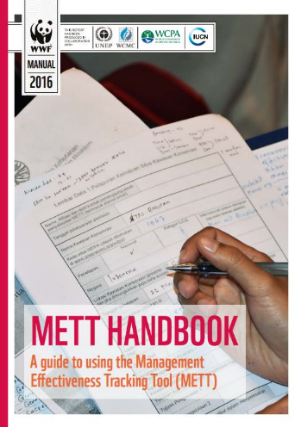
Management Effectiveness Tracking Tool
Focus/ Objectives: Assess current state of management effectiveness and track over time
Scope / Applicability: Site –level terrestrial protected area
Framework: Consistent with WCPA PAME Framework
Process/Method: Multiple choice (0 to 3 scale) questionnaire with 30 questions. Results in aggregated score but disaggregated scores can be made avaialble.
Typical time required: Varies from about 1 to 3 days.
Typical Cost drivers: Relatively low-costs.
Developer: WWF and World Bank
Strengths: Simple, adaptable, relatively low-cost, replicable over time, questions fairly comprehensive
Key limitations: relatively surface-level assessment, scoring process faily subjective,

Slide 7
Rapid Assessment and Prioritisation of Protected Area Management
Focus/ Objectives: Identify major trends and prioritize issues and allocate resources to improve ME in a system of group of protected areas
Scope / Applicability: PA system or groups
Framework: Consistent with WCPA PAME Framework
Process/Method: Five step process: scope, existing information, quesstionnaire, findings, next steps and recommendation
Typical time required: 3 days
Typical Cost drivers: Relatively low-costs.
Developer: WWF
Strengths: Simple, adaptable, relatively low-cost, system-level
Key limitations: not designed to provide in-depth outcome measure, or site-level information, inclusiveness varies with some region being done without community input

Slide 8
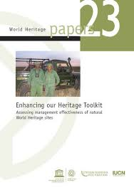
Enhancing our Heritage Toolkit
Focus / Objectives: assessing various components of World Heritage site management effectiveness that together build a picture of how well a site is being managed and achieving its objective
Scope / Applicability: World Heritage sites (and other protected areas, with adaptations)
Framework: Includes and builds on WCPA PAME Framework
Process / Method and Tools: Includes 12 tools and accompanying worksheets to compile the analysis
Typical Time Required: 3-4 days for 1st assessment and two to 3 days for subsequent assessments, excluding time to collect information
Developer: UNESCO World Heritage Center
Strengths: Adaptable, can be integrated with existing monitoring sysptem, in-depth, comprehensive, process can result in capacity strengthnenin
Limitations: Relatively costly and time consuming, requires adaptation to context

Slide 9
There are many other tools for different purposes as well
Purposes of assessments | Types of tools | Links
Social impact | SAPA (Governancance Assessment of PAs) | https://www.iied.org/assessing-social-impacts-protected-conserved-areas-sapa
Governance and equity | GAPA (Governancance Assessment of PAs) SAGE (Governancance Assessment of PAs) | www.iied.org › assessing-governance-protected-conserved-areas-gapa
Well-being & Benefits for local communities | PABAT (PA Benefits Assessment Tool) NBS (Necessity Basic Survey) | https://wwf.panda.org/?174401/PABAT https://mande.co.uk/special-issues/the-basic-necessities-survey/
Threats and law enforcement | SMART (Spatial Monitoring and Reporting Tool)
Notes:
4. The Basic Necessities Survey (BNS) is a method of measuring poverty that is:
Simple to design and implement. The results are easy to analyse and to communicate to others
Democratic in the way that it identifies what constitutes poverty and who is poor
Rights-based, in its emphasis on entitlement
5. To measure threats on the ground, the conservation community has increasingly begun to deploy standardized data collection during park ranger or community eco-guard patrols. Recently a consortium of conservation NGOs developed the SMART (Spatial Monitoring and Reporting Tool) approach to standardize patrol planning and reporting. Using SMART we generate the evidence that targeted patrol effort reduces direct threats to wildlife and their habitat.

Slide 10
IMET AND THE GREEN LIST STANDARDS

Slide 11
PAME and Standards
Assessment focus
PAME assesses management against a site’s individual goals and objectives
Standards evaluate a site’s management against peer reviewed best practices
Verification process
Although processes vary, most PAME systems are self-assessments; where they exist verification processes tend to be project based and do not involve accreditation or certification
Standards usually involve some kind of formal accreditation/ certification process with multiple steps to ensure compliance to the standards. Processes are encouraged to be based on international best practices

Slide 12
Green List Standards
The objective of the Standard is to "encourage protected and conserved areas to measure, improve and maintain their performance through globally consistent criteria that benchmark good governance, sound design and planning, effective management, and successful conservation outcomes."

Slide 13
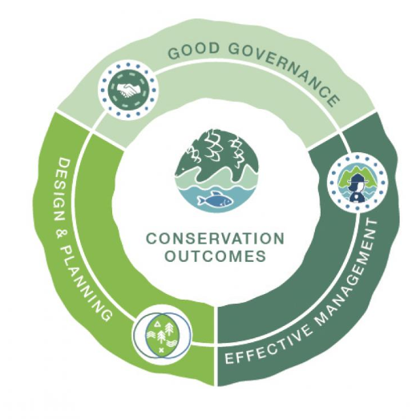
Green List Standards
The IUCN Green List Standard is organised into four components of successful nature conservation in protected and conserved areas. The baseline components concern:
• Good Governance
• Sound Design and Planning
• Effective Management
Together, these support the component on Successful Conservation Outcomes attesting to the successful achievement of an area’s goals and objectives. Each component has a set of criteria and each criterion has a set of indicators to measure achievement.

Slide 14
5 INDICATORS
Applicant provides evidence against context-setting indicators.
Successful completeness check by an EAGL representative admits site to Candidate Phase.
New Candidates are provided a log-in to COMPASS, the data management system for the IUCN Green List.
The site is ready to begin!
+45 INDICATORS
Candidates prepare evidence against all Green List indicators, with good stakeholder inputs.
Candidate is evaluated by Expert Assessment Group (EAGL).
An EAGL site visit helps to verify evidence & stakeholder support.
Once the EAGL agree that all indicators are achieved, the site is recommended for the Green List.
Until then, the Candidate continues improve, compiling better evidence, and engaging stakeholders for their support.
1
1
EVALUATION
The EAGL recommendation is submitted to the IUCN Green List Committee
The Reviewer reports on compliance with process.
The IUCN Green List Committee consider approval based on the EAGL and Reviewer recommendations.
Successful sites added to the ‘Green List’.
All Green List sites undergo periodic review in order to maintain their status.
Candidate profile is also reflected on Protected Planet®.
APPLICANT
CANDIDATE
GREEN LIST
PHASES AND EVALUATION
3

Slide 15
IUCN GREEN LIST STANDARDS
ACHIEVING QUALITY IN 4
COMPONENTS &
17 CRITERIA
Guarantee legitimacy and voice
Achieve transparency and accountability
Enable governance vitality and capacity to respond adaptively
Identify major site values
Design for long-term conservation
Understand threats and challenges
Understand social and economic context
Long-term management plan
Manage ecological conditions
Manage within social and economic context
Manage threats
Effectively enforce laws
Manage access and use
Demonstrate conservation of major natural values
Demonstrate conservation of ecosystem services
Demonstrate conservation of major cultural values

Slide 16
Legitimacy & voice
Direction
Performance
Accountability
Fairness & rights
Context
Planning
Inputs
Process
Outputs
Outcomes
1.1
Guarantee legitimacy and voice
Achieve transparency and accountability
Enable governance vitality and capacity to respond
Identify major site values
Design for long-term conservation
Understand threats and challenges
Understand social and economic
Long- term management plan
Manage ecological conditions
Manage within social and economic context
Manage threats
4.1
Demonstrate conservation of major natural values
4.2
Demonstrate conservation of ecosystem services
4.3

Slide 17
Legitimacy & voice
Direction
Performance
Accountability
Fairness & rights
Context
Planning
Inputs
Process
Ouputs
Outcomes
1.1
Guarantee legitimacy and voice
Achieve transparency and accountability
Enable governance vitality and capacity to respond
Identify major site values
Design for long-term conservation
Understand threats and challenges
Understand social and economic
Long- term management plan
Manage ecological conditions
Manage within social and economic context
Manage threats
4.1
Demonstrate conservation of major natural values
4.2
Demonstrate conservation of ecosystem services
4.3

Slide 18
Legitimacy & voice
Direction
Performance
Accountability
Fairness & rights
Context
Planning
Inputs
Process
Ouputs
Outcomes
1.1
Guarantee legitimacy and voice
Achieve transparency and accountability
Enable governance vitality and capacity to respond
Identify major site values
Design for long-term conservation
Understand threats and challenges
Understand social and economic
Long- term management plan
Manage ecological conditions
Manage within social and economic context
Manage threats
4.1
Demonstrate conservation of major natural values
4.2
Demonstrate conservation of ecosystem services
4.3

Slide 19
Legitimacy & voice
Direction
Performance
Accountability
Fairness & rights
Context
Planning
Inputs
Process
Ouputs
Outcomes
METT
EoH & IMET
GL

Slide 20
Legitimacy & voice
Direction
Performance
Accountability
Fairness & rights
Context
Planning
Rapid Assessment
Inputs
Process
Ouputs
Outcomes
METT

Slide 21
Legitimacy & voice
Direction
Performance
Accountability
Fairness & rights
Context
Planning
In-depth assessment
Inputs
Process
Ouputs
Outcomes
EoH & IMET

Slide 22
Legitimacy & voice
Direction
Performance
Accountability
Fairness & rights
Context
In-depth assessment
With means of verification
Planning
Inputs
Process
Ouputs
Outcomes
GL

Slide 23
Legitimacy & voice
Direction
Performance
Accountability
Fairness & rights
Context
Planning
Inputs
Process
Ouputs
Outcomes
SAPA
GAPA
METT
EoH & IMET
GL

