Slide 1
Integrated Management Effectiveness Tool (IMET) Training
Kigali, Feb 2020
Domoina Rakotobe

Slide 2
SESSION 3 - Understanding context of intervention and its links to management

Slide 3
Objectives of the session
At the end of this session, participant will be able to:
Explain what is the intervention context and what is inside
Distinguish the differences between context of intervention and context of management
Demonstrate links between context of intervention and management of a protected area

Slide 4
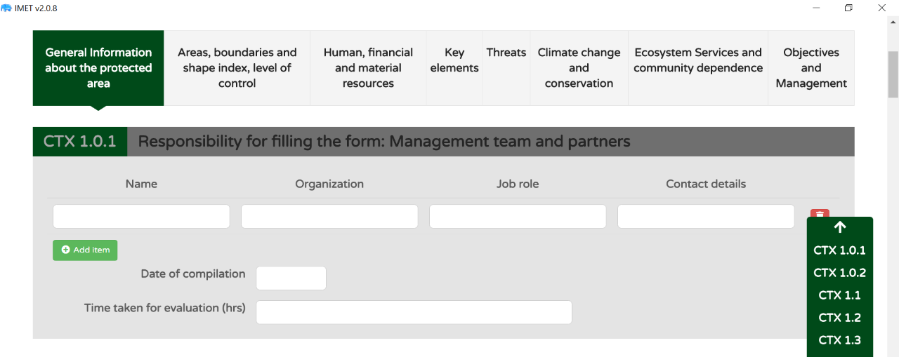
Context of intervention of PA management
1. General Information
2. Areas and Boundaries
3. Human, financial and materials
4. Key elements
5. Threats
6. Climate Change and Conservation
7. Ecosystem services and community dependence
Notes:
- How to fill it? What kind of information one has to prepare?

Slide 5
Context of intervention
Everything you need to know about the PA and its surroundings and its history (past information)

Slide 6
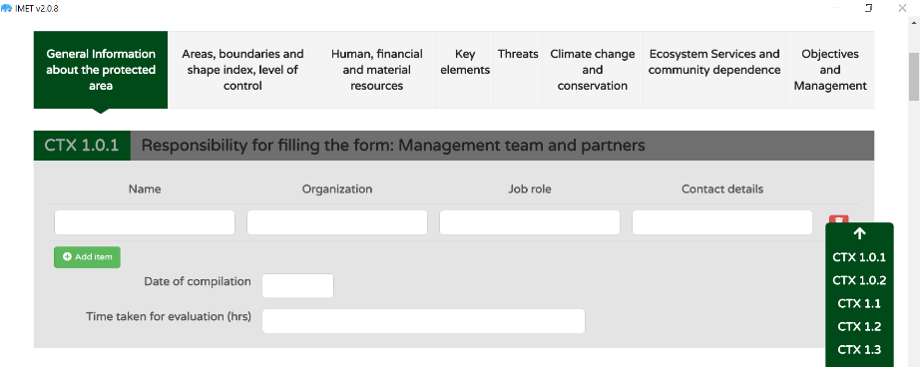
Time to explore the Contexte of Intervention (20’)
With your neighbour, open the Intervention Context
Go through all the questions together
IN PARTICULAR: look at key elements and threats
Discuss and note any question
Notes:
Answer any question while participant explore the Context of Intervention

Slide 7
Conclusion: Context of intervention of PA management
The Context of Intervention is the exhaustive description of the PA
It gives three (03) types of information
Crucial (extremely important): its location and area, its key elements, its threats
Secondary information (but still important) that help understand what is happening right now, but also has happened.
Surrounding information: relations with stakeholders, local communities…
The external environment influences management
Notes:
Make sure participants have enough cards
Discuss together if some cards need to be assigned to different groups

