Slide 1
Integrated Management Effectiveness Tool (IMET) Training
Kigali, Feb 2020
Domoina Rakotobe

Slide 2
SESSION 1 - Protected Area Management Effectiveness (PAME)

Slide 3
Objectives of the session
At the end of this session, participant will be able to:
Explain why evaluating effectiveness of management is critical
Cite and explain the six elements of the management effectiveness framework

Slide 4
Discuss with your peer (5’)
What's the difference between
"evaluating management" ?
and
“evaluating effectiveness of management"
Notes:
Discuss with you neighbour about the difference of these two elements

Slide 5
The key difference is effectiveness
Effectiveness:
Is the degree to which something is successful in producing a desired result; success.
Is the capability to produce a desire result
Evaluating effectiveness:
Of a communication campaign
Of a training
Of a drug
Notes:
1) Effectiveness is linked to a desired result, that is defined before hand. Effectiveness cannot be measured if there is not an objective, or a desired result.
2) For instance, if we evaluate the effectiveness of a training, we need to define in advance what do we want to achieve?
This is why, we have to set up the learning objectives.
In the same line, effectiveness of a drug is its ability to heal a disease in a certain amount of time.
The effectiveness of a communication campaign could be measure through the change of behaviors in the target audience – that needs to have been identified in advance.
In that sense, evaluating management is like saying: Is the management good or bad?
Evaluating the effectiveness of management is saying: Does our management achieve our goal?

Slide 6
Evaluating effectiveness
Evaluating effectiveness = Did we achieve our goals?
Evaluating effectiveness of management is evaluating to what extent management elements (planning, resources, organization…) achieve agreed objectives
Notes:
[graph] However it’s not a YES or NO type of answer that is needed.
Let’s take the example of evaluating the effectiveness of a training
First thing is the design: Is the course well designed to the desired target audience (for instance adult learner), do the learning objectives respond to the need of the trainees.
Adequacy and appropriateness: if we suppose that the syllabus and curriculum have been well written, how was the teacher’s teaching skills?
Delivery: it is asking if the participants have reached the learning objectives? If they have to pass a test, will they all succeed?

Slide 7
Evaluate a Protected Area Management Effectiveness
Does the management of a protected area help achieve its goals?
Does a protected area conserve its values?
Notes:
PAME does not assess people nor an institution.
In other words, it’s asking a very simple question: does a protected area conserve its values? We are evaluating management to achieve the main goal of a PA = to conserve its values.

Slide 8
Evaluate a Protected Area Management Effectiveness
Protected Area Management effectiveness evaluation is defined as the assessment of how well the protected area is being managed – primarily the extent to which it is protecting values and achieving goals and objectives (Hockings et al, 2006)

Slide 9
Why evaluating management effectiveness of a protected area (PA)?
Promote ccountability and transparency
Maintain the value of the PA
Enable support and adaptive management
Better assist in resource allocation
Help involve various stakeholders
Notes:
Before we move forward, we can ask WHY evaluating mgt eff.
Accountability: Protected areas now cover over 15 per cent of the world’s land surface and are increasing rapidly in marine areas as well. This represents a very major commitment to the protection of biodiversity, along with associated environmental services and cultural values, by local and national governments, local communities and private landowners. The people investing in protected areas, whether through voluntary donations to NGOs or through government taxes, have a right to know that these areas are being well managed. As the total number of protected areas continues to increase, so too do calls for proper accountability, good business practices and transparency in reporting
Maintain the value: Protected areas are facing a range of significant threats both from actions in the immediate vicinity and from pressures originating further away. Responding to such pressures is an urgent but often very tricky challenge if the values of protected areas are to be maintained

Slide 10
Limitations (and risks) in evaluating PAME?
Evaluate management vs. Evaluate managers
Bias of appraiser and PA management staff
Ambiguity in standards
Insufficient evidence
Leniency or Strictness Tenancy
Standards in rating
Notes:
Like any other evaluation, there are several limitations. If we take school evaluation, employee evaluation, performance evaluation: there are some common points that we can fing in PAME as well. These limitations can be attributed to
The evaluator’s approaches, and sometimes personnal characters
Tools used to do the evaluation
The assessed attitudes
Here are a few common limitations
There is a risk or fear that managers (people) are evaluated and not the management. If the managers feel or think they are audited or evaluated they will tend to response in a mode defensive way
Bias: The presence of ‘Halo Effect’ in evaluation can be the biggest weakness in evaluation. In Human resource management, for instance, a high rate is given to favoured employees whereas unfriendly employees are rated low. This is also very possible when you evaluate a PA where you’ve worked with for years, and if you have strong affinities with the assessed team
Evaluation is usually referred to some standards of performance. In PA management, the Management Plan or PA Strategic plan should be the reference point, but it is frequent that objectives are not clearly stated. If the standards are not clear, the assessors may follow different standards for different PAs.
Lack of evidence to support the responses to an evaluation. For instance, a PA team might be very convinced that they are doing well in protecting the PA values, let’s say a primate, however, they do not have sufficient data to support that the population of that primate is increasing over the years. In such cases, the effectiveness appraisal will be superfluous.
Leniency: Every evaluator has his own valuation procedure which is regarded as his own standard for evaluation. For example, some teachers are strict in evaluation of answer books whereas others are lenient. The lenient tendency is known as ‘Positive Leniency Error’ whereas strict tendency is called as ‘Negative Leniency Error’. The rating may be high or low depending upon the nature of evaluators.
Standards in rating: A first limitation is that if there is not a common rating system, various evaluators will rate a same process or product very differently, as we said – they can be biased. A second common limitation seen among evaluators, is that without an evaluation grid, they usually tend to give average rating.

Slide 11
The Framework for PA Management Effectiveness
A tool not a rule
Notes:
We have seen that there are important advantages in evaluating PAME, but there also can be limitations or even risks when it’s not properly done, the World Commission on PA, has established a framework.
As a framework, it is not aimed to be a rule, but more a tool to guide PA management effectiveness.
It is not a methodology, but is a guide to developing assessment systems as it has been seen all over the years the need to have for a variety of responses depending on needs and resources. The framework also includes suggested tools which can be used as the basis for developing an assessment methodology

Slide 12
The Framework for PA Management Effectiveness
Early 1980s → Need to make « reasonable judgements about programme effort, effectiveness, efficiency and adequacy with the objective of using these judgements to improve the effectiveness of management” (Thorsell, 1982).
Early 1990s →General program evaluation (not specifically for PA), mainly at site level.
From a capacity to manage approach towards “outcomes” or impact on the “ground”
2000 → 1st edition of the Framework (Hockings et all, 2000)
Notes:
A very brief history of how was it designed, how did it evolve
Hocking et al 2000: We clearly need to put as much effort into achieving sound and effective management of protected areas as into setting up new areas. As a result, interest is growing in ways in which we can monitor and evaluate the effectiveness of protected areas and apply the findings to progressively improve on-going management. This is not as easy as it sounds. “Protection” encompasses many values and has numerous facets. Loss of quality in protected areas can occur in many different forms. Effectiveness needs to be measured from various points of view, ranging from the status of the area and the way in which a protected area is designed through to the outcomes of management actions and the overall state of conservation of the area. Evaluation is needed at many different levels, from quick assessments to detailed monitoring studies undertaken to inform adaptive management.
The key questions that are of interest at this global and systemic level are whether the responsible authorities have the capacity to manage their protected areas effectively and whether this management is being delivered on the ground. Capacity to manage has many components and cannot be summarised in a single measure: the principal dimensions are the system of governance, level of resourcing and community support
The current framework is a 2nd edition of the first one, and has been published in 2006.
The framewok helps to give a common standard for evaluating a site of PA, but also have common ground on evaluating PA at national and global level.

Slide 13
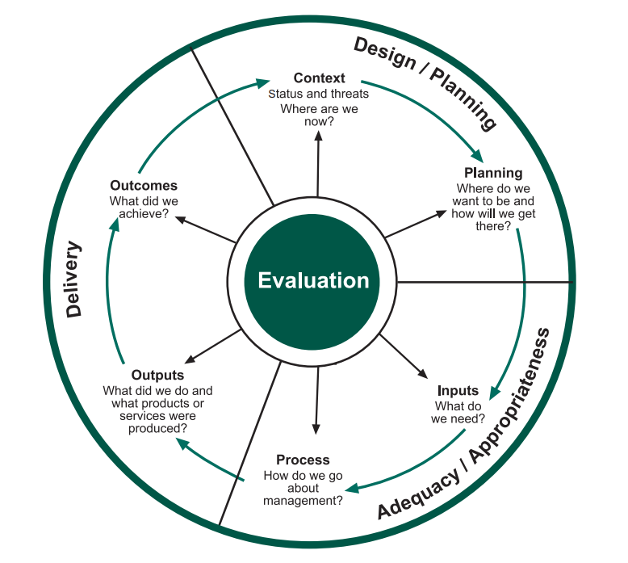
The Framework for PA Management Effectiveness
The Framework is based on the principle that good protected area management should follow a cyclical process with six stages or elements.
Notes:
Content

Slide 14
The Framework for PA Management Effectiveness
The Framework is based on the principle that good protected area management should follow a cyclical process with six stages or elements.
Management context
Planning
Inputs
Processes
Outputs
Outcomes
Notes:
Content

Slide 15
Exercise: Jigsaw (75’)
Steps:
Divide participants into 6 groups according to the 6 elements of the Framework → Each group appoints one leader
Each group will have time to read and discuss ONE element to be familiar with it. (10’)
Form new groups with a representative of the first group. Each member of the groupe will present his/her element to the new group (2min/ pers)
The original groups reconvene and share feedbacks. One representative will prepare a short final presentation based on what they learned from their groups and feedbacks. (15’)
Notes:
►This activity is a collaborative exercise that helps learners explore one topic and learn from others about other topics. Introduction (5') ► Break class into 6 groups and break assignments into pieces that the group assembles to complete the (jigsaw) puzzle: 1) Management Context, 2) Planning, 3) Inputs, 4) Process, 5) Outputs and 6) Outcomes. Each group will receive a document of each element, read it and discuss it together (10') ►Participants will be split into mixed groups. Each group contains 6 people from the 6 topics. Each member of the group will present his/her topic again to the group, and notes questions and briefly discusses the topic (15') ► Finally, the original groups reconvene and listen to presentations from each member. They will prepare a final presentation based on what they learned from their groups and feedbacks from others. (15') ► Restitution per group (2'x 6 groups= 12') Presentation: key messages (5')

Slide 16
Exercise: Jigsaw (75’)
STEP 1: Divide into six Groups
Group 1: Management context
Group 2: Planning
Group 3: Inputs
Group 4: Processes
Group 5: Outputs
Group 6: Outcomes
Appoint one leader
1
2
3
Grp 1
4
Grp 1
Grp 1
5
6
Grp 1

Slide 17
Exercise: Jigsaw (75’)
Read the Hockings et al (2006)
https://portals.iucn.org/library/efiles/documents/PAG-014.pdf
STEP 2: Learn your element
Management context (pp12-15)
Planning (pp18-20)
Inputs (pp 20-22)
Processes (pp22-24)
Outputs (pp 24-25)
Outcomes (pp26-27)
1
2
3
Grp 1
4
Grp 1
Grp 1
5
6
Grp 1

Slide 18
Exercise: Jigsaw (75’)
Read the Hockings et al (2006)
https://portals.iucn.org/library/efiles/documents/PAG-014.pdf
STEP 3: Share to others
Let's move!
You’ll have 2 minutes to share what you have learnt to others

Slide 19
Exercise: Jigsaw (75’)
STEP 5: Go back to your original group
And share what you’ve learned from others’ feedbacks
Designate someone for short restitution
1
2
3
Grp 1
4
Grp 1
Grp 1
5
6
Grp 1

Slide 20
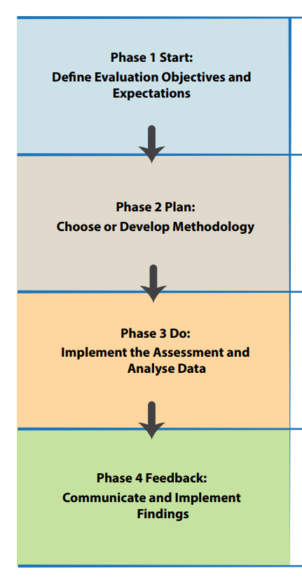
The Framework for PA Management Effectiveness
The Framework for PAME follows the same principles as Program Monitoring cycle.
Each element may interact with the other five and a consideration of all is needed to understand what is going on in the PA.
Common steps in applying the framework is
To define evaluation objectives
Choose a methodoly (or a tool) and plan an evaluation process
Implement evaluation
Analyse, communicate and implement results

Slide 21
Ongoing challenges in doing PAME
Other (usual) challenges
Capacity
Funds
Integration to decision-making
Ensuring accuracy
Careful wording of questions
Measuring trends over time
Descriptive vs. Quantitative scores
Etc.
Notes:
Although we can say that PAME as its current version now has 30 years, there are still ongoing challenges
Ensuring accuracy in assessments
Careful wording of questions: Loosely defined assessment questions can lead to several aspects of the way a question is framed (the assessment frame) being misinterpreted, particularly the scope (which aspects of management are being considered), the scale (which parts of the protected area are being considered) or the time frame (the period over which outcomes are being considered) (Cook et al. 2014a)
Measuring trends over time
Descriptive vs. Quantitative scores: The choice of whether to use qualitative or quantitative assessment categories can depend on the management issue being assessed. Quantitative assessment categories tend to be best suited to aspects of management that can be measured numerically, such as the status of biological attributes (for example, population status or vegetation condition) and the number of visitors to a protected area. Some aspects of management, however, are less suited to quantitative metrics, such as whether protected area managers have sufficient information about protected

Slide 22
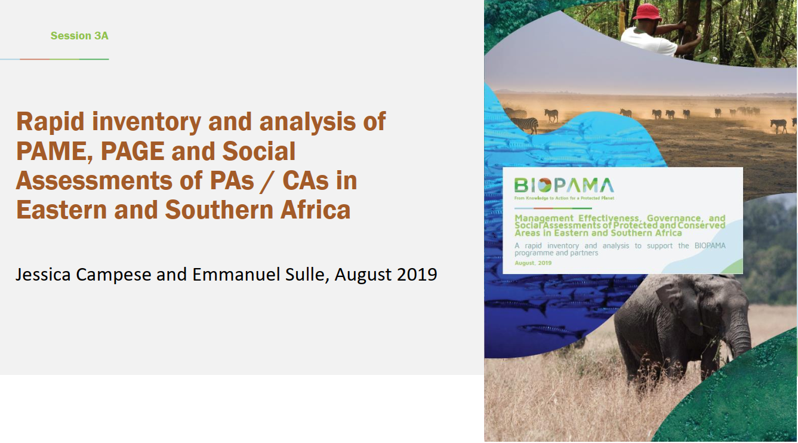

Slide 23
