Slide 1
IMET: THE WEST AFRICAN EXPERIENCE
Complex WAP (W-Arly-Pendjari)
Dede Amah
Technical Assistant BIOPAMA
An initiative of the ACP Group of States financed
by the European Union’s 11th EDF

Slide 2
Diagnostic tool
Visual tool
Monitoring and evaluation tool
Tool for improving management of PAs
Tool for comparison
Tool for prioritization of interventions and actions
Tool for resource mobilization/allocation
IMET stands for Integrated management effectiveness tool and is based on six elements: context, planning, inputs, process, outputs, outcomes
Notes:
INTRODUCTION

Slide 3
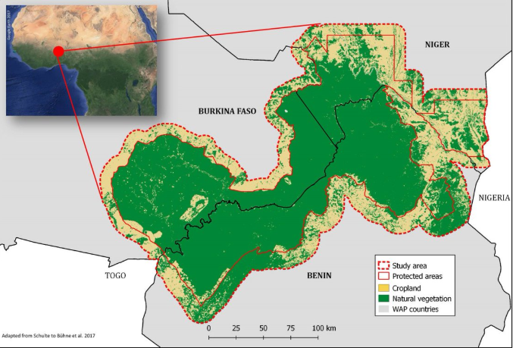
Transboundary Biosphere Reserve
Five (5) National parks
Parc national W Niger
Parc national W Burkina Faso
Parc national W Benin
Parc national d’Arly
Parc national de la Pendjari
3 countries (Burkina Faso, Niger, Benin)
Area: 10,000 km2
Notes:
INTRODUCTION

Slide 4
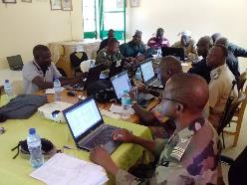
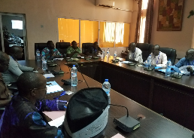
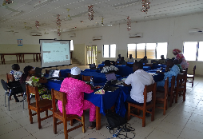
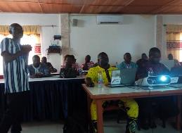
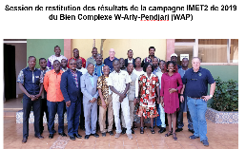
BIOPAMA trained IMET coaches
IMET Coaches trained WAP Park managers
Park managers carried out data collection with national actors, Rangers, NGOs, Communities, Traditional authorities, Municipalities, etc…and were supported by the IMET coaches
Site analysis and presentation of results done in each country
WAP result validation and roadmap developed
Budget: About $5000 in some cases
Partnership: GIZ (data collection and analysis), BIOPAMA (restitution)
Logistics: variable (venue, stakeholders, duration, budget, context)
Co-funding
W Niger
Pendjari
W Niger
W Burkina Faso
WAP validation
Notes:
INTRODUCTION

Slide 5
Strenghts Status of the park (Biosphere reserve) Up to date management plan coupled with a work plan Park boundaries well demarcated Existence of monitoring tools Capacity to use IMET to analyse data | Opportunities Grants (e.g. MIKES) IMET analysis available and validated Technical and financial partners (e.g. GIZ, BIOPAMA) Opportunity for cooperation with some donors Research analysis
Weaknesses Studies by some partners or research institutions not available or accessible Weak accounting of climate change impact in the park management Budget insufficient, lack of capacity to do monitoring Out dated information | Threats Insecurity and the threat of terrorism Climate change Illegal activities in the park Uncontroled bush fire
Notes:
INTRODUCTION

Slide 6
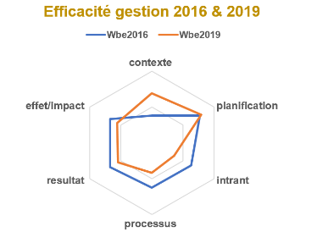
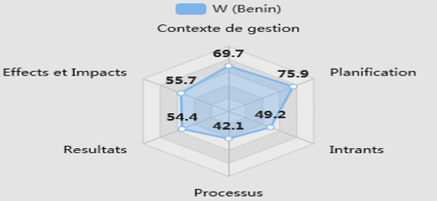
score bar
 | Contexte | planification | intrants | processus | résultat | effet/impact
2016 | 38 | 77 | 63 | 62 | 67 | 67
2019 | 69,7 | 79,5 | 35,8 | 41,3 | 54,4 | 55,7
Comparative analysis
radar
Notes:
INTRODUCTION

Slide 7
Recommendations (Parc national W Niger)
To the Management Team | Short term | Medium term
Strengthen cooperation with surrounding communities | X
Sign partnership contract with research institutions and other partners so that research conducted in the park are made available |  | X
To the Administrative Authority
 | X
To the Ministry in charge of protected areas
 | X
 | X
To the Technical and Financial Partners
 | X | X
 |  | X
Notes:
INTRODUCTION

Slide 8
Found IMET practical in formulating specific recommendations
Easy to visualize PA management efforts and progress, identify challenges, and areas for improvement
Useful for PA managers capacity development
Useful for elaboration of knowledge products (e.g. State of protected areas, SoPA)
Primary data that can feed into local, national, regional, and global database, IUCN green list, WDPA, BIOPAMA Observatories
Notes:
INTRODUCTION

Slide 9
THHH
THANK YOU!

