Slide 1
The Biodiversity and Protected Areas Management (BIOPAMA) Programme
2017-2023
Dede Amah
Technical Assistant BIOPAMA
An initiative of the ACP Group of States financed
by the European Union’s 11th EDF

Slide 2
An initiative of the African, Caribbean and Pacific (ACP) Group of States financed by the European Union (EU)’s 11th European Development Fund.
A six year programme (2017-2023)
A 60 million Euro investment
BIOPAMA combines
the technical expertise of the International Union for Conservation of Nature (IUCN) in protected areas and the biodiversity conservation and
the scientific know how of the Joint Research Centre of the European Commission (JRC).
Notes:
INTRODUCTION

Slide 3
The Biodiversity and Protected Areas Management Programme (BIOPAMA) aims to improve the long-term conservation and sustainable use of natural resources, in protected areas and surrounding communities, through the provision of a variety of services, tools and funding to conservation actors in the African, Caribbean and Pacific (ACP) countries.
Notes:
INTRODUCTION

Slide 4
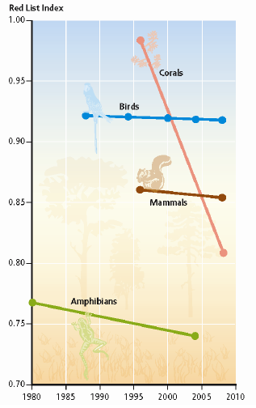
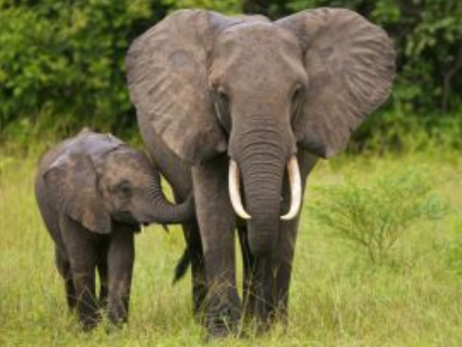
ACP countries’ key challenges
The main gaps identified are linked to:
Inadequate policy and legal framework
Weak and ineffective law enforcement
Inadequate assessments of impacts from infrastructure developments
Lack of sustainable funding mechanisms.
Consequences
Biodiversity continue declining
Ecosystems increasingly degraded
Climate change impacts to nature and society
Livelihoods, particularly of local communities, at risk.
Notes:
Why BIOPAMA is relevant ?

Slide 5
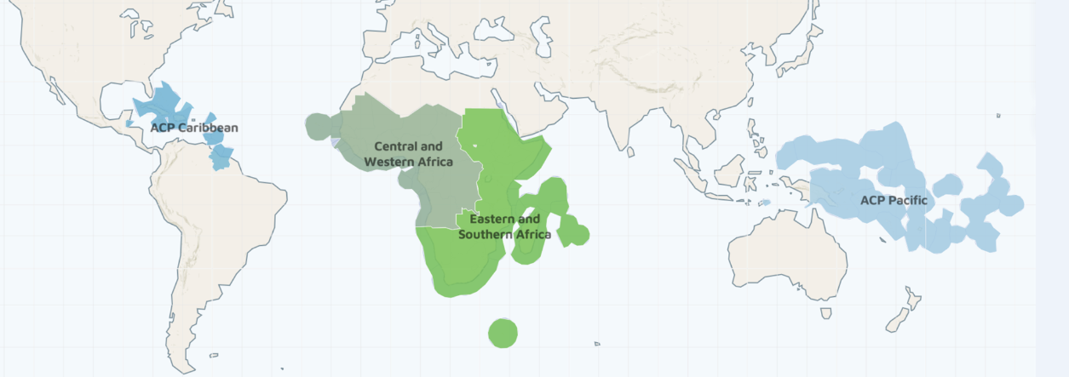
79 developing countries (including Least Developed and Small Island States)
More than 3 billion people whose livelihoods depend on the natural resources
More than half of the world’s 35 biodiversity hotspots
More than 9,000 protected areas, terrestrial and marine
Notes:
Where do we work ?

Slide 6
BIOPAMA MAP OF ACTORS
GLOBAL
EU
ACP
IUCN
JRC
WCMC
Donors
Programme coordination & support
Global Partner
REGIONAL
HOST INSTITUTION
Regional Partner
REGIONAL OBSERVATORY - REGIONAL HUB
NATIONAL
EU DELEGATION
ENVIRONMENT SECTOR
Donor
GOVERNMENT
NGO’s
RESEARCH
EDUCATION
PRIVATE SECTOR
Beneficiaries
LOCAL
PROTECTED AREAS and SURROUNDINGS
COMMUNITIES
PROTECTED AREA MANAGEMENT TEAM
Notes:
Who does what and at what level ?
The direct beneficiaries of the BIOPAMA programme are the protected area actors at the regional, national and local levels, whose efforts will continue to be supported by the provision of tools, services, capacity development and the possibility to finance actions at the site level.
Ministries of Environment and National agencies leading on biodiversity conservation
Protected Area agencies
Regional organizations
Local communities living in and around protected areas and
Civil society

Slide 7
Regional organisations, national and local conservation actors are key partners and beneficiaries.
BIOPAMA seeks to complement and align with existing platforms and initiatives.
BIOPAMA is implemented at the regional level through the IUCN Regional Offices in Eastern and Southern Africa, West and Central Africa, Mexico Central America and the Caribbean, and Oceania offices.
Key regional economic commissions (ECOWAS, EAC, ECCAS, SADC) and regional institutions are partners in the programme’s implementation.
Notes:
The African, Caribbean and Pacific regions represent some of the most challenging places on Earth and host a huge share of our planet’s biodiversity. While the programme’s objectives are the same across all the regions, BIOPAMA can only succeed by tailoring them to respond to specific needs and complement countries’ efforts filling the gaps where they exist.

Slide 8
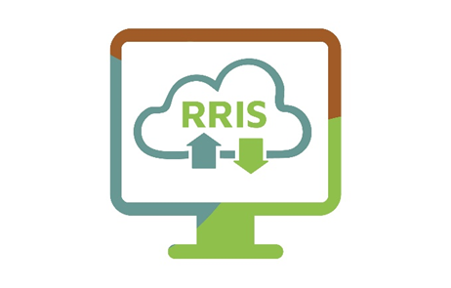
BIOPAMA STRATEGY (2017-2023)
THE REGIONAL OBSERVATORY/
RESOURCE HUB
THE REGIONAL REFERENCE
INFORMATION SYSTEM
THE ACTION COMPONENT
CAPACITY BUILDING
BIOPAMA provides unique and tailored support to protected area authorities in the ACP countries to address their priorities for improved management and governance of biodiversity and natural resources.
Notes:
BIOPAMA Strategy
RRIS
An open-source, free and secure tool.
Collects and analyses protected areas information and trends.

Slide 9
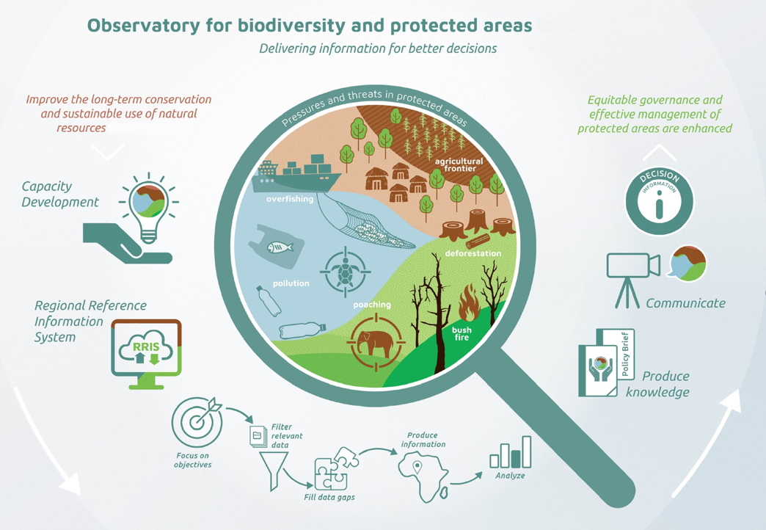
The biodiversity and protected areas observatory is a regional center that compiles and analyzes relevant data and provides information to support field interventions, policies dialogues and decision-making processes at local, national and regional levels
The observatory offers information management systems and tools, capacity building, knowledge sharing products and communication activities aiming to reinforce the management effectiveness and governance of protected areas and surrounding communities in the region.

Slide 10
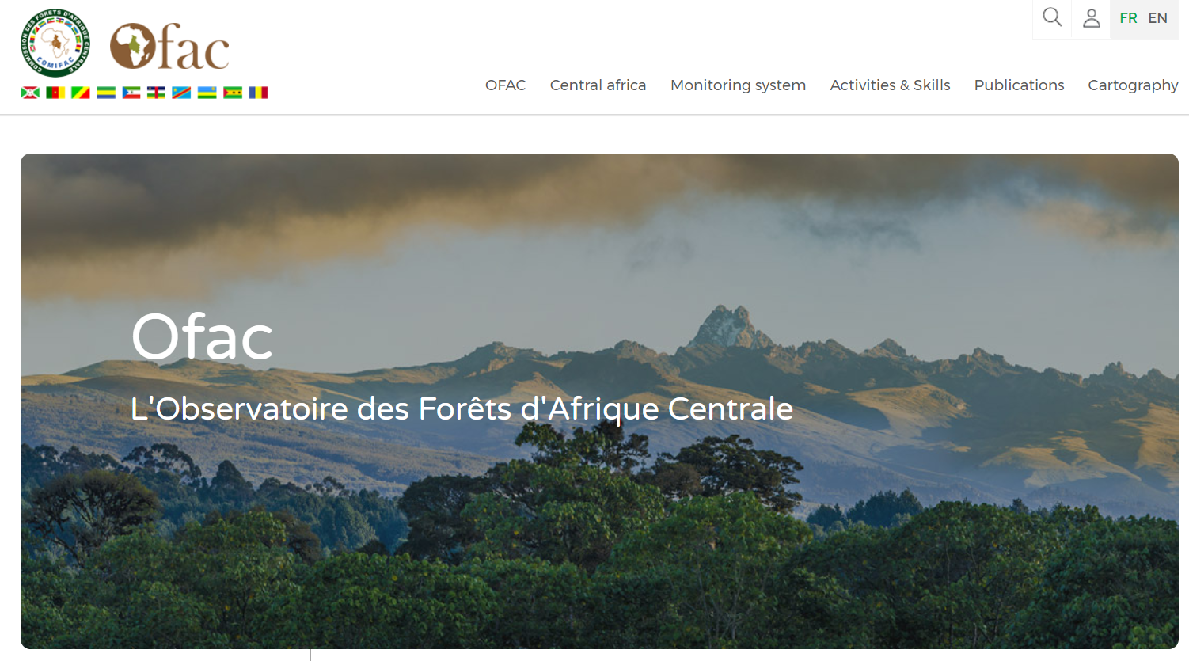
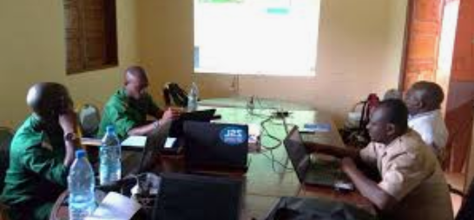
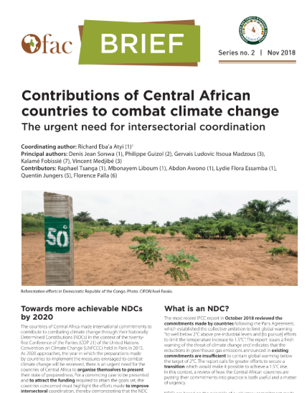
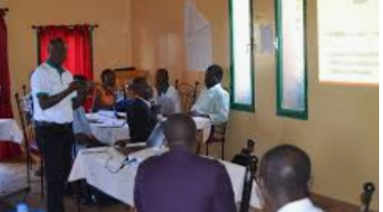
Information management portal
Capacity Building
Knowledge products
https://www.observatoire-comifac.net

Slide 11
The regional reference information system is free, secure and built using open source technologies. The system hosts a broad range of data that can be stored and used, such as field data, international indicators, satellite imagery, maps, photos, surveys and documents.
https://rris.biopama.org
Notes:
An open-source, free and secure tool.
Collects and analyses protected areas information and trends.
Includes tools such as IMET (the Integrated Management Effectiveness Tool) and others
Typical information includes: protected areas and biodiversity ecosystems, species, habitats, pressures, threats, management, governance, climate change vulnerability, etc.
Will be harmonised with other major global datasets, e.g. WDPA, PANORAMA – Solutions for a Healthy Planet and the IUCN Green List of Protected and Conserved Areas.

Slide 12
The BIOPAMA Action Component provides funding opportunities to address protected and conserved areas, sustainable use of biodiversity, natural resources priorities for actions on the ground in Africa, the Caribbean and the Pacific (ACP) countries.
https://action.biopama.org

Slide 13
https://biopama.org/ (BIOPAMA WEBSITE) https://portals.iucn.org/um/webforms/newsletter.php?n=435,436,437,438
USEFUL LINKS
rris.biopama.org yammer.com/biopama

Slide 14
THHH
THANK YOU!

