Slide 1
Case Study from Jordan: Ajloun Forest Reserve

Slide 2
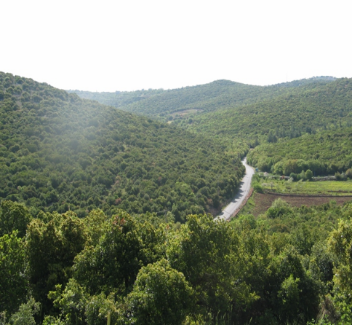
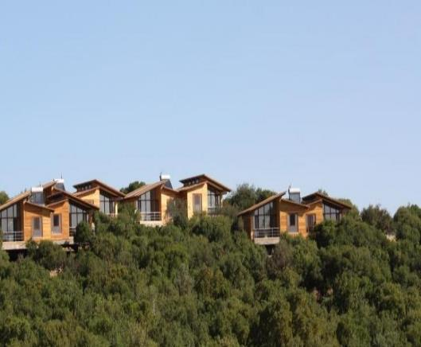
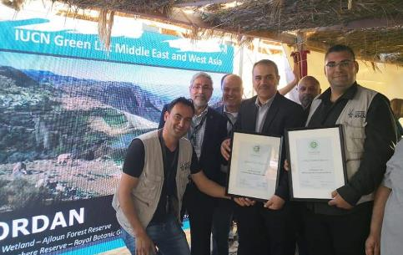
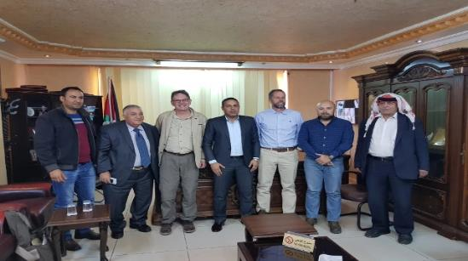
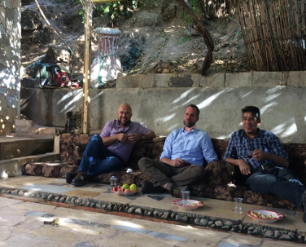
Understanding the site’s natural and cultural values at a site Level
Understanding the distribution and intensity of threats at a site level
Reflecting this understanding in the site’s zoning plan and management plan
Integrating the site into the wider landscape

Slide 3
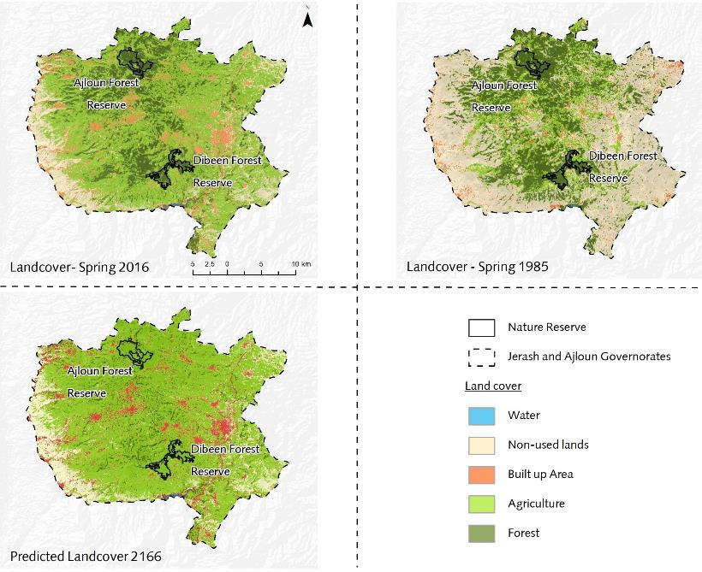
Current
Historical
Predicted
Mainstreaming forest conservation in the development planning and land use planning at the larger landscape.
Sufficient buffer zone taking into consideration forest corridors
Integration of the small forest Reserve in the wider landscape

