Slide 1



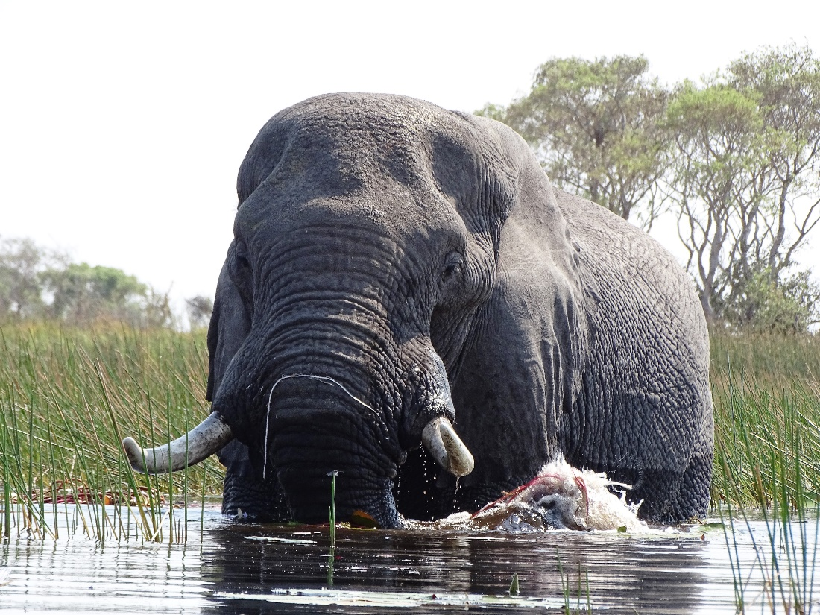
Conditions for protected area effectiveness
Stephen Woodley
Vice Chair for Science and Biodiversity
World Commission on Protected Areas, IUCN

Slide 2
PA Effectiveness Depends on the Question Being Asked
Questions asked on PA Effectiveness | What is Measured | Strengths and Weaknesses
Are they in the right places? | Coverage of species; KBAs; or representative ecosystems | Usual broad scale but better methods; We know PA have poor coverage; SCP focus on maximum ROI
What is the overall state of the ecosystem in a protected area? | Measures of ecological integrity or health (usually a composite) | Considerable scientific input for both design and analysis. Rarely counterfactual
What is the condition of parts of the ecosystem, such as species population trends or % cover? | Population time series trends; Change in cover | Measure have be unrelated to overall condition; Available data
What is the effectiveness of the management system? | PAME ; METT | Global PAME standard exists; Does not focus on biodiversity outcomes; Results mixed
What is the value of ecological services provided by the PA? | Water quality; Carbon storage; Recreation | Relatively quickly and cheaply; Benefits are used defined; Not related to ecological outcomes
What is the economic benefit of the protected area? Or ROI? | Contribution to GDP; Jobs; Employment | Not done regularly; Measures may be completely unrelated to biodiversity outcomes
Is Nature 1) better off inside a protected area, relative to not having a protected area; 2) in good condition relative to theoretical thresholds

Slide 3
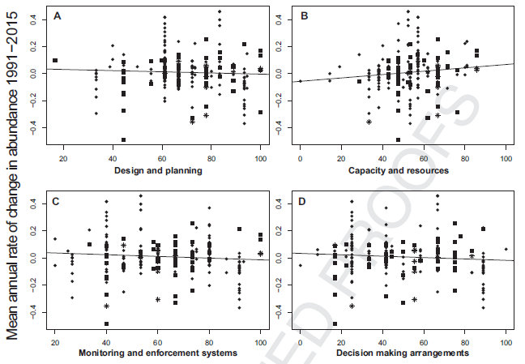
A global analysis of management capacity and ecological outcomes in PAs
– Geldmann el al. Conservation Letters 2018
Positive relationship between our METT-based scores for Capacity and Resources
Study highlights the paucity of appropriate data for rigorous testing.

Slide 4
Large mammal population declines in African PAs
- Craigie et al., Biological Conservation 143, 2010

Slide 5
On Average, Tropical Reserve Health Is Declining – Laurence et al, Nature 489, 2012

Slide 6
Laurence et al., Nature 489, 2012

Slide 7

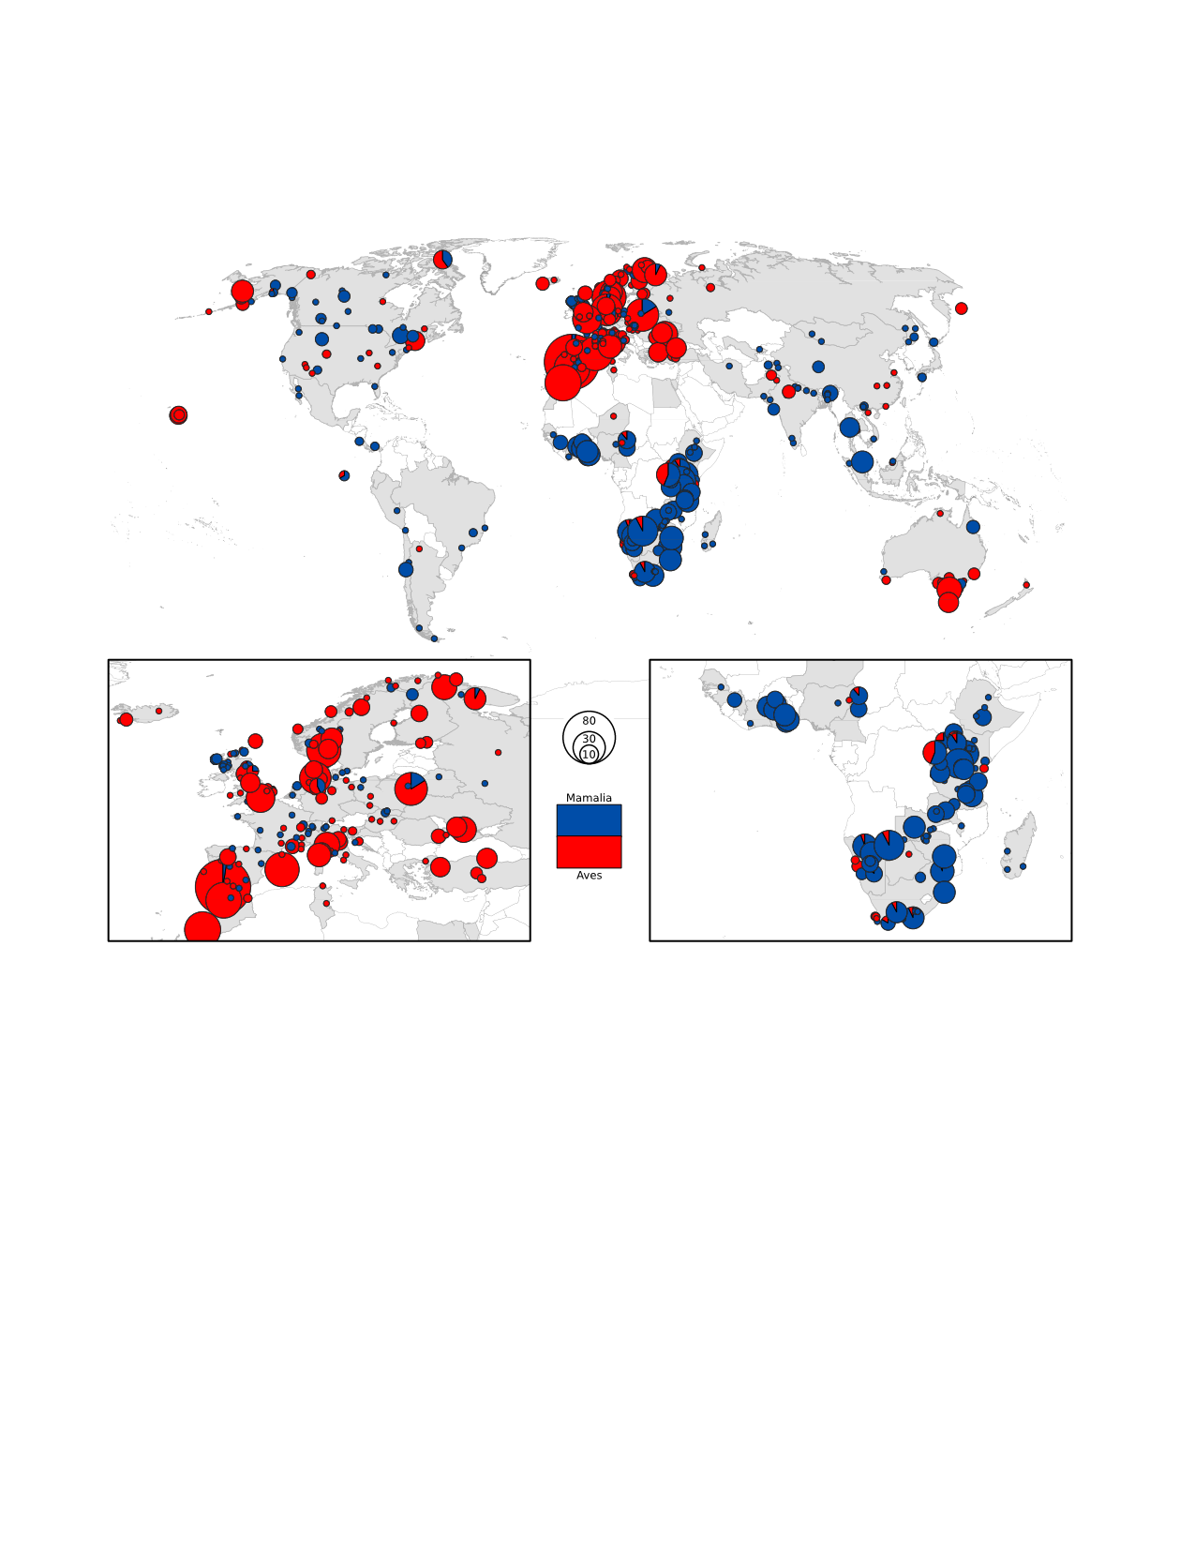
Predictors of Wildlife Populations in PAs
- Barnes, M., Craigie, I. D., Harrison, L., Geldmann, J., Collen. B., Whitmee, S., Burgess, N. Brooks, T., Hockings, M., Woodley, S. Nature Communications 2016
What’s the overall trend of populations?
What types of species are benefitting more?
Under what circumstances are protected areas effective?

Slide 8
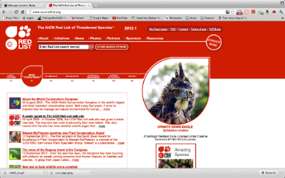
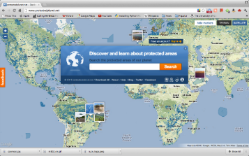
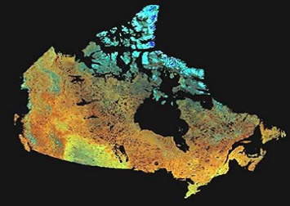
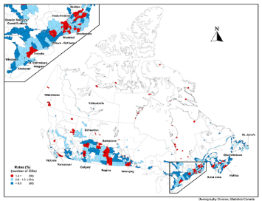
Drivers
  Explanatory variables
    Site (Protected Area), species and country scales
    6 non-exclusive categories
      Design (e.g. size, shape)
      Species Ecological Traits (e.g. body mass, taxa)
      Management Type (IUCN Category)
      Socio-economic context (National GDP, HDI, corruption)
      Human Development (e.g. road density, land-use change)
      Time series characteristics (e.g. length)

Slide 9
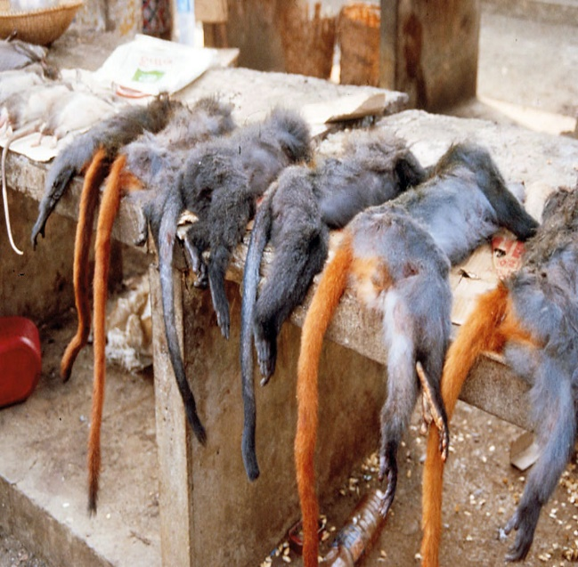
Socio-economic metrics
Human Development Index (HDI)
  Hunger (Malnutrition)
  Corruption Index
  GDP (Gross Domestic Product)
Wealthier countries have more capacity, resources
OR
Developing countries have greater threats, more resource dependence
OR
An axis of governance?
© Jürgen Freund/WWF-Canon

Slide 10
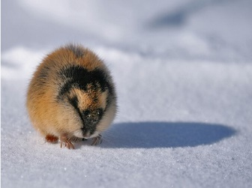
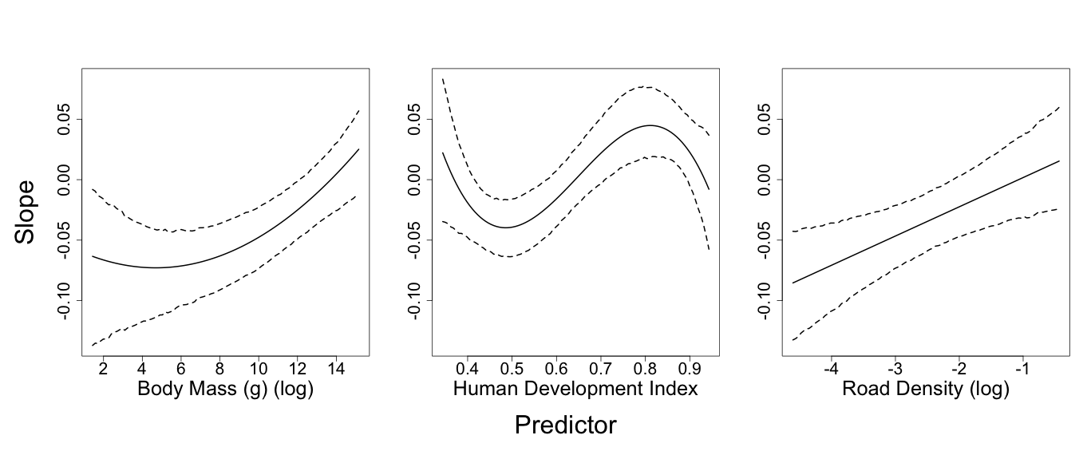
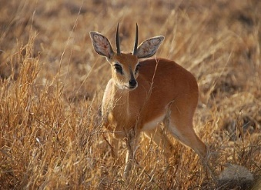
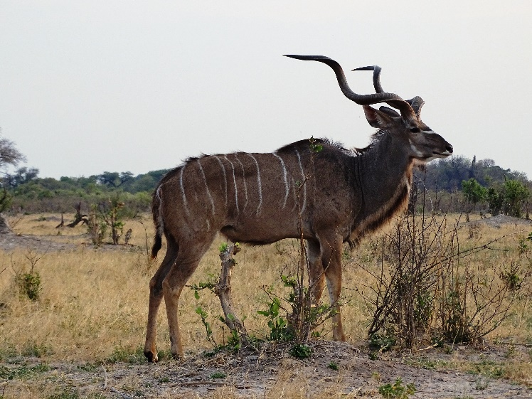
Body Mass
Larger bodied biodiversity doing better
Management effect?
© Jürgen Freund/WWF-Canon
© Jürgen Freund/WWF-Canon

Slide 11
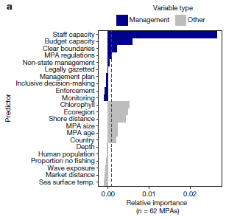
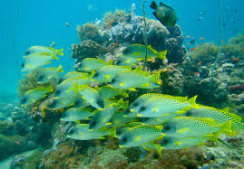
Marine Conclusions Are Similar
(Edgar et al. Nature 2014, Gill et al. Nature 2017)
Most MPAs are the same as fished areas - with widespread shortfalls in staff and financial resources..
Some MPAs are extremely effective.
Conservation benefits driven by five key features – no-take, well enforced, old (>10 years), large (>100 km²), and isolated by deep water or sand.
Management drives MPA effectiveness – adequate staff and budget capacity yield 3 times greater impact

Slide 12

Review of all literature
Geldmann et al. 2013, updated 2017
Protected areas are working - Terrestrial - 117 counterfactual studies:
    74% positive impact
    12% negative
    10% no effect
    4% had mixed results
Outcome results are highly variable
We have weak metrics of success
There are many predictors of success and failure.

Slide 14
Predictors of increasing effectiveness | Reference | Generalized elements of success
No-take or harvest | Edgar et al. (2014) | Sound governance/sound management
Capacity and Resources | Geldmann et al 2018 | Sound management
Established protected area regulations | Geldmann et al. (2013) | Sound governance/sound management
Increased anti-poaching | Geldmann et al. (2013) | Sound management
Increased enforcement | Gill et al 20167 | Sound governance
Established legislation | Geldmann et al. (2013) | Sound governance
Established PA targeted interventions | Geldmann et al. (2013) | Sound management
Greater protected area age | Edgar et al. (2014) | Sound management
Larger protected area size | Blackman et al. (2015) | Sound ecological design
Greater indigenous governance | Nolte et al. (2013) | Sound governance
Greater gross domestic product per capita | Barnes et al. (in press) | Sound governance/sound management
Greater Gini score | Barnes et al. (in press) | Sound governance/sound management
Large animal body size | Barnes et al. (in press) | Sound management
Greater benefits to local community | Bruner et al. (2001) | Sound governance/sound management
Clearer boundary demarcation | Bruner et al. (2001) | Sound management
Lower corruption | Smith and Walpole (2005) | Sound governance
Strictness of protection | Sciberras et al. (2015) | Sound governance/sound management

Slide 15
Ecological integrity
Species, Cover
Ecosystem Services
Ecological Outcomes
100
Governance
100
Management
100
Who decides
Who benefits
Corruption
Enforcement
Restoration
Monitoring
Capacity
100
Size
Location
connectivity
Ecological Design

Slide 16
Factors Determining Positive Ecological Outcomes in Protected Areas
high
Isolation
Good Governance
Relative Importance of Factor
Effective Management
Ecological Design
low
low
high
Cumulative level of Threat

Slide 17
What drives PA success ?
Yes PAs work - when they are set up to work
Different PA Categories and Governance types all work
Ongoing struggle with measuring ecological condition, management inputs and counterfactuals
Governance underlies the foundation and allows management to operate.
Management capacity, including enforcement, is essential.
Ecological design is fundamental, but superfluous without governance and management.

Slide 18
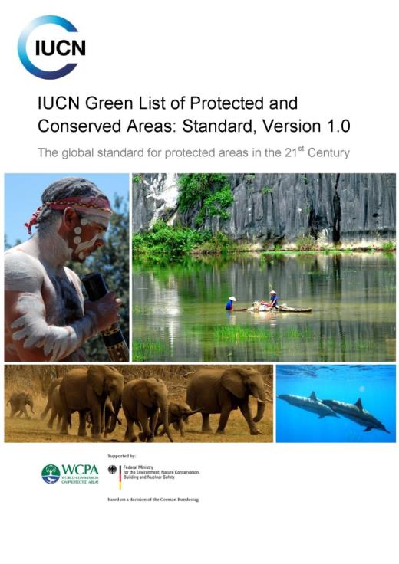

PERFORMANCE STANDARD FOR THE 21ST CENTURY
Global Standard for driving and recognising area-based conservation success
Adaptable to country/region
Voluntary commitment
Independently assured evaluation procedure
Globally consistent & credible recognition for protected/conserved areas, staff and communities
Notes:
SO what is this standard about?
IMAGE: This is Version 1.0 of the standard that’s available on IUCN’s website: www.iucn.org/greenlist
At the heart of the IUCN Green List is a global performance standard for protected and conserved areas in the 21st century. By ‘21st Century’ the intent is to convey that the Standards is at the cutting edge of protected and conserved area management effectiveness and equitable governance –it is designed to credibly demonstrate and position green listed areas to serve as critically important solutions to the relevant sustainability challenges of this century as captured by the Global Goals for Sustainable Development, in particular: 13-17 dealing with biodiversity, climate change, strong institutions and partnerships
The Standard’s indicators are adaptable to the context of any jurisdiction and the Green List can be implemented in diverse locations, cultures and geographies while maintaining global consistency.
The whole Green List process is voluntary and accessible; any protected and conserved area can apply, not just the biggest and most well-known. In this way, there is broad access to the chance to receive credible and independent verification of local success stories. Site managers or stakeholders must be motivated and passionate about making the GL commitment
The independent evaluation and assurance system provided by the Green List allows for rigour and transparency in decision-making, and allows staff and managers and local stakeholders to enjoy recognition based on merit and achievement. The evaluation procedure against the performance standard is independently assured – ensuring no conflict of interest and objective evaluations of PAs and CAs
By committing to meet this standard, site managers seek to demonstrate and maintain performance and deliver real nature conservation and governance results. The objective of the Global Standard is: To encourage protected and conserved areas to measure, improve and maintain their performance through globally consistent criteria that benchmark good governance, sound design and planning, effective management, and successful conservation outcomes.

Slide 19
Assessing Ecological Integrity - Suite of Indicators
Biodiversity Ecosystem Functions Stressors
(characteristic of region) (resilient, evolutionary potential ) (unimpaired system)
Species richness
- change in species richness*
- numbers and extent of exotics*
Population Dynamics
- mortality/natility rates of indicator species*
- immigration/emigration of indicator species*
- population viability of indicator species*
Trophic structure
- size class distribution of all taxa
- predation levels
Succession/retrogression
- disturbance frequencies and size
(fire. insects, flooding)*
- vegetation age class distributions*
Productivity
- Remote or by site
Decomposition
-by site
Nutrient retention
- Ca, N by site
Human land-use patterns
- land use maps, roads densities, population densities.*
Habitat fragmentation
- patch size, inter-patch distance, forest interior*
Pollutants*
- sewage, petrochemicals etc.
- long-range transport of toxics
Climate*
- weather data
- frequency of extreme events
Other*
- park specific issues

Slide 20
Forest EI Indicator
Fair
Poor
Good
Stand Level
Forest EI
Landscape Level Forest EI
Models
ASSESSMENT
tree productivity, songbird index, salamander populations change, foliar nutrient index, decomposition efficiency
FF BioD Index (SAR, top predators, ungulates), CFBioD Index (ecosystem representation), connectivity, productivity
Measures
dbh, canopy condition, species composition, chopstick dry weight loss, songbird/salamander density, relative soil arthropod abundance, foliar nutrient concentrations
SAR and other species population assessments, relative ecosystem abundance, FragCube, RS Measures
Data

Slide 21
Modelled Thresholds: Example – populations of Caribou

Slide 22
State of the Park Report Summary
Gros Morne National Park

