Slide 1





Fair and effective protected and conserved areas

Slide 2
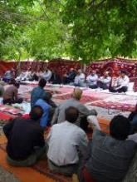
2010 COP 10 Decision X/2
Strategic Plan for Biodiversity 2011-2020
Target 11:
By 2020, at least 17 per cent of terrestrial and inland water areas, and 10 per cent of coastal and marine areas, especially areas of particular importance for biodiversity and ecosystem services, are conserved through effectively and equitably managed, ecologically representative and well connected systems of protected areas and other effective area-based conservation measures, and integrated into the wider landscapes and seascapes.

Slide 3

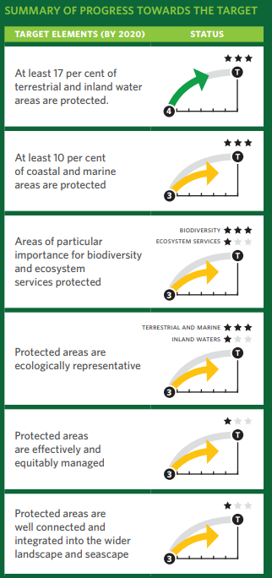
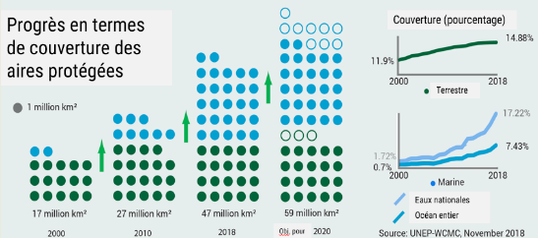

Slide 4

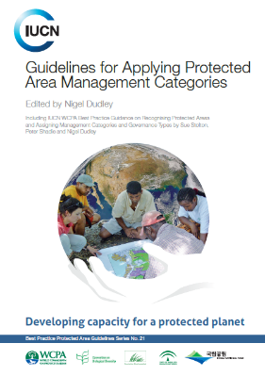

especially areas of particular importance for biodiversity and ecosystem services ….
2.1 Identify major site values
2.2 Design for long-term conservation
2.3 Understand threats and challenges
2.4 Understand social and economic context

Slide 5
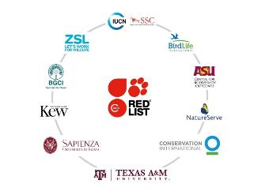
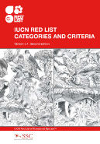
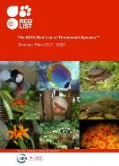
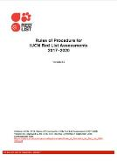
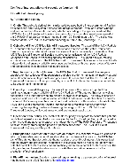
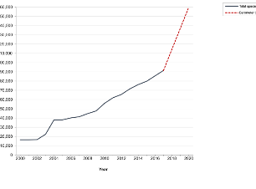
The IUCN Red List of Threatened Species™
Coverage
Contains assessments for 91,523 species.
By 2020 it contains 160,000 species so that The IUCN Red List becomes a ‘Barometer of Life’

Slide 6
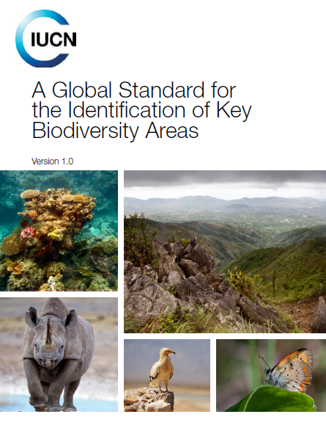
KBA Partnership and Standards
First time conservation community has agreed on a common approach to identifying sites
Identification of the most important sites globally for conservation
Sites that make significant contributions to the global persistence of biodiversity
Notes:
The consultations led to the publishing of “A Global Standard for the Identification of Key Biodiversity Areas” in 2016 which describes the standards and criteria to identify KBAs

Slide 7

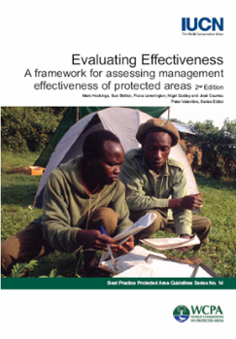
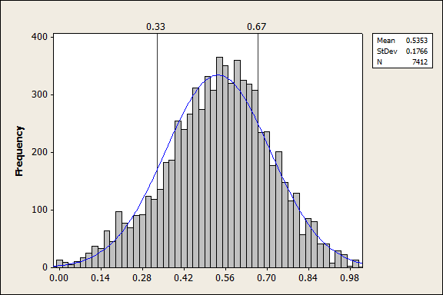
… effectively managed ….
3.1 Long-term management plan
3.2 Manage ecological conditions
3.3 Manage within social and economic context
3.4 Manage threats
3.5 Effectively enforce laws
3.6 Manage access and use
3.7 Measure success

Slide 8
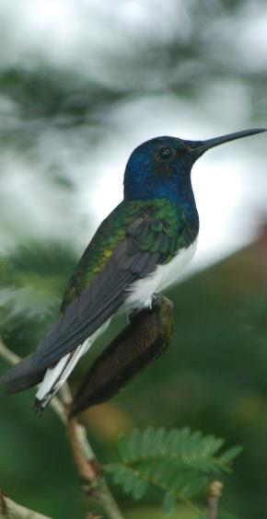
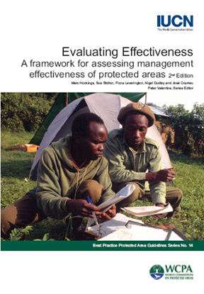
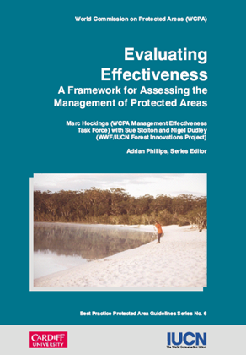
The IUCN - WCPA
PAME Framework

Slide 9
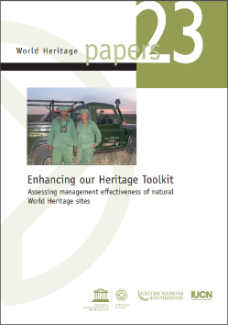


A range of diagnostic tools being applied
METT+
EoH
IMET

Slide 10

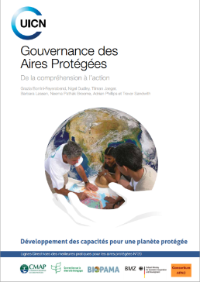
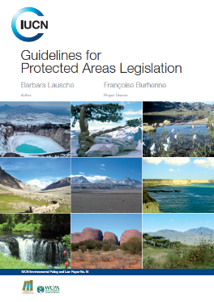
…. equitably governed ....
1.1 Guarantee legitimacy and voice
1.2 Achieve transparency and accountability
1.3 Enable governance vitality and capacity to respond adaptively

Slide 11
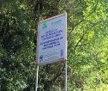


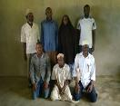
Governance diversity: 4 governance types
Type 1
Governance by single sector entity/government
Type 2
Governance by Indigenous peoples and communities
Type 3
Type 4
Shared governance
From national to local levels
Private governance
Land owners, NGOs, religious groups, for-profit entities..
Transfrontier, multi party governing bodies
(e.g. ICCAs)
Notes:
The IUCN and the CBD recognises four legitimate types of governance that are fully compatible with the definition of protected area by CBD or IUCN

Slide 12
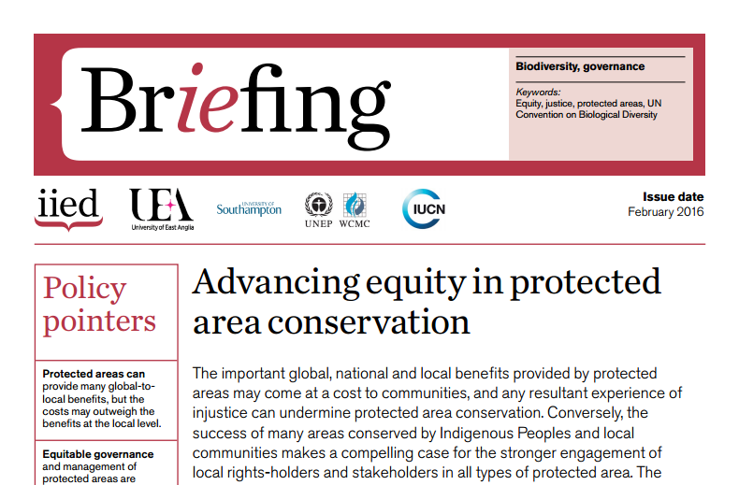
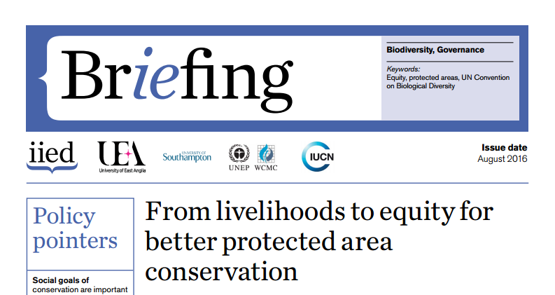

Slide 13
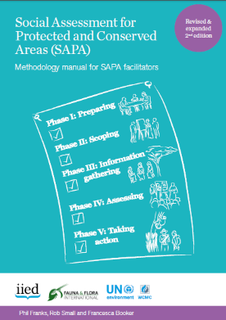
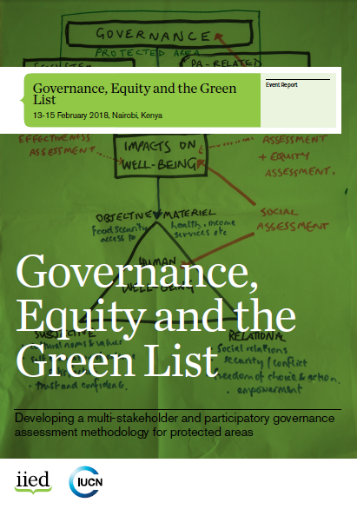
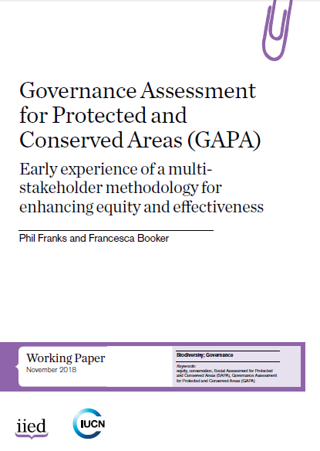

Slide 14

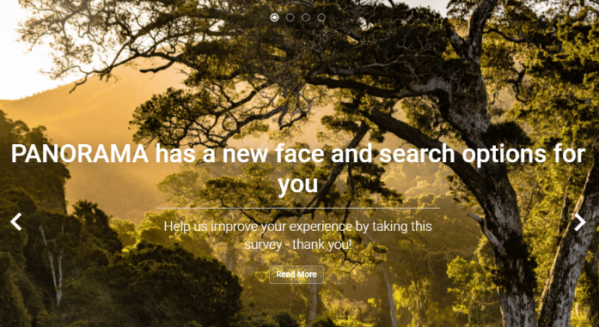

…. integrated into the wider landscape and seascape

Slide 15
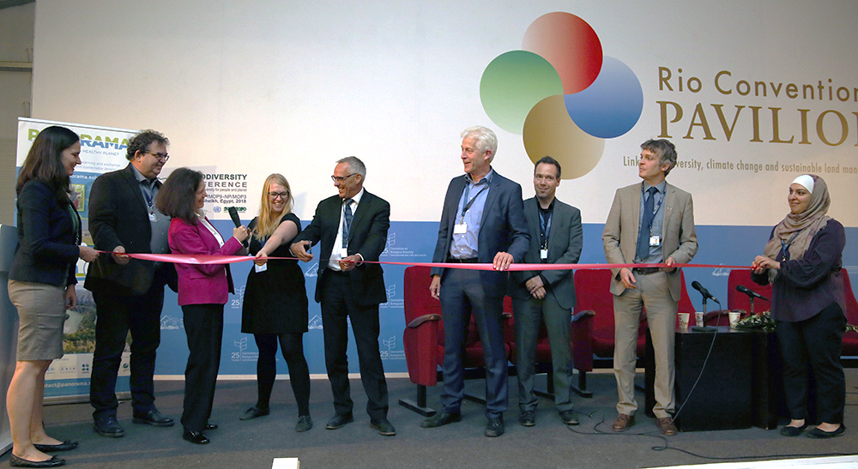
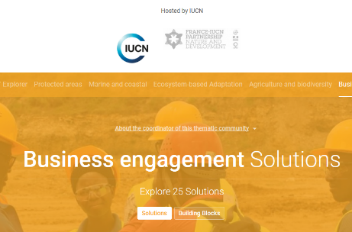
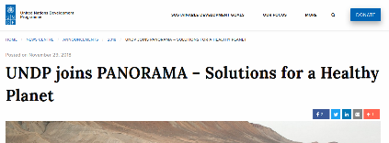




Slide 16
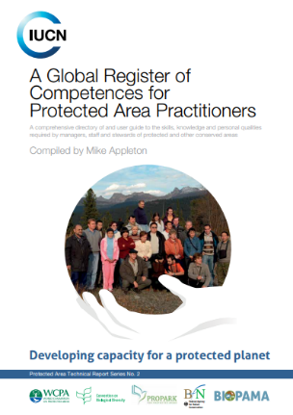
IUCN Standards and knowledge:
Competence standards for protected area professionals
➔ Defining the essential competences, through body of knowledge, learning, assessment and qualifications

Slide 17
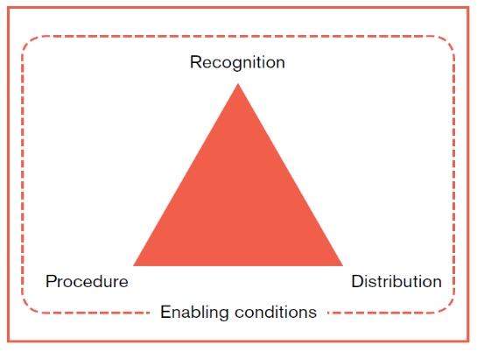
2018 COP 10 Decision 14/8
Recognition is about acknowledging and respecting rights and the diversity of identities, knowledge systems, values and institutions of different actors.
Procedure is about participation of actors in decision making, transparency, accountability, and processes for dispute resolution.
Distribution is about the allocation of benefits across the set of actors, and how costs/burdens experienced by some actors are mitigated.

Slide 18
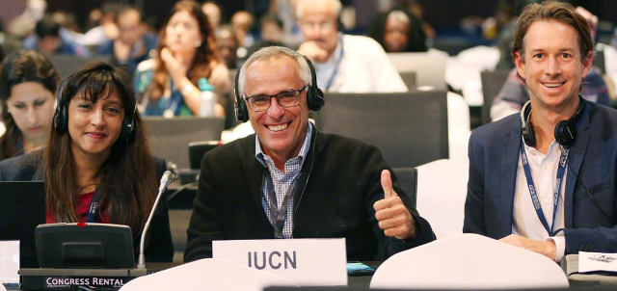
COP14 adopts the definition of other effective area-based conservation measures, as well as criteria for their identification based on IUCN WCPA guidance, and voluntary guidance on mainstreaming, governance and equity
Requests IUCN and UNEP-WCMC to incorporate these “OECMs” into the World Database on Protected Areas

Slide 19
Effective area-based conservation measures
PAs
Primary objective is conservation
Other
Outcome is conservation even if objective is something else

Slide 20
SPECTRUM OF OECMs
Other ….. effective area-based conservation measures
Achieves the in situ conservation of biodiversity
Less intention to conserve biodiversity
More intention to conserve biodiversity
Ancillary
- ‘No-disturbance’ areas
Secondary
- Areas that are protected through very low-impact use
- Watershed protection areas
- Medicinal plants sustainable use areas
Primary
- ICCAs or privately governed areas with a primary conservation objective…
... but the governance authority is unable to secure PA designation or prefers not to be recognised as a PA
- Sacred natural sites
- Military areas
- War graves

Slide 21
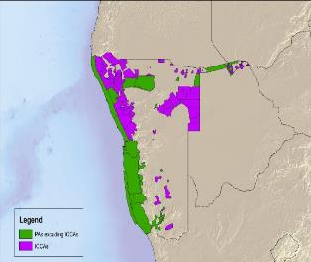
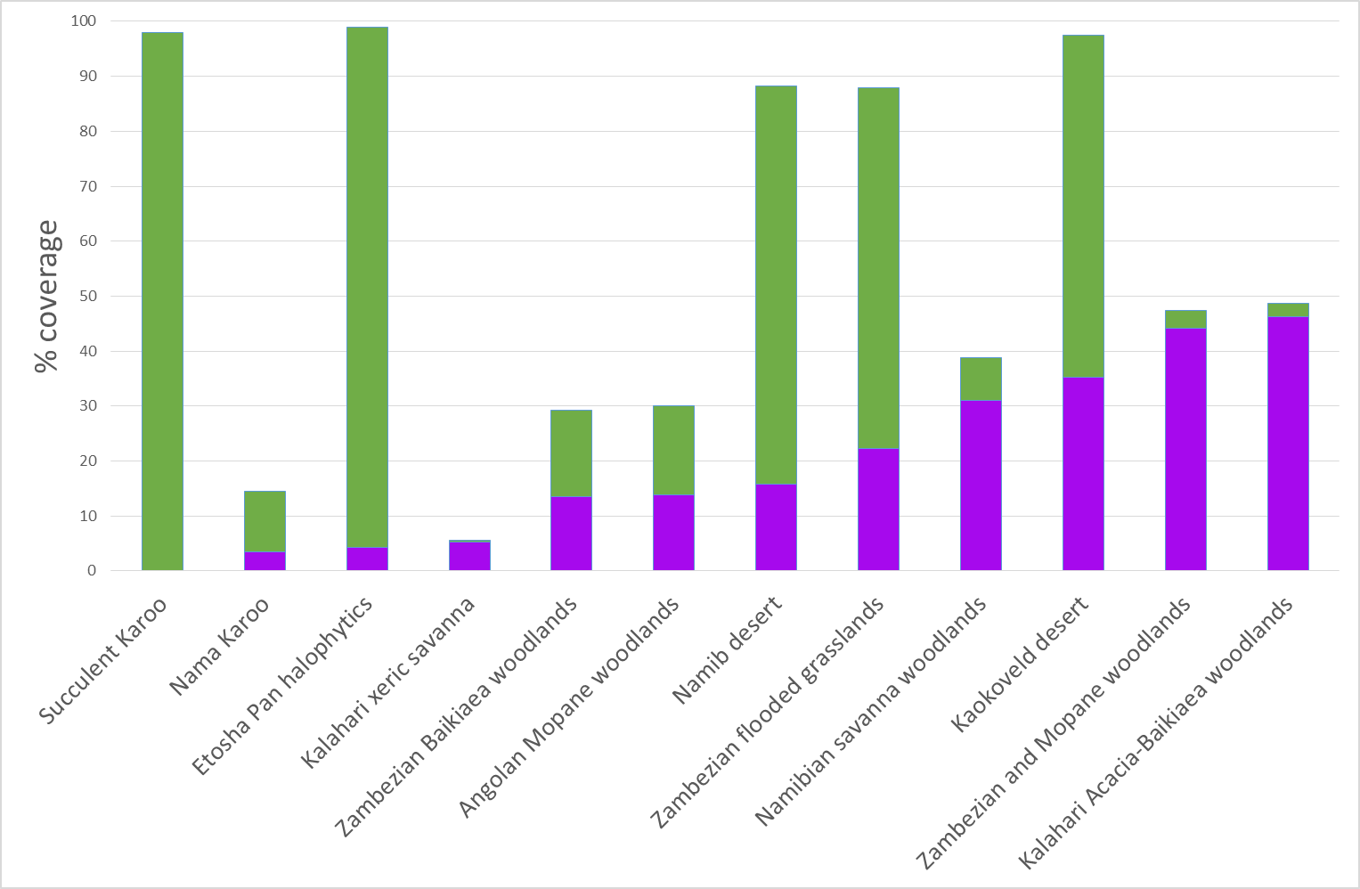
… well connected
Namibia: 34 protected areas, 159,000km²
Conservancies: 112 additional conserved areas, add 164,000km²
Protected and Conserved Areas Coverage
Protection of Ecoregions

Slide 22
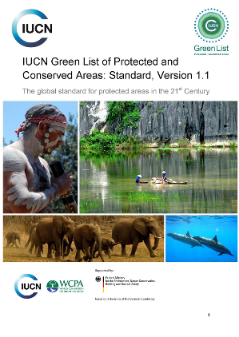
The IUCN Green List of Protected and Conserved Areas
A VOLUNTARY mechanism for raising the bar in protected and conserved areas
Applies to protected AND CONSERVED AREAS
A means to MEASURE conservation outcomes.
Identify CAPACITY needs and link to INVESTMENT and impacts
IUCN GREEN LIST MISSION
To increase and recognize the number of Protected and Conserved Areas globally that are fairly governed, effectively managed, and achieving their conservation outcomes

Slide 23
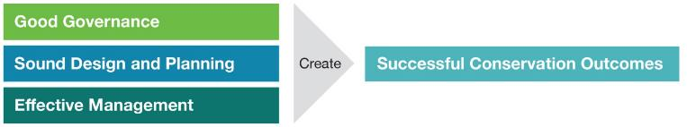
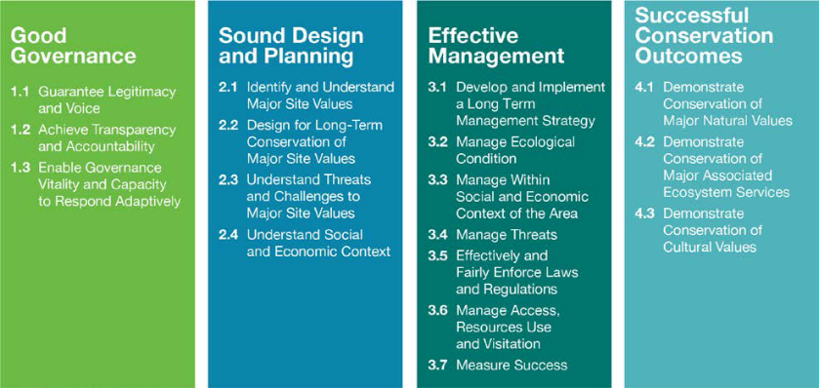
The IUCN Green List Global Standard
Notes:
Application of IUCN Best Practices
Application of IUCN Knowledge Products

Slide 24


2016 CBD COP Decision 13/2:
  Parties to
  “ promote the IUCN Green List of Protected and Conserved Areas as a voluntary standard to encourage protected area management effectiveness”
  2017 IUCN Council:
  Approval of
  Green
  List Standard
Version 1.1
Notes:
MARC - QUICK BACKGROUND
WCC 2012-Res-041-EN: https://portals.iucn.org/library/node/44008
The Green List concept originated in 2008 and began to be developed in 2009 with a workshop in Granada, Spain and pilot studies in Colombia commencing in 2011. Work on the concept expanded in 2012, following the IUCN World Conservation Congress in Jeju, Korea. It was initially designed to help provide a framework for the use of various IUCN tools and processes, such as Protected Area Management Effectiveness and Assessments for Good Governance.
Between 2012 and 2014, pilot phase with a draft standard, with 25 sites admitted to the pilot list at WPC 2014 Sydney
Between 2014 and 2016, finalizing version 1.0 of the standard that was released at WCC 2016 Hawai’I
CBD COP 13 reference.
Specifically GL contributes to Aichi Target 11: CBD’s Strategic Plan 2011-2020 Aichi Target 11 Protected areas increased & improved: “By 2020, at least 17 per cent of terrestrial and inland water areas and 10 per cent of coastal and marine areas…are conserved through effectively and equitably managed…systems of protected areas and other effective area-based conservation measures...”

Slide 25
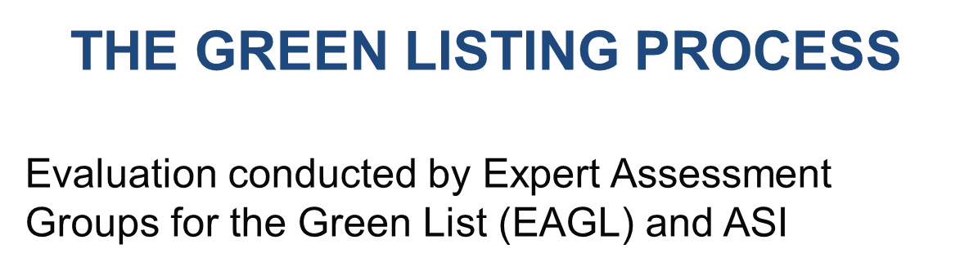

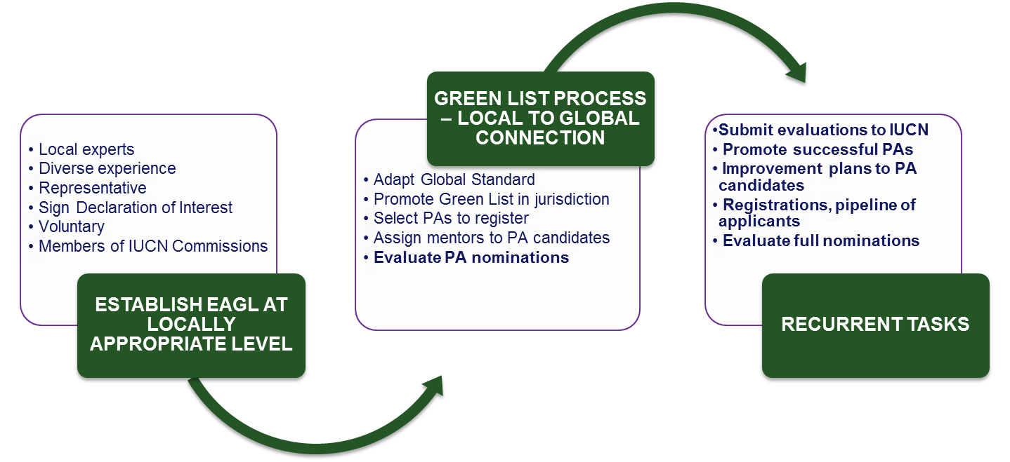
INTERNATIONAL UNION FOR CONSERVATION OF NATURE
Notes:
Additional points:
Natural systems are fundamental to achieving the Sustainable Development Goals and to all development
Natural systems such as forests, wetlands and mangroves regulate climate, contribute to food and water security, and reduce the risk of disasters
business as usual is no longer an option
With proper attention, investment and action, natural systems can rebound and continue to sustain life on Earth

Slide 26
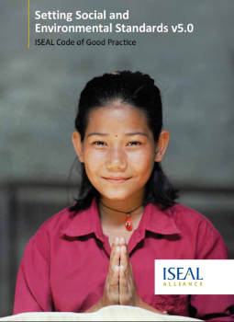
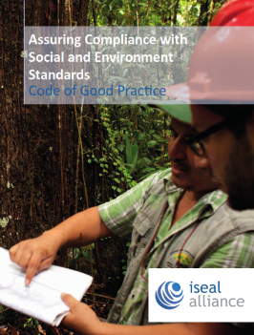
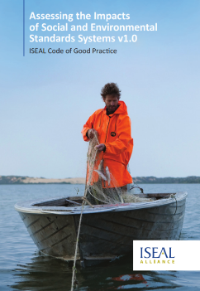

ASSURANCE
ISEAL Codes of Practice
Accreditation Services International (ASI)
Independent Reviewer assigned to each jurisdiction
Compatibility with other programmes (FSC, Blue Flag, GSTC)
Notes:
Assurance is very important to the Green List. It provides credibility and transparency to the process. The IUCN Green List process is based on international codes of best practice in standard setting and certification. All the independent review of the Green List process is carried out by ASI, IUCN’s assurance provider.

Slide 27
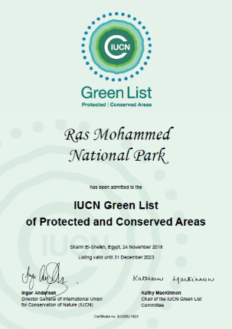
15 new sites from 8 countries admitted in Nov 2018 at COP14 in Egypt + 6 more new sites admitted in March 2019
A total of 46 sites from 14 countries now listed
User Manual Version 1.2 released incl. new Terms of Reference for WCPA RVCs
35 countries committed; 18 Trained EAGLs; 300+ Candidate Sites

Slide 28
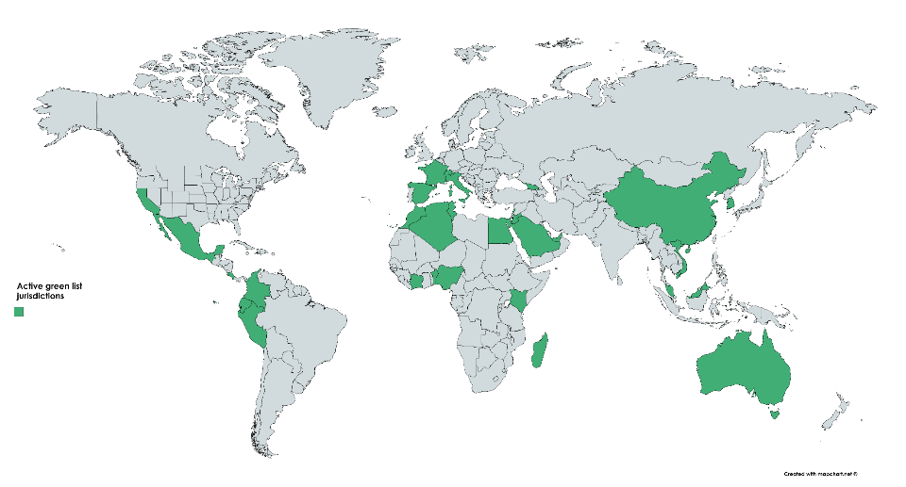

Notes:
Application of IUCN Best Practices
Application of IUCN Knowledge Products

Slide 29
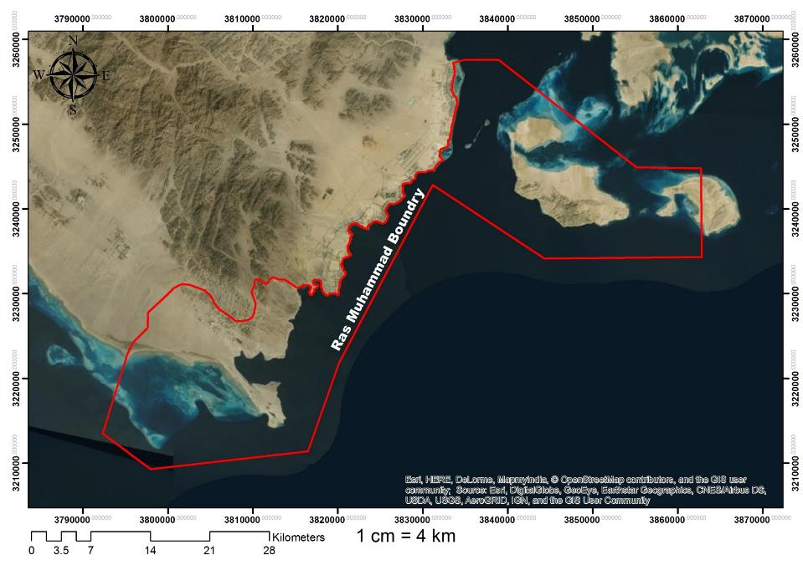
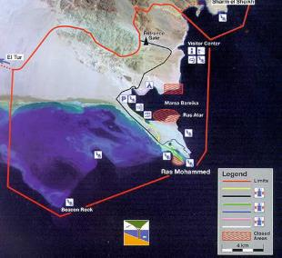
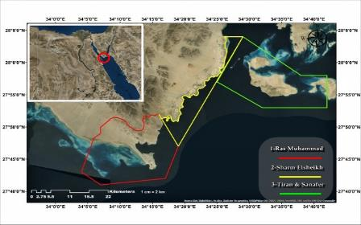
The marine area of 34,500 ha is a no-take area for fishing. Artisanal fishing is permitted in Nabq MPA, adjacent, north.
The Main Ras Mohammed peninsular area is managed as a tourism concession by the Bedouin community. Some areas are completely no access
MAP: RAS MOHAMMED NATIONAL PARK
No development is allowed in the RM coastal zone or Tiran-Sanafer islands. The yellow zone is the Sharm El Sheikh municipal zone where limited coastal development is allowed with permits.

Slide 30
SITE: | RAS MOHAMMED NATIONAL PARK | CRITERION | ADAPTED INDICATORS (MIDDLE EAST) | STATUS | EAGL COMMENT (INDICATORS & CRITERION)
1. GOOD GOVERNANCE |  | 1.1 GUARANTEE LEGITIMACY AND VOICE | 1.1.1 GOVERNANCE STRUCTURE IS DEFINED | FULLY MET
 |  |  | 1.1.2 GOVERNANCE MECHANISMS ENGAGE STAKEHOLDERS | FULLY MET
 |  |  | 1.1.3 RIGHTS OF INDIGENOUS AND LOCAL COMMUNITIES | FULLY MET
 |  |  | 1.1.4 STAKEHOLDER ROLES IN DECISION-MAKING | FULLY MET
 |  |  | 1.1.5 GOVERNANCE MECHANISMS HELP ADVANCE GENDER EQUITY | FULLY MET
 |  |  | 1.1.6 GOVERNANCE MECHANISM ARE ACCEPTED BY STAKEHOLDERS | FULLY MET
 |  | 1.2 ACHIEVE TRANSARENCY AND ACCOUNTABILITY | 1.2.1 GOVERNANCE AND MANAGEMENT DOCUMENTS ARE AVAILABLE TO PUBLIC | FULLY MET
 |  |  | 1.2.2 MANAGEMENT APPOINTMENTS AND FIGURES ARE PUBLIC KNOWLEDGE | FULLY MET
 |  |  | 1.2.3 OUTCOMES OF MANAGEMENT DECISIONS ARE PUBLICLY AVAILABLE | FULLY MET
 |  |  | 1.2.4 READILY AVAILABLE GRIEVANCE MECHANISMS ARE IN PLACE | FULLY MET
 |  | 1.3 ENABLE GOVERNANCE VITALITY AND CAPACITY TO RESPOND ADAPTIVELY | 1.3.1 GOVERNANCE IS ADAPTIVE TO RESULTS FROM MONITORING | FULLY MET
 |  |  | 1.3.2 PLANNING AND DECISION-MAKING IN THE CONTEXT OF NATIONAL LAWS | FULLY MET
 |  |  | 1.3.3 PLANNING AND DECISION-MAKING DRAWS ON MULTIPLE KNOWEDGE SOURCES | FULLY MET
 |  |  | 1.3.4 SITE PLANNING CONSIDERS HISTORICAL EVENTS AND FUTURE PROJECTIONS | FULLY MET
2. SOUND DESIGN AND PLANNING |  | 2.1 IDENTIFY AND UNDERSTAND MAJOR SITE VALUES | 2.1.1 THE SITE MEETS THE IUCN DEFINITION OF A PROTECTED AREA / CONSERVED AREA | FULLY MET
 |  |  | 2.1.2 CORRECT IUCN PA CATEGORY | FULLY MET
 |  |  | 2.1.3 MANAGEMENT PLAN OR EQUIVALENT | FULLY MET
 |  |  | 2.1.4 NATURAL VALUES AND ECOSYSTEM SERVICES AND CULTURAL VALUES IDENTIFED | FULLY MET
 |  | 2.2 DESIGN FOR LONG-TERM CONSERVATION | 2.2.1 SITE IS LARGE ENOUGH AND SUFFICIENTLY WELL-CONNECTED | FULLY MET
 |  |  | 2.2.2 THE SITE IS PART OF AN IDENTIFIED CONSERVATION NETWORK | FULLY MET
 |  |  | 2.2.3 DESIGN FOR ECOLOGICAL INTEGRITY | FULLY MET
 |  | 2.3 UNDERSTAND THREATS AND CHALLENGES | 2.3.1 THREATS TO MAJOR VALUES ARE IDENTIFIED AND UNDERSTOOD | FULLY MET
 |  |  | 2.3.2 LIKELY CLIMATE CHANGE IMPACTS ARE UNDERSTOOD | FULLY MET
 |  | 2.4 UNDERSTAND SOCIAL AND ECONOMIC IMPACT | 2.4.1 UNDERSTAND POTENTIAL SOCIAL AND ECONOMIC IMPACTS | FULLY MET
 |  |  | 2.4.2 POTENTIAL SOCIAL AND ECONOMIC IMPACTS ARE ADDRESSED IN MANAGEMENT PLANNING | FULLY MET
3. EFFECTIVE MANAGEMENT |  | 3.1 DEVELOP AND IMPLEMENT LONG-TERM MANAGEMENT STRATEGY | 3.1.1 THE SITE HAS A CURRENT MANAGEMENT PLAN OR EQUIVALENT | MET + conditions | MET, BUT COULD EE IMPROVED: SEE EAGL STATEMENT BELOW
 |  |  | 3.1.2 DEMONSTRATE MANAGEMENT ACTIVITIES ARE IMPLEMENTED | FULLY MET
 |  |  | 3.1.3 ADEQUATE, FUNCTIONAL, SAFE INFRASTRUCTURE AND EQUIPMENT | FULLY MET
 |  |  | 3.1.4 TRAINED STAFF AND EFFECTIVE MANAGEMENT TEAM | FULLY MET
 |  |  | 3.1.5 MANAGEMENT EFFORTS SUPPORT EQUITY, INCLUDING GENDER | FULLY MET
 |  |  | 3.1.6 FINANCIAL CONSTRAINTS DO NOT THREATEN SITE MANAGEMENT | MET + conditions
 |  | 3.2 MANAGE ECOLOGICAL CONDITION | 3.2.1 STRATEGIES IN PLACE TO MAINTAIN ECOLOGICAL PROCESSES | FULLY MET
 |  |  | 3.2.2 IMPLEMENT MANAGEMENT ACTIVITIES RELATED TO NATURAL VALUES | FULLY MET
 |  | 3.3 MANAGE SOCIAL AND ECONOMIC CONTEXT | 3.3.1 SOCIAL AND ECONOMIC CONTEXT INCORPORATED INTO MANAGEMENT | FULLY MET
 |  |  | 3.3.2 OPPORTUNITIES TO ENHANCE SOCIAL AND ECONOMIC BENEFITS ARE CONSIDERED | FULLY MET
 |  | 3.4 MANAGE THREATS | 3.4.1 MANAGEMENT WORK PROGRAMME RESPONDS TO THREATS | FULLY MET
 |  | 3.5 ENFORCE REGULATIONS | 3.5.1 PATROL AND SURVEILLANCE SYSTEMS IN PLACE | FULLY MET
 |  |  | 3.5.2 LEGAL REGULATIONS FAIRLY APPLIED | FULLY MET
 |  |  | 3.5.3 LAWS AND REGULATIONS ARE PUBLICLY AVAILABLE | FULLY MET
 |  | 3.6 MANAGE ACCESS, RESOURCE USE AND VISITATION | 3.6.1 TYPES AND LEVELS OF PERMITTED ACTIVITIES ARE DESCRIBED AND COMPATIBLE | FULLY MET
 |  |  | 3.6.2 APPROPRIATE USE AND ACCESS IS MANAGED TO MINIMISE IMPACTS | FULLY MET
 |  |  | 3.6.3 VISITOR ACCESS IS DESCRIBED AND COMPATIBLE | FULLY MET
 |  |  | 3.6.4 IMPACTS OF VISITOR ACCESS ARE MINIMISED | FULLY MET
 |  | 3.7 MEASURE SUCCESS | 3.7.1 MONITORING OF MAJOR SITE VALUES | FULLY MET | MET, BUT COULD EE IMPROVED: SEE EAGL STATEMENT BELOW
 |  |  | 3.7.2 THRESHOLDS FOR SUCCESS ARE IN PLACE FOR MAJOR SITE VALUES | MET + Conditions
4. SUCCESSFUL CONSERVATION OUTCOMES |  | 4.1 NATURAL VALUES | 4.1.1 SITE MEETS OR EXCEEDS THRESHOLDS FOR MAJOR NATURAL VALUES | FULLY MET
 |  |  | 4.1.2 EAGL RECOGNISES CHALLENGING EXTERNAL CONTEXT | FULLY MET
 |  | 4.2 ECOSYSTEM SERVICES | 4.2.1 SITE MEETS OR EXCEEDS THRESHOLDS FOR ECOSYSTEM SERVICES | MET + conditions | MET, BUT COULD BE IMPROVED: SEE EAGL STATEMENT BELOW
 |  |  | 4.2.2 ECOSYSTEM SERVICE PROVISION DOES NOT PREJUDICE OTHER NATURAL VALUES | FULLY MET
 |  | 4.3 CULTURAL VALUES | 4.3.1 SITE MEETS OR EXCEEDS THRESHOLDS FOR MAJOR CULTURAL VALUES | FULLY MET

Slide 31
RAS MOHAMMED NATIONAL PARK VALUES – OUTCOME TABLE |  |  | SITE INDICATORS KEY EVIDENCE LINKS: | Reef sensitivity and zoning plan 2017
MAJOR SITE VALUES | MONITORING OF VALUES | THRESHOLDS OF SUCCESS | CONDITION OF VALUES | SUMMARY OF TRENDS AND RESULTS
1. NATURAL VALUES | CORAL REEF: Detailed coral reef transect monitoring at 22 key sites within RMNP, measure species diversity (n), live cover (%). Also remote sensing of 60km reef. Crown of Thorns (CoT)– RMNP protocols plus citizen science and NGO-supported M&E activities link. Fisheries diversity and abundance – studies within / out RMNP and at 22 key sites monitor invertebrates and fish, with key indicator species (ie butterfly fish) as well as studies on commercial species. | At each key site: maintain stable or increasing species diversity; live coral cover; and key indicator species (invert / vertebrates, inc. butterfly fish); or minimal decreases at specific sites where this is offset by mean increases overall across 22 sites. No CoT outbreaks beyond low density encounters | Current reef quality is in good condition with average living cover diversity of 80% in most key sites. The highest coral cover recorded in shark observatory with 90% coral cover. The condition is better than the unprotected reef sites outside the control of the MPA. Bleaching in all sites is less than c10% and coral recruitment and survival rates are significantly high. Previous CoT events have not peaked the serious impacts of 2002 – which by 2005 had already shown good recovery. | Overall coral health is very good, with minor bleaching events recovering well with high recuperation. No CoT outbreaks. Fish diversity and abundance remains high. Protection is effectively maintaining coral reef values, compared to areas adjacent and outside the MPA, and the 35 years of protection to date has clearly had a conservation impact.
 | BIRDS: 240 species recorded. White stork migration of key significance. Annual monitoring during migration Aug-Oct. Bird observation sites and hides in place. | Presence of all resident species – at least 80 species observed per year; white stork migrants at least 150k individuals per year, preferably above 250k. No incidence of oil-spill deaths of birds. Seabird colony area stable, ratio of species and abundance is stable. | Bird diversity remains stable in 2017. 2018 Stork migration over 180,000 individuals estimated to date. Seabird colonies stable. No oil-related bird deaths recorded. | White Stork migration numbers are stable, but lower than in previous years. More access to flyway data from Eastern Europe / Anatolia would help RMNP better determine thresholds.
 | SEA TURTLES: Main beaches monitored for nesting turtles and hatchling success. Any illegal access recorded. | Green Turtle nesting occurs at each site to at least 100% of ten-year average, for a greater than 120 nests per season total; Hawksbill turtle nests at greater than 30/season for all monitored beaches. | Turtle nesting beaches in stable condition. Nesting numbers stable yet species-specific monitoring unavailable since 2011. | Three marine turtle species recorded in RMNP waters and nesting success is stable. New turtle hatchery support to begin in 2019 with project funds (GEF)
2. ECOSYSTEM SERVICE VALUES | FISH PRODUCTIVITY: RMNP is a complete no-take zone. Adjacent zones have managed artisanal and commercial fisheries that benefit from RMNP productivity (reefs, mangroves, seagrass). Reef transect monitoring includes data on commercial species such as lutjanus spp. | At each key site: maintain stable or increasing key indicator species (invert / vertebrates, inc. lutjanus and holothura); or record minimal decreases where this is offset by increases overall across 22 sites. | Key commercial fisheries species numbers are stable within the RMNP. Recent studies demonstrate that connectivity with adjacent marine zones – including artisanal Bedouin fisheries in the contiguous Naqba MPA – provides overspill of key fishery resources. | RMNP demonstrates continued conservation of commercial resources for wider Red Sea-based fisheries.
 | MANGROVE NURSERIES: Avicennia Marina areas are monitored remotely for coverage and through site-based assessment for health and integrity. CO2 estimates use standard methodologies. | The total area of A. Marina is stable or increasing – ie not falling below 80 hectares and increasing to 100ha by 2023 through restoration. Future estimates should provide an increase on the 0.03 Mt sink of CO postulated in 2018. | Mangrove areas are in good condition and increasing in area (5 ha since 2007). | Mangrove conservation and integrity is providing CO2 sink benefits and contributes to the health of fish and invertebrate species, as demonstrated for key natural values (4.1.1)
3. CULTURAL VALUES | BEDOUIN CULTURAL HERITAGE: Cultural Heritage sites (especially on RM peninsular and beaches) monitored by reps of Bedouin community as part of concession. | Bedouin custodians are satisfied that their cultural heritage areas within RMNP are a) accessible to community members b) restricted outsiders and c) maintaining integrity and good condition. | Feedback in 2018 (including through GL consultation and site-visit dialogue) demonstrates good condition of values and satisfaction of traditional owners. | Heritage sites are intact and in good condition, as reported by Bedouin custodians.
 | EDUCATION AND VISITOR EXPERIENCE: Number of visitors to Visitor Centre and feedback on exhibition operations; trip advisor rating for RMNP diving experiences. | At least 1,000 visits per month to centre; continued ratio of 4.5 stars or 90% positive reviews for diving tours and camping. All negative reviews are responded too / dealt with by management. | Education facilities are in good condition and operating well. Visitor feedback shows good experience = 92.5% positive (5,567 4* or 5* feedback by 1st Nov 2018) | Visitor experience and education improve with higher impacts every year between 2012 and 2018. New Visitor centre 2018.

Slide 32
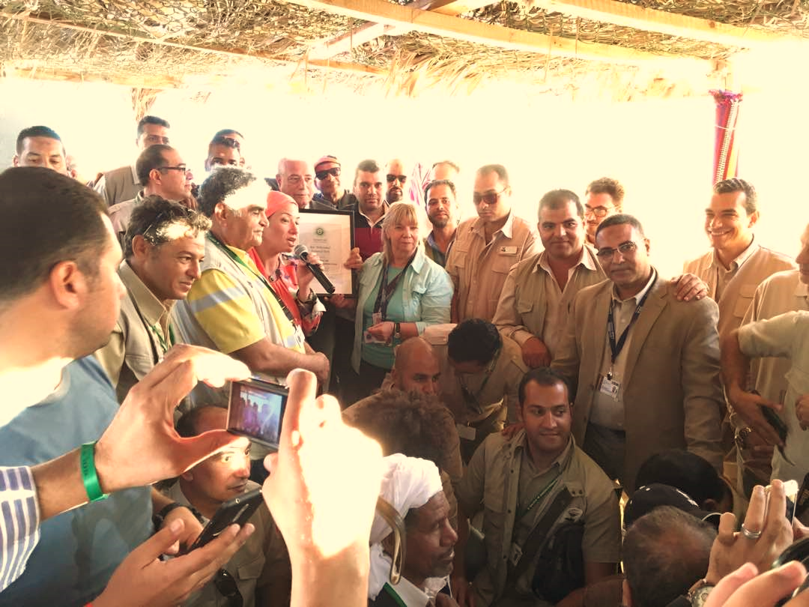
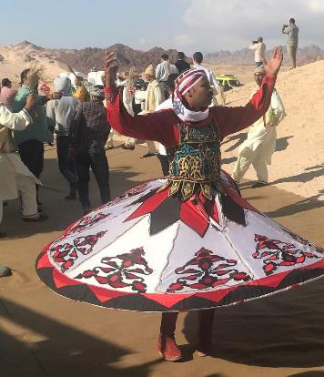

IUCN Green List of Protected and Conserved Areas

Slide 33




Slide 34


All areas of particular importance
Effective area-based conservation measures
Connected
Effectively managed
Integrated into wider landscape and seascape
Equitably governed
Post-2020 Set measurable targets for each

Slide 35

Opportunity to roll this out in the 79 Africa, Caribbean and Pacific
Group of States

