Slide 1
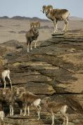
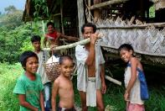
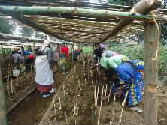
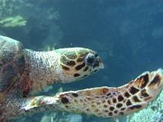
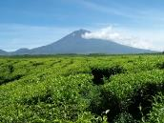
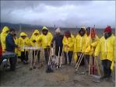
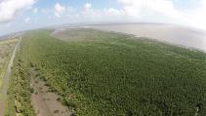
www.panorama.solutions
BIOPAMA – Achieving Fair and Effective Protected Areas
Global workshop; Gran Paradiso National Park, June 2019

Slide 2
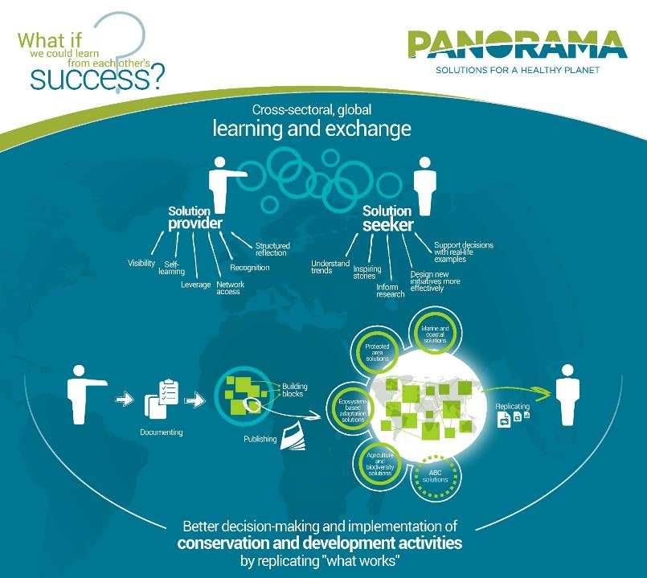
Notes:
PANORAMA is a partnership initiative (IUCN + 6 other organizations) that promotes solutions for nature conservation and sustainable development
Identifying, analysing, documenting and promoting specific success stories from vast range of “solution providers”
Connecting “solution providers” and potential replicators for mutual learning from proven success
Sol providers gain visibility + recognition for their work, go thru a structured self-learning process
Sol seekers can build on existing sol’s to find inspiration, design new initiatives more effectively+ support decision-making
Sol’s being identified, documented in a structured manner, reviewed + published on online platform + shared thru other means f potential replication
Covers multiple, inter-linked thematic issues; incl. PAs

Slide 3
Local action – global learning! The PANORAMA „Solution-ing“ Methodology
~450 Providers
Solution
>500 Solutions
BB1
BB2
BB3
BB4
~1450 Building Blocks
~70 Countries
PANORAMA Solutions …
are tools, methods, processes and approaches that work and inspire action, and
have an impact
are scalable
address conservation and development challenges in an integrated manner
Notes:
Based on a universally applicable learning methodology, combining “online” and “offline” peer-peer learning; unique modular case study format
Sol’s broken down into key elements of success or building blocks

Slide 4
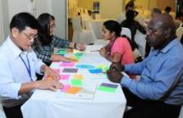
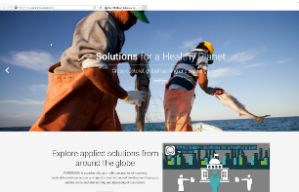
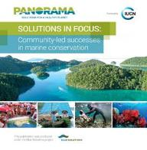
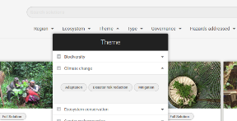
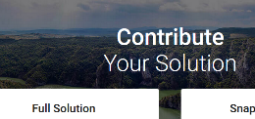
Integrated Learning and Knowledge Sharing
Face-to-face meetings
Workshops
Trainings
Side Events at Conferences
Sophisticated online platform www.panorama.solutions
Communications
Publications
Newsletters
Webinars
Social Media
Videos
Contests
Aichi Targets for Biodiversity Protection under Convention on Biodiversity (CBD)
Notes:
PAN relies on a variety of formats to „source“ soluions, make the sol‘s known and foster exchange, incl. E.g. Publications, webinars, face-to-face meetings and a sophisticated web platform
VIDEO

Slide 5
Sharing solutions during the BIOPAMA event
Solutions Clinics
Tuesday, 9:00-9:45am
Tuesday, 1:00-1:45pm
Wednesday, 6:00-7:00pm
Thursday, 9:00-9:45am
Thursday, 1:00-1:45pm
PANORAMA Solution Celebration
Group dinner on Thursday night
Notes:
Use this workshop to source a strong set of addtl. Case studies from the pax (from you!)
These could relate to many diff aspects of PA mang and governance; eg. could demonstrate how application of a certain assessment toolkit has led to better conservation outcomes
You are all invited to join one of the 5 voluntary “Solution Clinics” sessions; where we will support you in developing and writing a case study in the PAN format, to eventually be published on the platform
Many of you have indicated in the registration that you’d like to contribute a case, and have received an email from me, suggesting you join a specific Clinic session; even if you haven’t been contacted, you are welcome to join and discuss your potential case study, or simply learn more about PAN
Furthermore, some of you are already Sol Providers, with published cases on PAN – during group dinner on Thur night, we would like to celebrate these sol’s and their initiators in a little ceremony

Slide 6
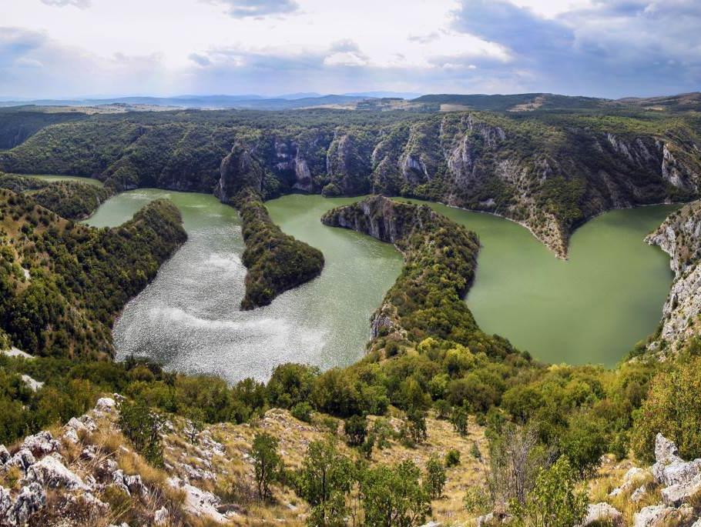
www.panorama.solutions
Twitter: @Panorama_Planet, #PanoramaSolutions
marie.fischborn@iucn.org

