Slide 1
PAME sessions

Slide 2
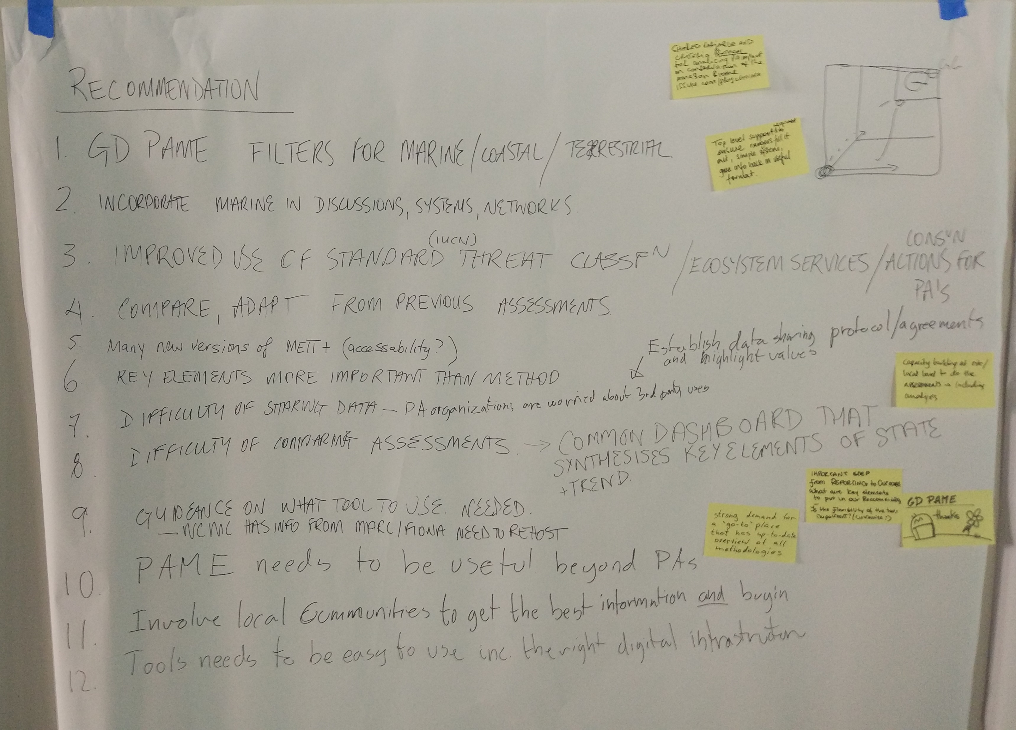

Slide 3
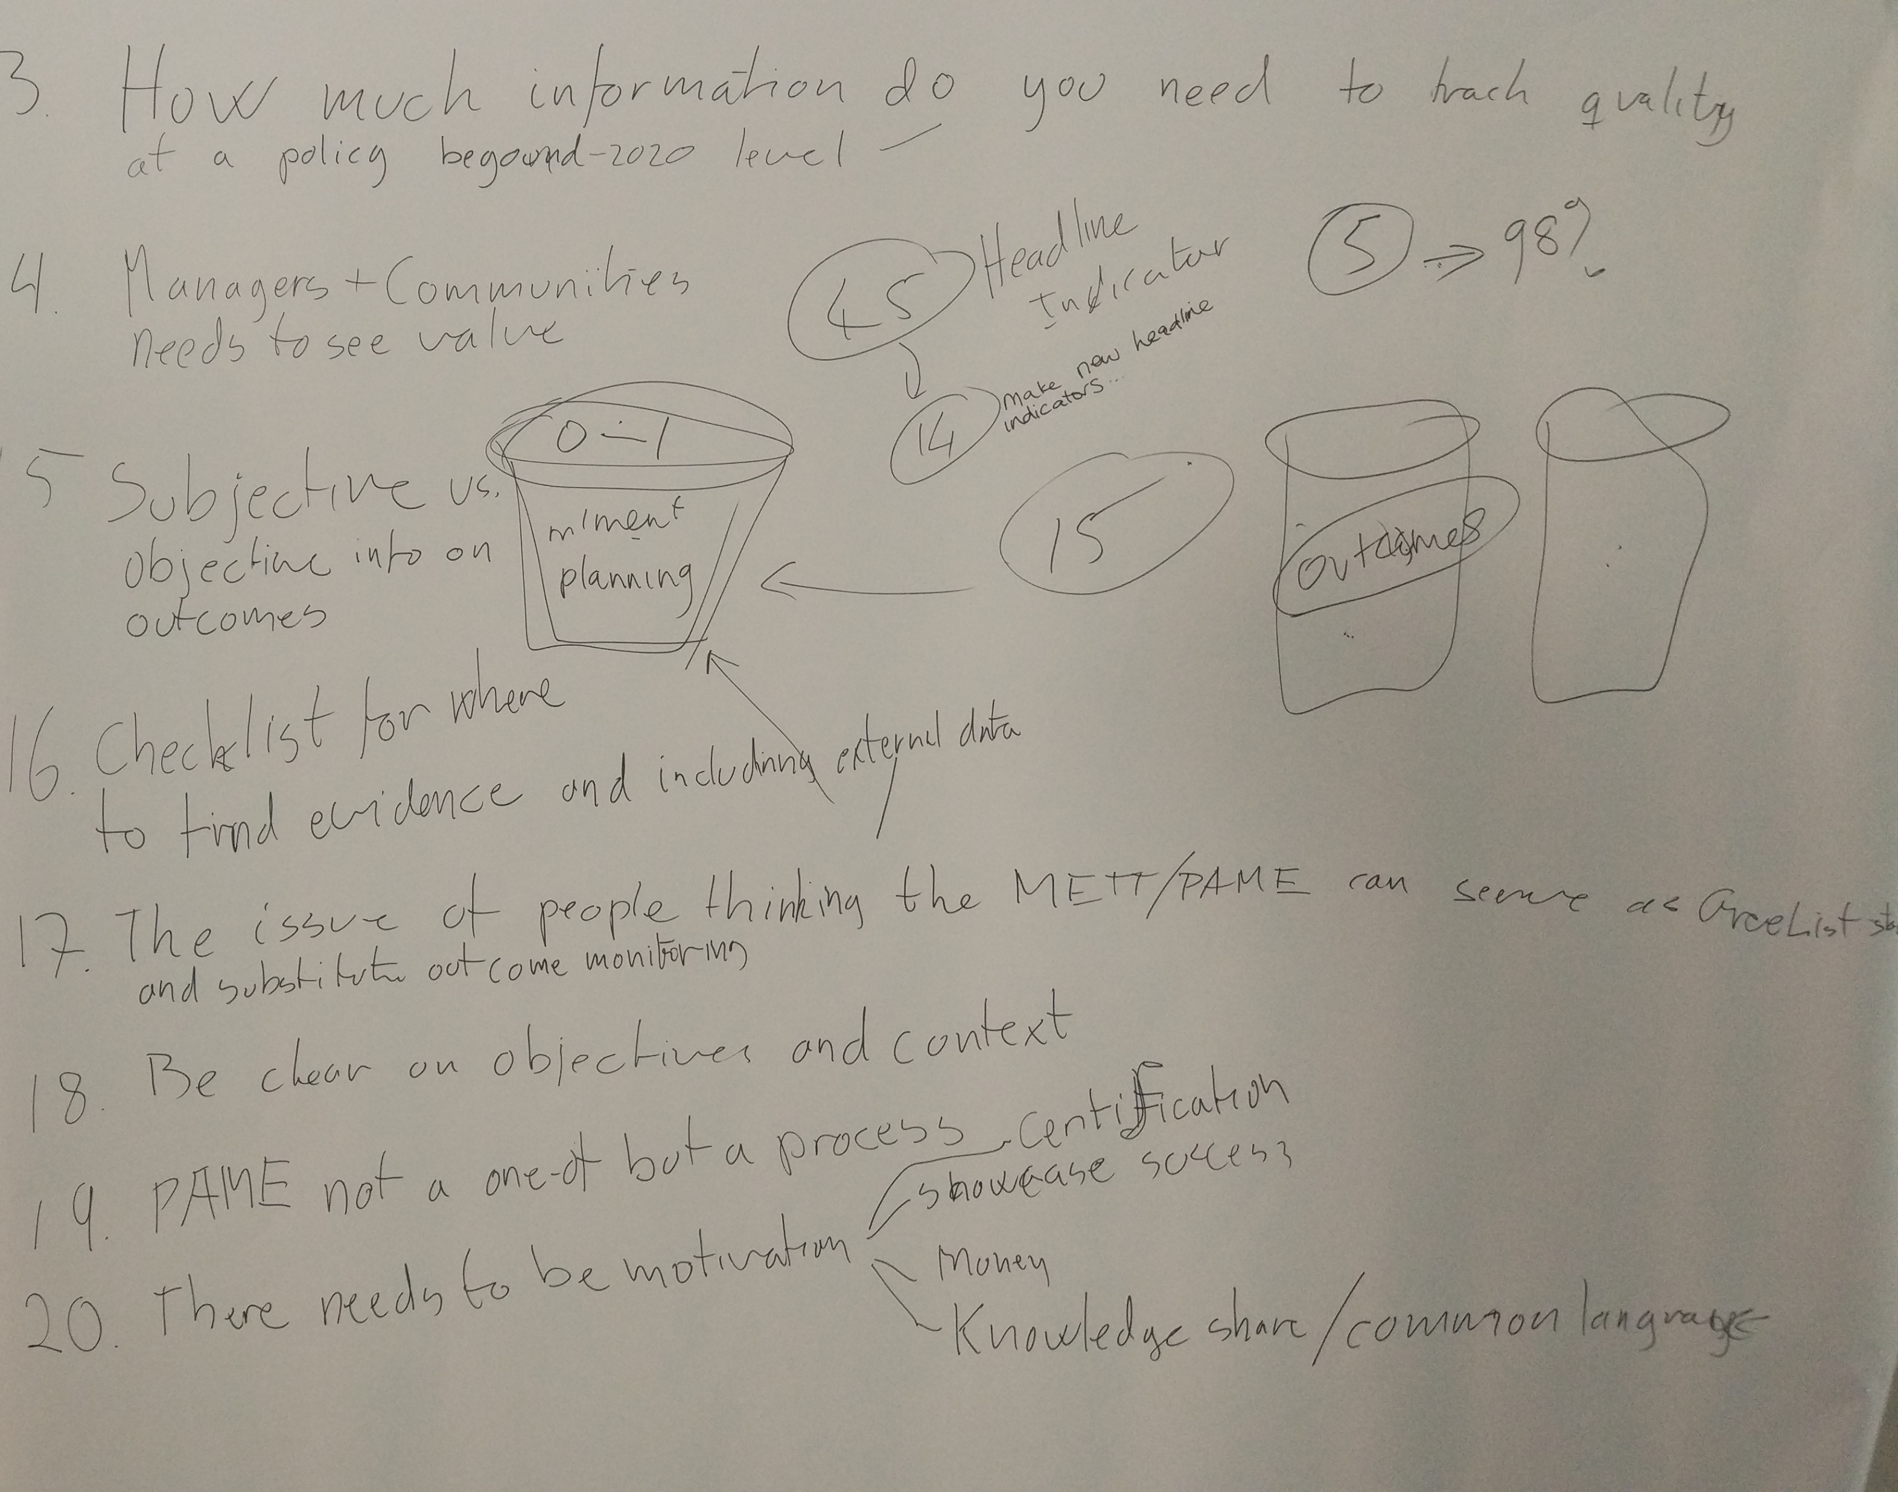

Slide 4
Major take-homes
PAME assessment need to be useful for improving 1) local knowledge and improving capacity as well as 2) help to gather knowledge beyond the individual site (learning from best practice tracking policy targets)
The process is more important than the specific method used. And a detailed inclusive method is also necessary to ensure local value
There was a clear need for having a place where people could assess strengths and weaknesses of different methodologies ideally linked to the Green List standard

Slide 5
Major take-homes
There is an important balance to be resolved between making data available and not putting manager/countries on the spot where things are not perfect
Involving local communities and all stakeholders is essential both to capitalize on LEK and ensure local support and buy-in
The ultimate objective is to preserve (biodiversity) outcomes, so this need to be incorporated in to a PAME process – how will likely vary

