Slide 1


Protected areas governance assessment experience in Colombia: Key learnings from a territory approach
WWF – IUCN WCPA – Parques Nacionales Naturales Colombia
Notes:
Darle agradecimientos a:
Assessment Manager:
Julia Miranda, Director National Parks Agency
National Park Agency, Technical Team:
Team leader: Constanza Atuesta, National Protected Areas System –SINAP- General Coordinator
Team Members
Natalia Florez, Monitoring and Site level assessment Officer – AEMAPPS-
Carolina Jarro, PA Management Plans Group Coordinator
Specialists:
German Corzo, external Advisor, Technical Division
Hernando Zambrano, external Advisor, Technical Division
WWF, Technical Team
Team leader: Sandra Valenzuela, Programme Director & Protected Areas Expert, WWF Colombia
Team Members
Sandra Chamorro, PA Management Effectiveness Specialist, external consultant
Paola Echeverri, Regional Protected Areas Specialist, external consultant
External Evaluation Team:
Team leader: Associate Professor Marc Hockings, University of Queensland & IUCN WCPA Vice-Chair for Science and Management of Protected Areas
Team Members
Nigel Dudley, IUCN WCPA Vice- Chair for Capacity Development and Equilibrium Consultants
Dr. José Courrau, IUCN WCPA Co-Chair of the Management Effectiveness Specialists

Slide 2
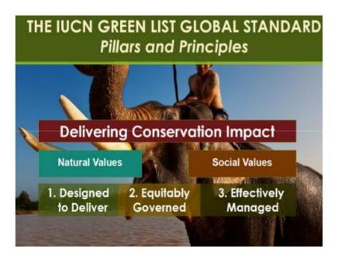
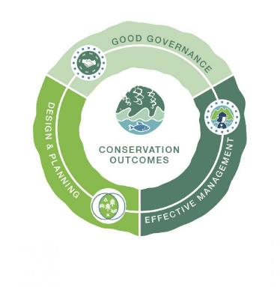




GL Pilot phase: 2011- 2014
GL implementation phase: 2015-2019
Pre-selection of 5 new PAs + sustain original 3:
Chingaza National Park
Malpelo Sanctuary
Guanentá Alto Río Fonce Sanctuary
Los Katíos National Park
Cahuinarí National Park
Succesfull accreditation of 3 Pas:
Gorgona National Park
Tatamá National Park
Galeras Sanctuary

Slide 3





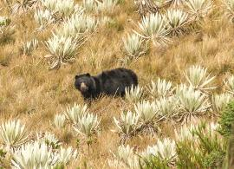
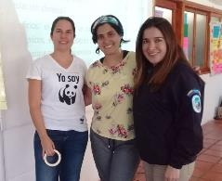
Governance assessments: methodological approach, site & national levels

Slide 4


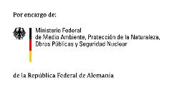

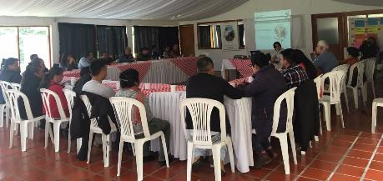
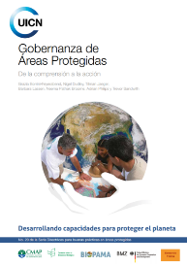


1st moment: PA Governance concepts and PA context – setting a common ground on where we are and what governance means for the group, out of a conceptual framework.
What is governance?
Differences with management
Differences with other concepts e.g. participation, governability
PA governance: diversity and quality
Governance in the PoWPA & the GL

Slide 5

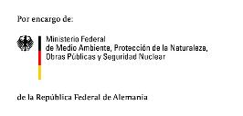


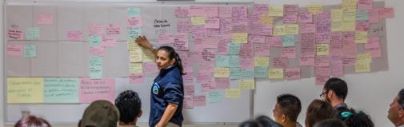
2nd moment: Timeline of interactions – aimed at identifying how relations between actors (park management, stakeholders, rightsholders) have evolved + placing all actors at the same level of participation
Relevant context facts(political, economic, social and environmental)
PA declaration
Learnings
Changes in management
Situations triggering dialogue
Alternative production projects
Use agreements
Milestones in the relation construction process
Participatory Manaement plan s or strategies
Conflicts
Political agreements
3rd moment: Reflecting on the timeline – analysing milestones, changes in the territory, PA declaration process, opportunities taken, engagement of actors in decisión-making, etc.

Slide 6



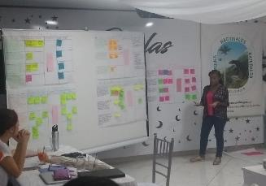
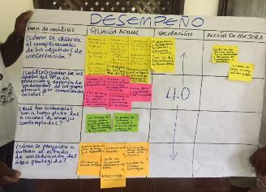
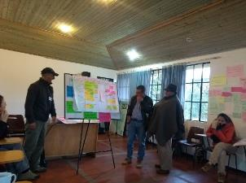
4th moment: Valuing “the road travelled”

Slide 7



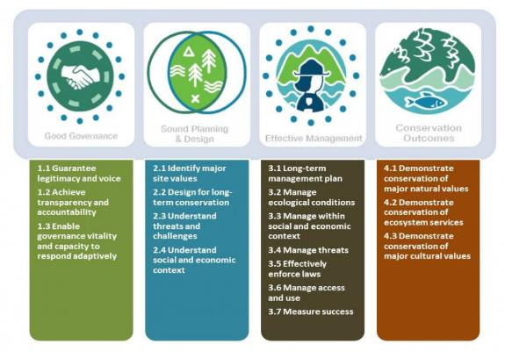
GOOD GOVERNANCE PRINCIPLE
Analysis Theme | Current Situation Description | Valuation (based on governmeter) | Improvement Action/Key Actor
Planning and management instruments consider rights, roles and responsibilities of stakeholders
Whenever adequate, these reflect GL indicators!

Slide 8



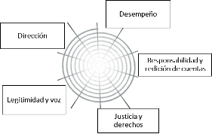
5th moment: Governance improvement route map
Spider graph of governance state of art, based on valuation
Prioritization of actions per principle – identification of potential actors
Voluntary, not legally binding, points a possible way forward!
Good Governance Principle | Improvement strategic action | Key actor
Legitimacy & Voice
Direction
Performance
Accountability & Transparency
Fairness & Rights

Slide 9




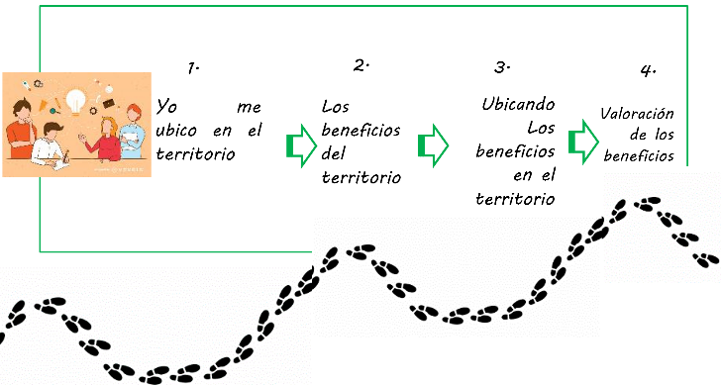
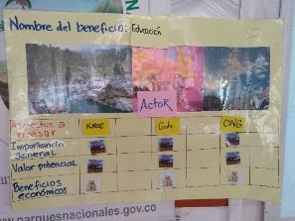
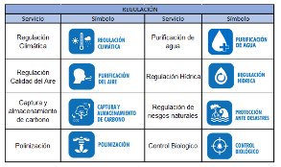
Protected Areas Percieved Benefits Analysis**
Where am I within in the territory
What benefits are delivered
Where are those benefits deliverd
Who much do those benefits value
**Adapted/developed from PA-BAT

Slide 10
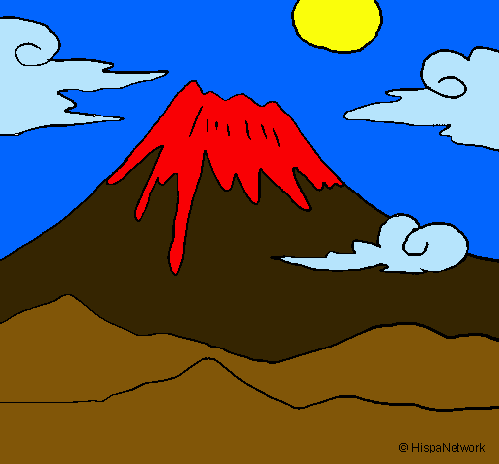

Benefit valuation
High
Mid
Low
Notes:
Materiales: además del punto como grupo, otro como un hilo

Slide 11



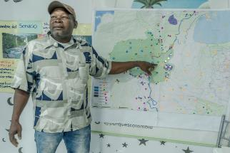
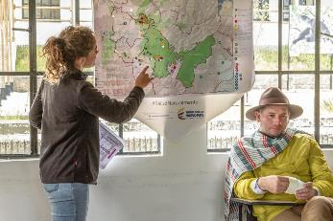
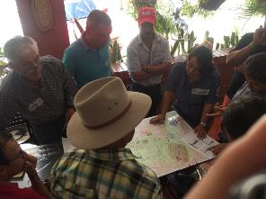
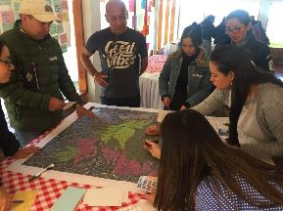
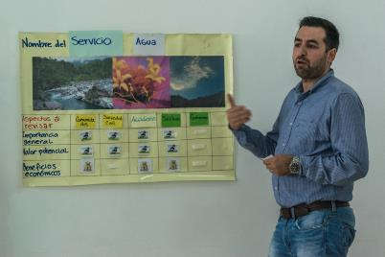

Slide 12
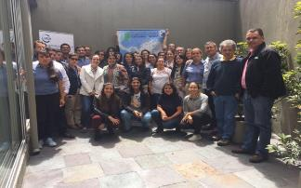



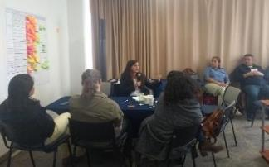
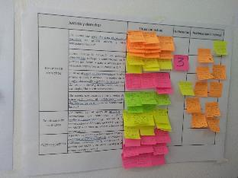
System-level Assessment
PA Governance concepts and context.
Timeline and remarks.
Participation and articulation among SINAP actors
Case-studies at different scales.
Governance valuation and improvement plan.

Slide 14
Governance assessments: lessons learned

Slide 15
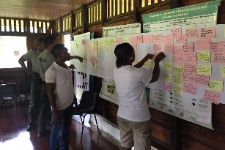
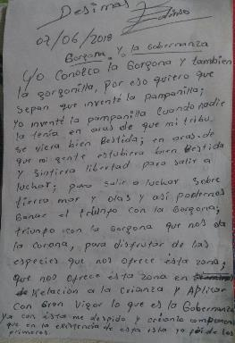
This tools need proper adaptation to national contexts – lenguaje, applicability of concepts, sensibilisation through locally-understandable symbols.
Valution vs scoring - governance increased potential to improve when valued,
Identification of variables and data within PAME tools eases the process
Inclusion of variables /questions related to governance and equity into PAME tools
PA governance is complete when thinking about the territory – Territorial governance for PAs
Improvement route maps are a means to greater integration objectives, from ecological, cultural and social angles.

Slide 16
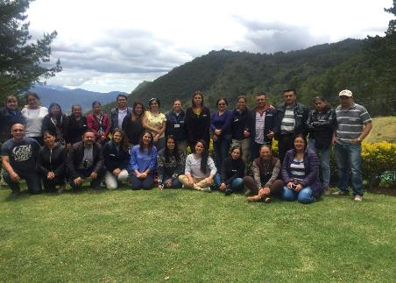
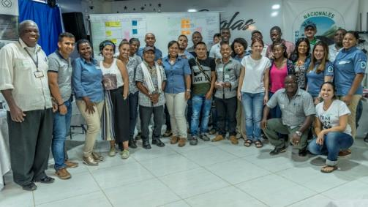
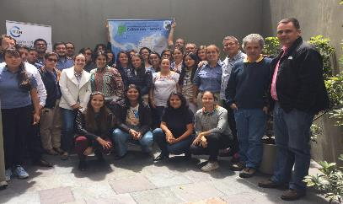
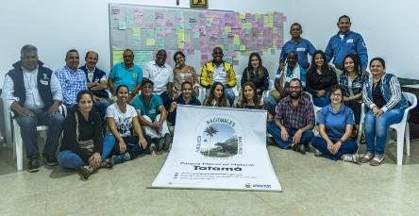
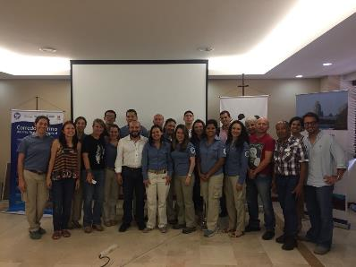
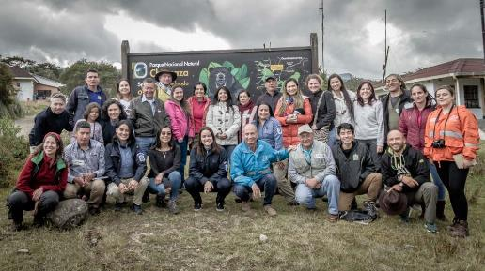
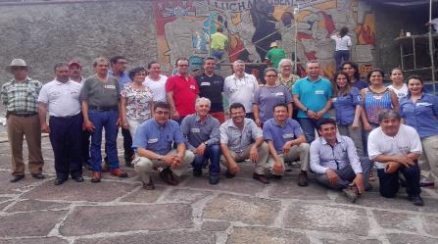
Thank you – Gracias!

Slide 17
