Slide 1
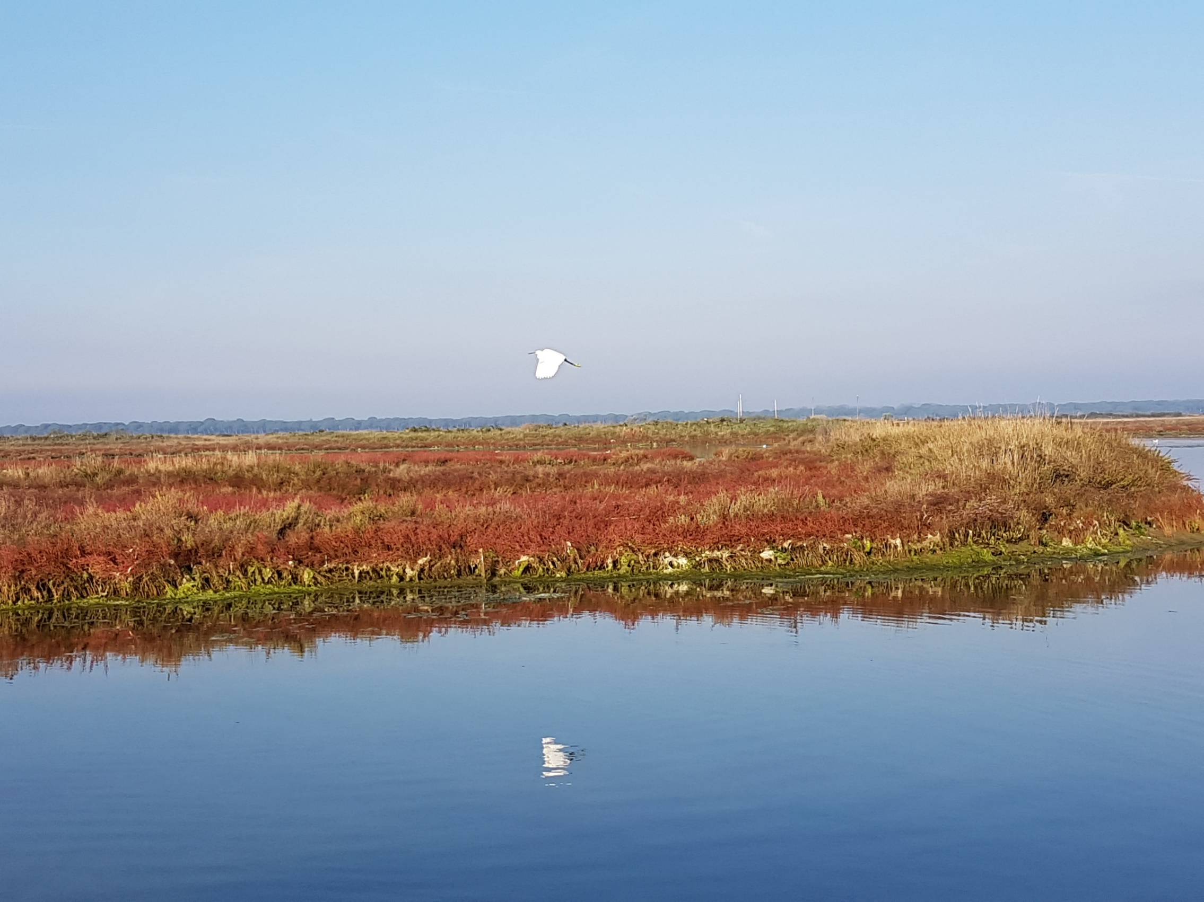
Monitoring Biodiversity in Protected and
Conserved Areas
Results of workshop facilitated by
PJ Stephenson
© PJ Stephenson

Slide 2
Examples of Challenges Identified:
Capacity
Monitoring often only happens when projects are present and is therefore timebound, unsustainable and lacks continuity
Too much reliance on external/expatriate expertise
No culture of monitoring and data use for decision-making
Monitoring schemes are sometimes too ambitious and try to do too much
Funding and capacity are inadequate and short-term
Monitoring is often seen as extra work - not part of the management norm
Indicator selection
Lack of appropriate, measurable thresholds
Unclear how much time is needed to collect data for different indicators

Slide 3
Examples of Challenges Identified:
Data collection
Multiple, disparate, unharmonized and non-comparable methods for data collection within and between countries
Lots of plans and protocols that are not used
Monitoring not integrated across taxa, land/seascapes etc
Hard for managers to choose appropriate tools and methods (or even know what is available)
Monitoring often not participatory or collaborative
Lack of baselines
Effort biased towards certain species.

Slide 4
Examples of Challenges Identified:
Data storage and analysis
Data collected are not properly assessed or analysed
Researchers do not always share their data
No integration between data portals.
Data presentation and reporting
Unwillingness to share data for various reasons
Assumptions made that PA management effectiveness equates to biodiversity outcomes
No systematic capture and sharing of lessons.
Data use in decision-making
Poor communication between data collectors and managers
Focus on management outcomes rather than conservation outcomes
Analyses not well synthesized for decision-makers
No process in place for data to inform decisions.

Slide 5
Examples of Potential Opportunities and Solutions:
Prioritize monitoring needs
Keep in mind the need to develop systems that:
Are easy to maintain and sustainable
Are simple and effective
Can be implemented by park managers and allow analyses at the site level.
Build on what is there:
Build on existing initiatives, tools and data portals (e.g. regional BIOPAMA observatories and resource hubs; Coral Reef Monitoring Network; IUCN Commissions tackling issues around monitoring; State of Protected and Conserved Areas Reports; GBIF BID project, etc etc)
Map existing tools and identify those most relevant for monitoring Green List criteria (in relation to thresholds, indicators, data collection, data storage and analysis, identifying partners and building capacity).
Break silos by developing platforms and tools to link different systems.

Slide 6
Examples of Potential Opportunities and Solutions:
Define systems and ways of operating:
Identify the questions that need answering with monitoring
Streamline and simplify monitoring processes, indicators and systems
Develop integrated PA monitoring systems across species, ecosystems and land/seascapes with local adaptations that take account of PA goals and species
Adopt an ecosystem approach and think ecologically
Develop and implement relevant partnerships
Build on projects and institutionalize monitoring (data collection, analysis, sharing) by incorporating it into the roles of national governments and relevant departments as well as PA staff
Make better use of law enforcement staff for data collection
Ensure all research data are fed back to government departments
Identify local agencies able to collect and share data
Develop citizen science initiatives where they are appropriate and effective.

Slide 7
Examples of Potential Opportunities and Solutions:
Key guidelines and support needed for capacity building:
Develop standardized methods for monitoring species and habitats in PAs of different sizes in different biomes
Collect and share all relevant papers and guidelines relating to monitoring
Provide links to monitoring tools from the IUCN Red List website
Develop a decision-support system to help people choose between the different tools and methods available
Produce and share case studies and good examples of successful monitoring
Provide guidance for developing data management plans at different levels
Develop templates for monitoring assessments (defining options for monitoring and what they each take in terms of capacity needed, time, cost, what you get out of it, etc).

Slide 8
Examples of Potential Opportunities and Solutions:
Next steps
Assess priority actions identified by participants
Share draft report for further input
Develop guidelines, tools and case studies for monitoring biodiversity.
StephensonPJ@gmail.com
www.speciesmonitoring.org

