Slide 1
The Joint Research Centre and the power of data to support decision making on protected and conserved areas
Gran Paradiso National Park, Cogne, Aosta, Italy 24th to 28th June, 2019

Slide 2
The Joint Research Centre and the power of data to support decision making on protected and conserved areas
What is the Joint Research Centre?
JRC and Knowledge Management for biodiversity conservation
Focus on BIOPAMA
A central role for the users and for the BIOPAMA Regional Observatories
Our expectations for this workshop

Slide 3
1. What is the JRC?

Slide 4
JRC – the European Commission Joint Research Centre: who we are, what we do
As the science and knowledge service of the Commission our mission is
to support EU policies with independent evidence throughout the whole policy cycle
Make accessible data and information for better decisions
Show the value and the power of data and of their visualisation
Promote clear data standards, data sharing and open access tools
Work with partners, engage with people, learn from experiences

Slide 5
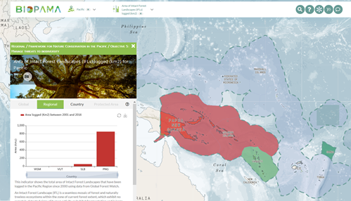
Our work…
Geospatial information and data visualization
Data quality check -
Standards and harmonization
Best scientific practices
Raw data
Databases
JRC data and products
Industry, Academia, NGOs
Data filtering
Data processing
Expert panel information
Better information for decision making
KNOWLEDGE MANAGEMENT

Slide 6
2. JRC and Knowledge Management for biodiversity conservation
The Digital Observatory for Protected Areas (DOPA)
Copernicus and the Global Land Service: Vegetation, Energy, Water, Cryosphere, Hot spots ground based, …
Water Surface Tool
GMES&Africa and the e-Station
Biodiversity and Protected Area Management Programme - BIOPAMA
JRC
and
BIODIVERSITY
Science supporting policy
Knowledge driving decisions
World leader in geospatial applications for policy

Slide 7
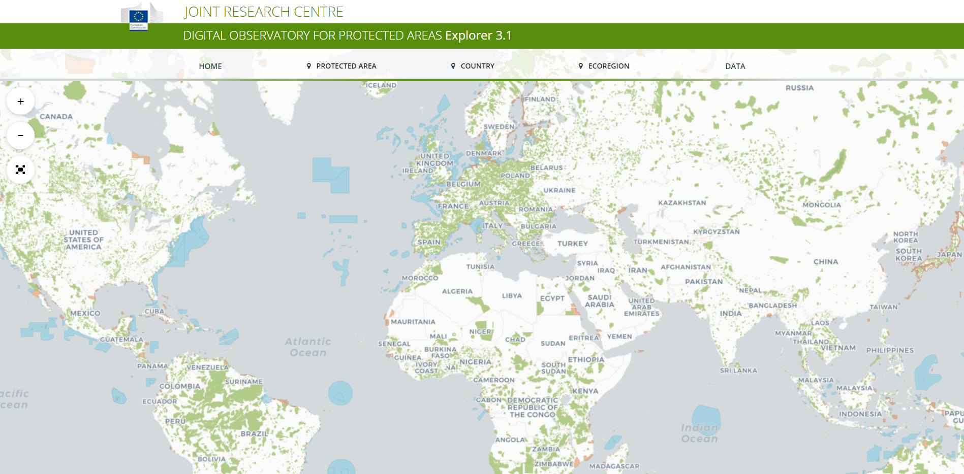
DOPA https://dopa-explorer.jrc.ec.europa.eu
JRC and Knowledge Management for biodiversity conservation
Standardized indicators and >400 metrics on PAs globally, endorsed by CBD (2 CBD indicators)
Nearly 30000 PAs >25km2, covering more than 95% of the global protected surface
DOPA is a global system, based on WDPA, for providing robust comparable data
BIOPAMA provides resources for ongoing development
Notes:
DOPA input to the Aichi Target 11 and 12 country profiles and how they were used in regional CBD workshops to support countries

Slide 8
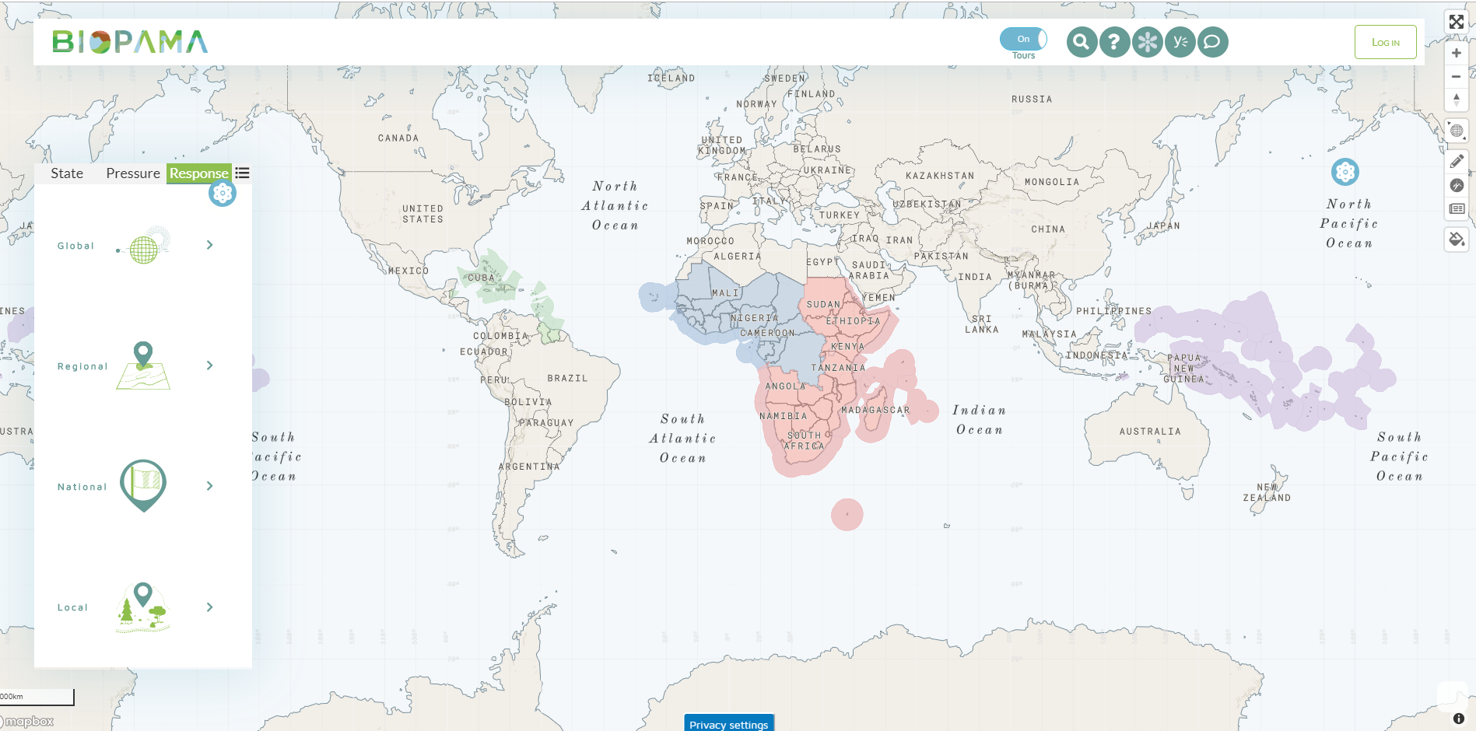
Reference Information System https://rris.biopama.org
JRC and Knowledge Management for biodiversity conservation
Reference Information Systems for biodiversity and PAs management are maintained and enhanced for the ACP countries and regions, supporting decision-making processes at all levels, combining best-available data with query, analysis and reporting functions tailored to the specific needs of priority conservation landscapes
Notes:
Led by the Joint Research Centre, the in-house science service of the European Commission
Applying world-class information systems technology to the challenges of protected areas assessment, monitoring and management
Working in partnership with IUCN and leading agencies and institutions across the ACP region
Linking to key policy objectives and targets for biodiversity and development, from international conventions to local site management

Slide 9
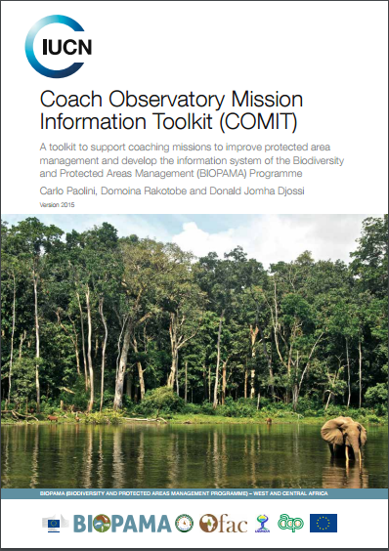
IMET: quantitative, comparable, scalable Embraces a culture of evaluation based on prioritization for decision-making, supporting an integrated “planning-monitoring-evaluation approach”
The Integrated Management Effectiveness Tool (IMET) – 06/2015
IMET Data Base – 04/2018
System level assessments – 07/2018
IMET 2.0 – 06/2019
Quantitative, comparable, scalable
Specific modules: Automatic reporting (factsheets), Law Enforcement, Monitoring, Planning, Governance of Ecosystem services

Slide 10
3. Focus on the Biodiversity and Protected Areas Management Programme (BIOPAMA)

Slide 11
BIOPAMA: from BIOPAMA 1 to BIOPAMA 2…
Reinvigorating concepts and importance of Governance and Management
Integrating the best available data, tools, standards and practices to better analyze and support fair and effective PAs, from diagnosis to action
Recognizing the importance of structured datasets and the need for new assessments to “feed” the Regional Observatories
Reassertion of a central role for the Regional Observatories and for the interaction with the users
Regional management effectiveness reviews: Caribbean, 2018 – E&SA and Pacific, 2019; W&CA, strong emphasis on IMET from 2016
Strong focus on ownership and capacity building (the example of C&WA)

Slide 12
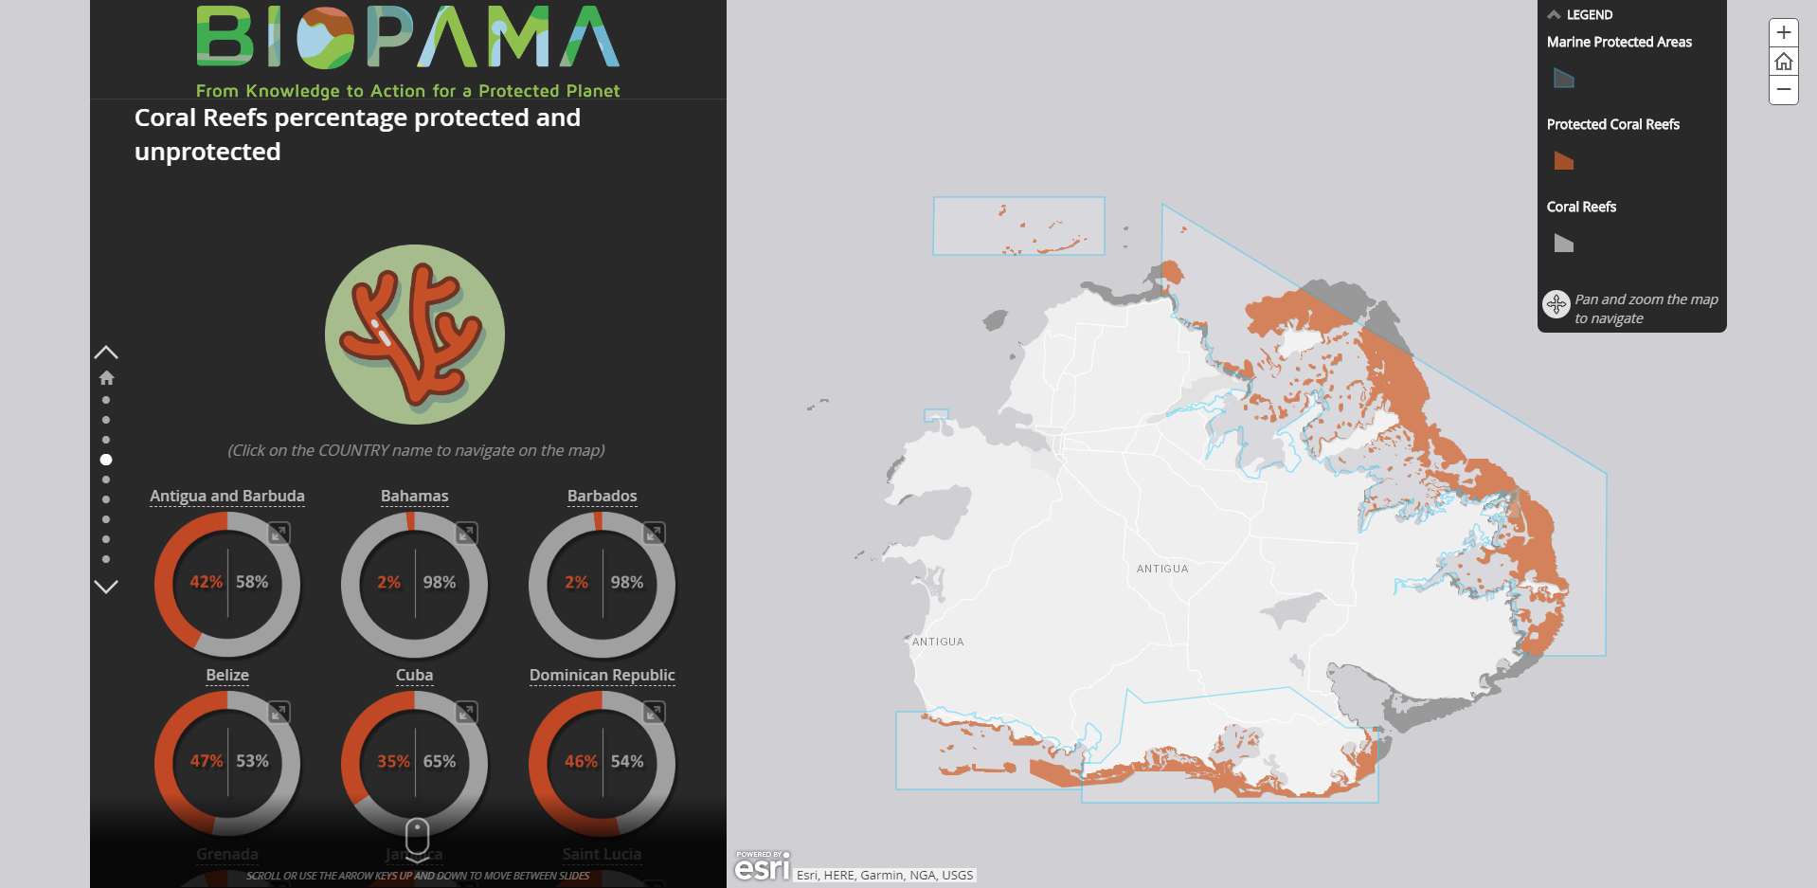
Improving understanding through data, narratives and visualisation
http://rris.biopama.org/storymaps/Caribbean-Marine-Protected-Areas
Notes:
Improving understanding on biodiversity and protected areas through narratives---starting from ecological (biodiversity) data to manage also ME info

Slide 13
BIOPAMA: PAME and PAGE module
The PAME/PAGE module (work in progress, in collaboration with WCMC) aims to support PAs and National Agencies in improving governance and management to better achieve conservation outcomes. It sustains effective engagement and partnership with key stakeholders.
Notes:
Visualisation of the Protected Area Management Effectiveness (PAME) assessments. Engaged with WCMC to ensure access to the PAME data and metadata. IMETs have been included in GD-PAME
Module supports ROs and promote people contribution and sharing data. It will host data and info that come from regional ME reviews.
JRC Knowledge management makes accessible crucial data and information (i.e.ME lessons learnt from regions) to inform better policy makers and for getting "ad hoc" actions for biodiversity conservation

Slide 14
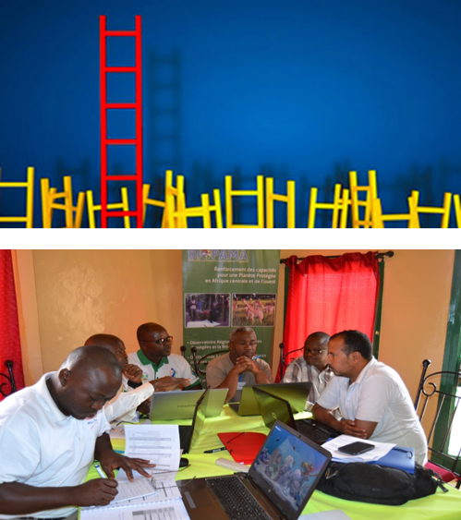
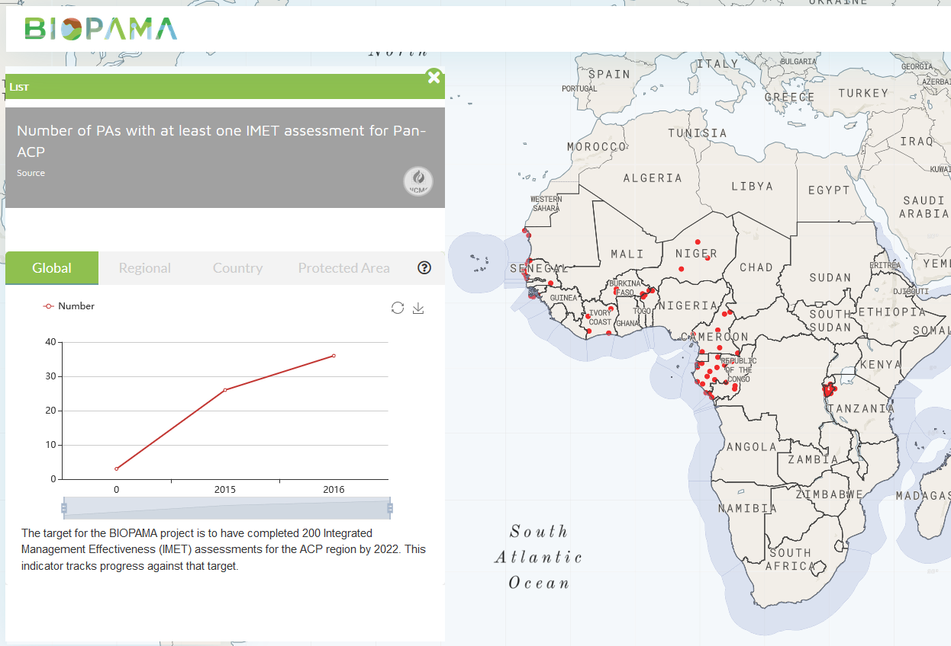
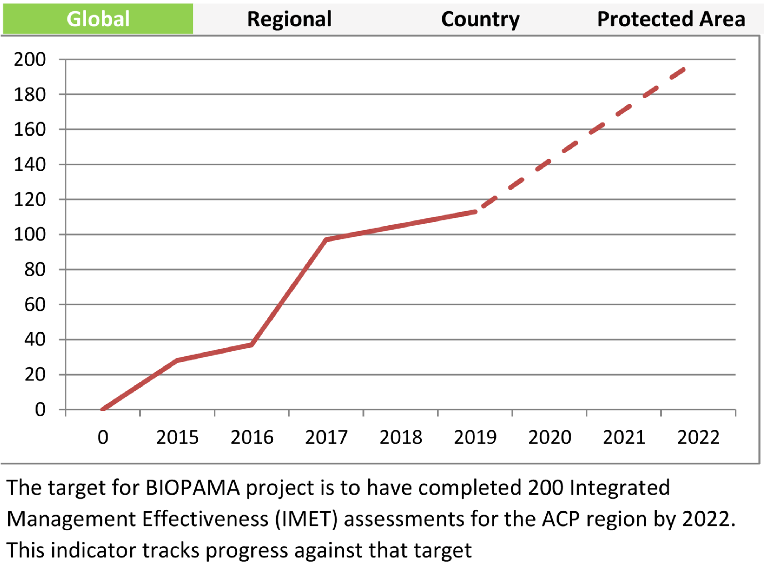
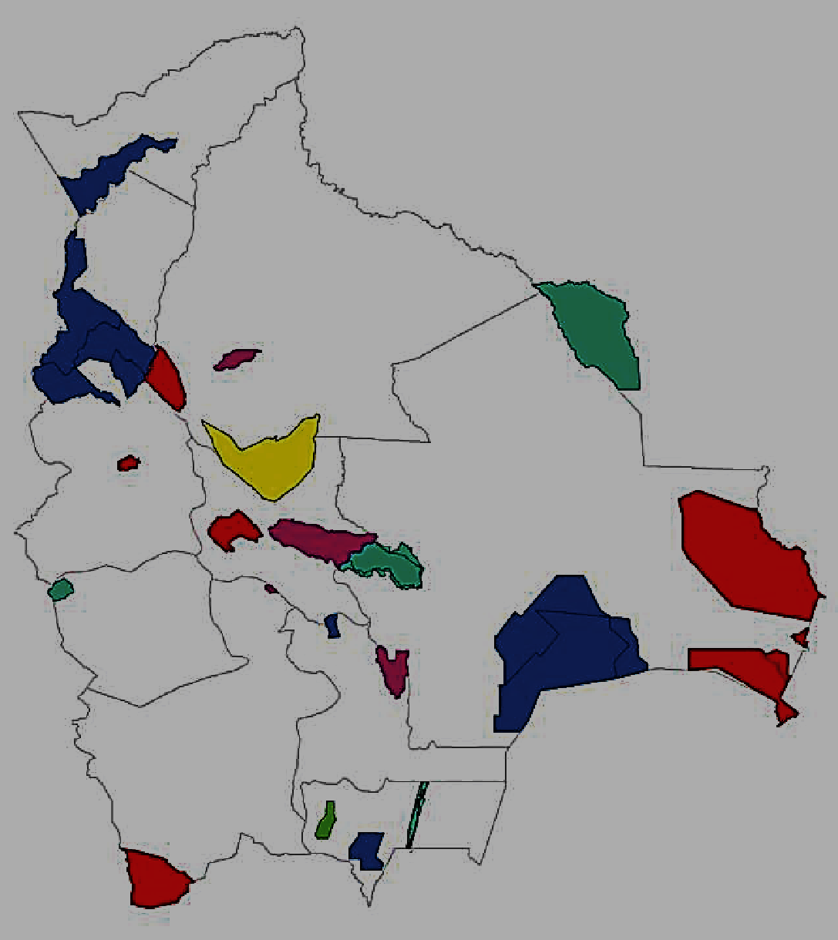
The Integrated Management Effectiveness Tool (IMET): engaging with users
Bolivia
Notes:
Database setup a key achievement of Year 1, forms basis for effective data management and analysis
Statistical analysis, upscaling- Burundi example
Visualisation and tracking of results

Slide 15
4. A central role for the users and for the BIOPAMA Regional Observatories

Slide 16
BIOPAMA: a central role for the users and for the Regional Observatories
To establish and maintain a gateway to data and tools for managers and policy-makers
To provide an update for the regional actors and partners towards capacity building
To support decision-makers for more effective protected area management and biodiversity conservation in the ACP regions, through analytical products and Decision Support Systems (DSS)

Slide 17
RIS
Other information on conservation, management and governance
Collection & Validation
Protected area
Information provider
Consumption on planning, monitoring and effectiveness
Share
Self-assessment + other information
Information flow
Share
Act
Securing & Analysis

Slide 18
5. Our expectations for this workshop

Slide 19
Our expectations for the workshop and our suggestions
A systematic use of information systems duly structured and organized, easily accessible, facilitating analysis, evaluation and decision-making
Consolidation of knowledge on PAME to make real progress in understanding protected areas management effectiveness
Use PAME results to support smarter investments and recognize protected areas management challenges
Clarify how best progressing with PAME campaigns - where, what methods, who
Ensure the establishment of functional links with the USERS and the Regional Observatories

