Slide 1
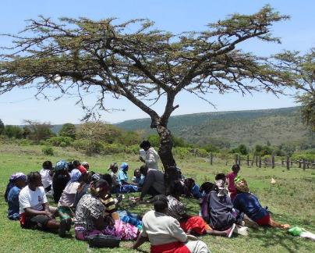
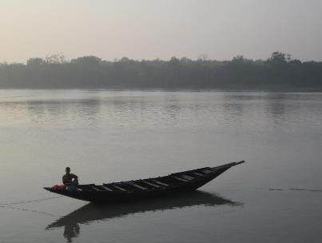
Governance and equity assessment in the context of Protected Area (PAs) and Conserved Areas (CAs)
Phil Franks, Francesca Booker
International Institute for Environment and Development (IIED), UK

Slide 2
Evolution of PA governance and equity in CBD
CBD Programme of Work on Protected Areas (2004):
Strengthening PA governance appears across 7 of the 16 goals of PoWPA, with particular emphasis on participation of Indigenous Peoples and Local Communities
CBD Aichi Target 11 (2011):
By 2020, at least 17 per cent of terrestrial and inland water areas and 10 per cent of coastal and marine areas, especially areas of particular importance for biodiversity and ecosystem services, are conserved through effectively and equitably managed...
Review of progress on Aichi target 11 (June 2018):
Despite advances in guidance with respect to governance assessment, and the existence of at least 29 different governance assessment methodologies for PAs and related contexts, applications of site-based governance assessments remain limited.
CBD COP14 Decision 8 on PAs and OECMs (November 2018)
“Equitable management” now referred to as “governance and equity”.
Suggested actions: Facilitate and engage in site-level governance assessments ….. and take actions for improvement at the site level and draw lessons for policy level
Notes:
. Equitable management means: PAs should be established and managed in close collaboration with, and through equitable processes that recognize and respect the rights of indigenous and local communities, and vulnerable populations. These communities should be fully engaged in governing and managing PAs according to their rights, knowledge, capacities and institutions, should equitably share in the benefits arising from PAs and should not bear inequitable cost (CBD Sec 2011)

Slide 3
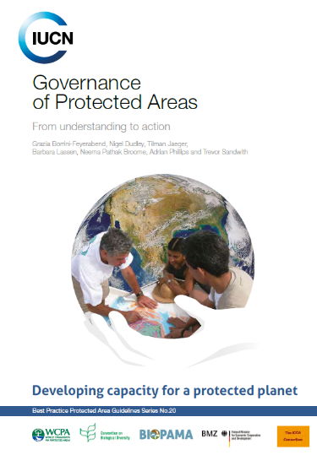
Governance diversity and quality
Governance diversity / governance type. Four major types
Governance by government
Shared governance
Private governance
Community governance incl. ICCAs
Governance quality / good governance. Five major principles :
Legitimacy and voice
Accountability
Fairness and rights
Performance
Direction
with 43 specific considerations
Notes:
Governance is about power, relationships and accountability. It is about who makes decisions, how those decisions are made, how resources are allocated, and how actors have their say and hold those in power to account.
Management is about what is done to achieve these objectives, and includes defining and allocating lower level objectives, responsibilities and accountabilities.

Slide 4
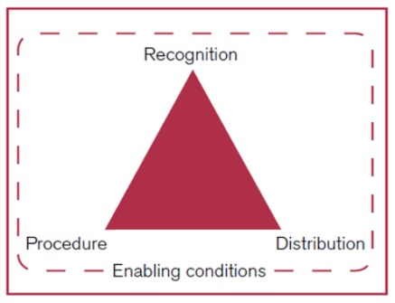
Equity framework for conservation of PAs/CAs
In conservation, equity is largely a matter of good governance. It has 3 dimensions:
Recognition: acknowledgement of, and respect for, actor’s rights and their identities, knowledge systems, values and institutions.
Procedure: inclusiveness of rule and decision-making, transparency, accountability, access to justice and dispute resolution.
Distribution: sharing of costs and benefits among different actors, and how the costs experienced by some actors are mitigated.
From: CBD/COP/DEC/14/8 Voluntary guidance on effective and equitable governance models
Notes:
This is text from a decision of CBD COP14

Slide 5
Good governance and equity principles for PAs/CAs
EQUITY: RECOGNITON | 1. Recognition and respect for the rights of all relevant actors
 | 2. Recognition and respect of all relevant actors and their knowledge, values and institutions
EQUITY: PROCEDURE | 3. Full and effective participation of all relevant actors in decision making
 | 4. Accountability for actions and inactions and transparency
 | 5. Access to justice, including effective dispute resolution processes
 | 6. Effective and fair law enforcement (or more broadly the rule of law)
EQUITY: DISTRIBUTION | 7. Effective measures to mitigate negative impacts on indigenous peoples and local communities
 | 8. Benefits equitably shared among relevant actors based on one or more agreed targeting options
OTHER | 9. Achievement of conservation and other objectives
 | 10. Effective coordination and collaboration between actors, sectors and levels

Slide 6
Governance & equity principles and themes
A major constraint to governance assessment is poor understanding of governance principles => unpack principles into more specific themes

Slide 7
Four overlapping domains of PA assessment
Notes:
The size of the management effectiveness box depends on the specific methodology being used. What is shown here is basic METT. Some new versions of METT include some coverage of ecological outcomes.

Slide 8
Four overlapping domains of PA assessment
Notes:
The size of the management effectiveness box depends on the specific methodology being used. What is shown here is basic METT. Some new versions of METT include some coverage of ecological outcomes.

Slide 9
Four overlapping domains of PA assessment
Notes:
The size of the management effectiveness box depends on the specific methodology being used. What is shown here is basic METT. Some new versions of METT include some coverage of ecological outcomes.

Slide 10
Countries/sites that have used SAPA and GAPA (Jun 2019)
SAPA | GAPA
Kenya – Ol Pejeta Conservancy | Bangladesh – Sundarbans Forest Reserve
Kenya – Ruma NP | Philippines – Agusan Marsh Wildlife Reserve
Kenya – Kisiite MPA | Philippines – Mt Apo NP
Uganda – Ruwenzori NP | Philippines – Mt Balatukan NP
Uganda – Lake Mburo NP | Philippines – PD 1636 NP (General Nakar)
Uganda – Mgahinga NP | Zambia – Chiawa GMA
Mozambique – Maputo NP | Zambia – Mumbwa GMA
Zambia – Mumbwa GMA | Kenya – Kalama Conservancy
Zambia – South Luangwa NP | Kenya – Mara North Conservancy
Gabon – Monts De Crystal NP | Kenya – Olderkesi Conservancy
Gabon – Loango NP | Kenya – Kanamai BMU and LMMA
Ethiopia – Awash NP | Uganda – Lake Mburo NP
Liberia – Sapo NP

Slide 11
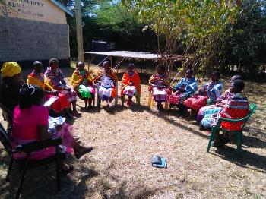
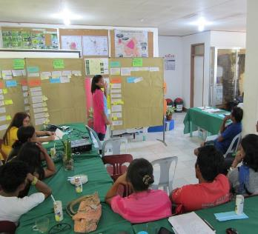
Governance assessment for protected and conserved areas (GAPA)
What is GAPA?
GAPA is a methodology for assessing the quality - including equity - and underlying challenges of the governance of a protected or conserved area and any related conservation and development activities.
Uses of GAPA
As a health check, to determine strengths and challenges of governance arrangements and thereby identify issues that need some attention;
As a diagnostic, to understand the underlying causes of existing governance challenges and thereby identify actions that could improve the situation;
For monitoring progress, to establish a baseline against which changes in governance over time can be measured.

Slide 12
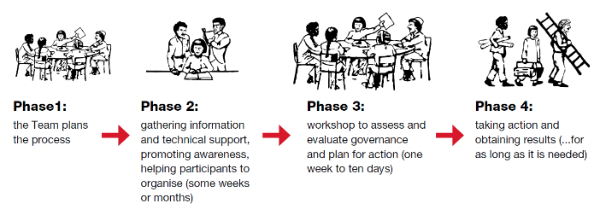
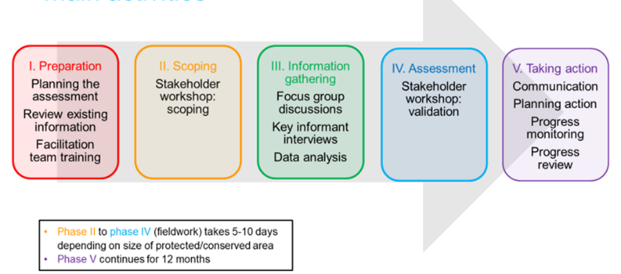
Generic governance assessment process
GAPA process

Slide 13
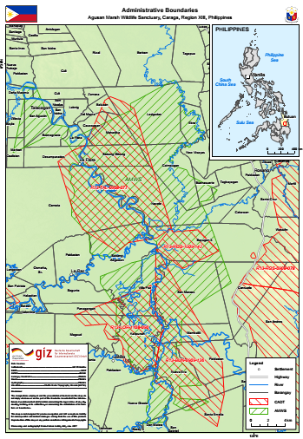
GAPA in the Philippines Agusan Marsh Wildlife Sanctuary
400km2 of wetlands in Mindanao
Ancestral Domains of Indigenous Peoples (red shading) overlap with the PA (green shading)
Governance type:
shared governance overseen by the Protected Area Management Board
GAPA Information gathering
11 interviews with key informants
Focus group discussions in 6 communities including men, women and IP representatives

Slide 14
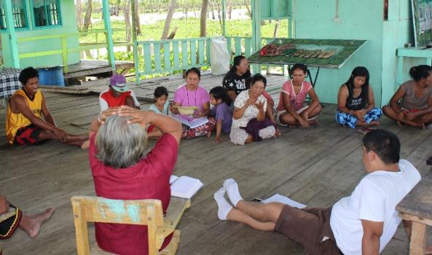
Challenges: Participation in decision making
Processes for selecting representatives
weak representation of women and Indigenous Peoples. With IPs this is partly because elections for IP representatives are, at times, not properly conducted
Two-way communication with representatives
poor performance of community representatives in terms of sharing information with the people they represent
Inputs to decision-making
timing and location of meetings are often unfavourable for community participation

Slide 15
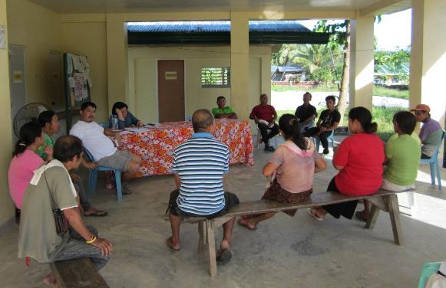
Challenges: transparency
Information sharing processes
government and NGOs are poor at sharing information resulting in agencies working in the same communities having little idea of what other agencies are doing
researchers are failing to inform communities of what they are doing and failing to share the results with them
Knowledge
community members unclear on what they can and cannot do in different areas of the PA due to lack of information on boundaries of different zones

Slide 16
Challenges: Recognition and respect for rights
Acknowledging and not violating others rights
non-IPs failing to respect IP land rights within the boundary of the PA
Some non-IPs have been given genuine land titles within the PA and these are not respected by IPs
Free, prior and informed consent
cases where developers do not follow a proper FPIC process and developments proceed without IP consent

Slide 17
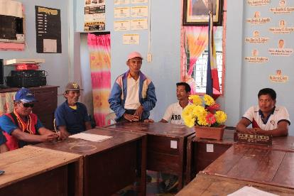
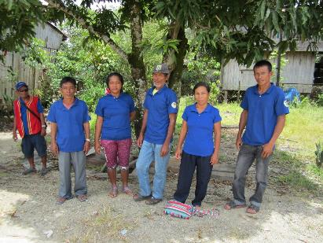
Challenges: effective and fair law enforcement
Respect for law enforcement agents
IPs who are central to the law enforcement system are not given the respect they deserve and are not paid
Coordination between law enforcers
lack of presence on the ground of the national agencies that support law enforcement.
Procedures and sanctions
people arrested for illegal activities are often released without prosecution

Slide 18
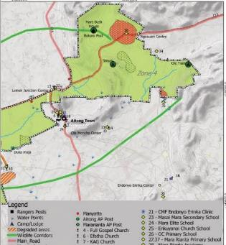
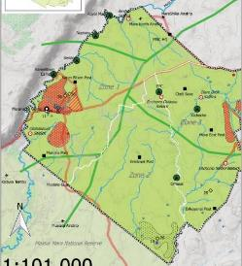
GAPA in Kenya Mara North Conservancy
Kenya Wildlife Conservation and Management Act 2013 gave legal recognition to wildlife conservancy
Mara North Conservancy Company made up of 12 tourism partners and established the conservancy in 2009
Land is owned by 700 individuals and is leased by Mara North Conservancy for a lease fee paid to each
Land owners are represented by a Land Owners Committee (LOC) of 19 individuals
GAPA information gathering
12 interviews with key informants
Focus group discussions in 4 communities (men and women separated)
Notes:
The land of MNC is owned by around 700 individuals who have titles ranging from 20 – 150 acres. The company responsible for management of MNC (Mara North Conservancy Ltd) has negotiated leases of fifteen years for the majority of these individual land plots. The MNC company is made up of twelve tourism businesses (“tourism partners”) who operate safari camps and lodges on land within the conservancy. Under the terms of the lease, the company has full authority to manage the land for wildlife conservation-based tourism subject to allowing the land owners to graze their cattle within the conservancy according to an agreed grazing plan. In return the land owners get regular lease payments and they and their families benefit from a range of development project funded by the MNC Company and donations from tourists through individual camps Trusts.

Slide 19
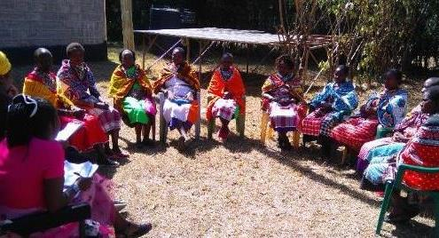
Participation in decision making
Resources for actors to participate
Expensive to bring people together e.g. transport, food
Representation
Little participation of women in community meetings
LOC members are not elected and are not representing interests of other land owners
There are no women representatives on LOC sub-committees eg bursaries committee

Slide 20
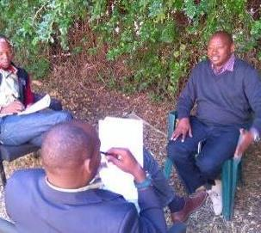
Fair sharing of benefits
How, and by whom, benefit sharing decisions are made
Local women and men don’t have the opportunity to explain their needs for development projects eg water supply for women
Benefit sharing outcomes
Not all land-owners are benefiting from development projects (bursaries, schools, water)
Limited women's employment by conservancy stakeholders eg tourism, rangers
Unfair sharing of grazing for cattle – some people have many cattle and some people have few

Slide 21
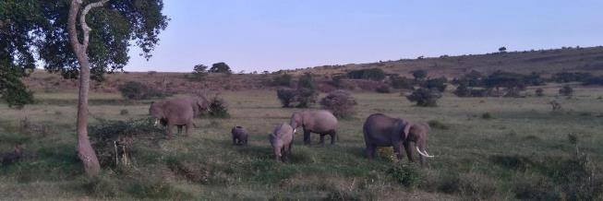
Transparency
Information sharing processes
No provision for land-owners AGM in current structures so meetings are ad hoc
Access to specific information
Tourism partners do not disclose financial reports (bed nights) and this creates suspicion from landowners
Not clear how much money is collected from fines for illegal grazing, and how they are using this finance
Women lack basic information on the conservancy, what does it mean to have land under the lease, what are their rights etc.

Slide 22
Rapid Assessment of PA Governance and Equity (PAGE-RA)
What is PAGE-RA?
RA-PAGE is a scorecard-based methodology for rapid assessment of the quality of governance – including equity - of a protected/conserved area and any related conservation and development activities.
Responds to:
CBD COP14 Decision 8 on PAs/CAs
Facilitate site-level governance assessments ….. take actions for improvement at the site level and draw lessons for policy level
IUCN Green List – needs a tool for systematic assessment of PA governance quality at site level
Constraints of in-depth assessment of governance – notably cost, complexity and political sensitivity
 | SAPA | GAPA | PAGE-RA
Uses at site level
Governance health check | * | *** | **
Diagnosing governance problems | * | *** | *
Monitoring progress | * | ** | **
Uses at national level
System assessment | * | N/A | **
National reporting | * | N/A | **
Cost in USD (excl. convening) | $5-15k | $5-15k | $2-5k

Slide 23
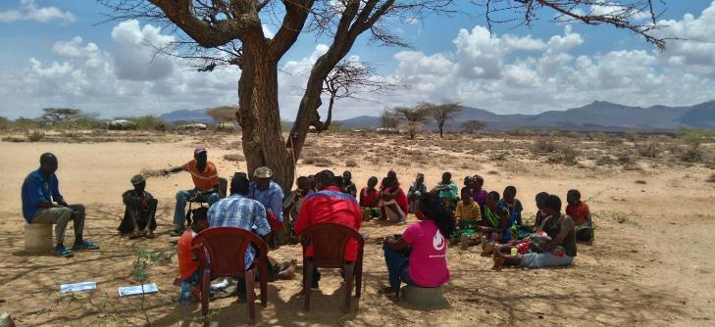
The End
For more information contact: phil.franks@iied.org, francesca.booker@iied.org

Slide 24
Continuum of protected are governance type

Slide 25
Inventory of governance assessment methodologies
IIED’s Governance Assessment for PAs and CAs (GAPA) methodology draws on many of these

