Slide 1
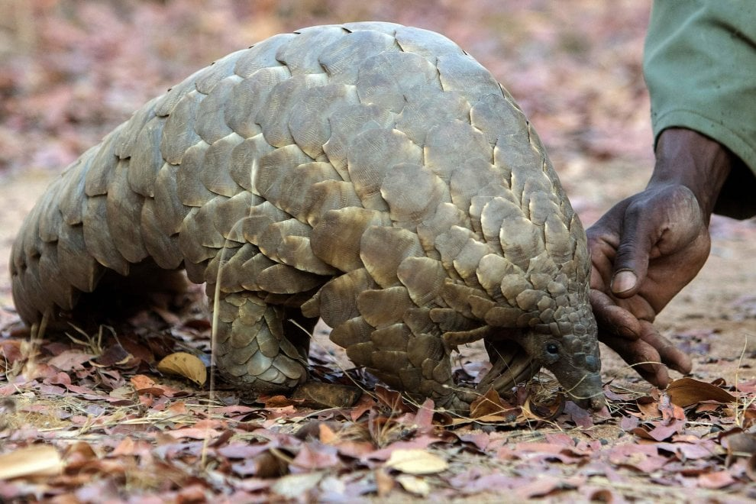
IMET
Assessment and improvement of the management
–
Protected areas framework analysis
Piotr Białowolski,
Paolo Roggeri
Carlo Paolini

Slide 2
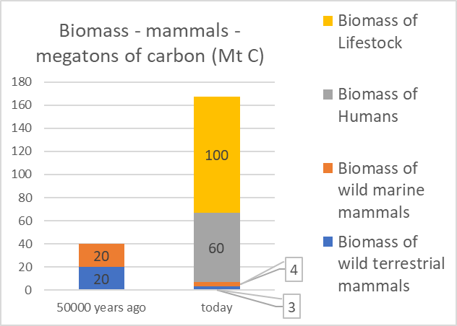
General observation

Slide 3
Outline
Assessment and improvement of management effectiveness
Protected areas framework analysis

Slide 4


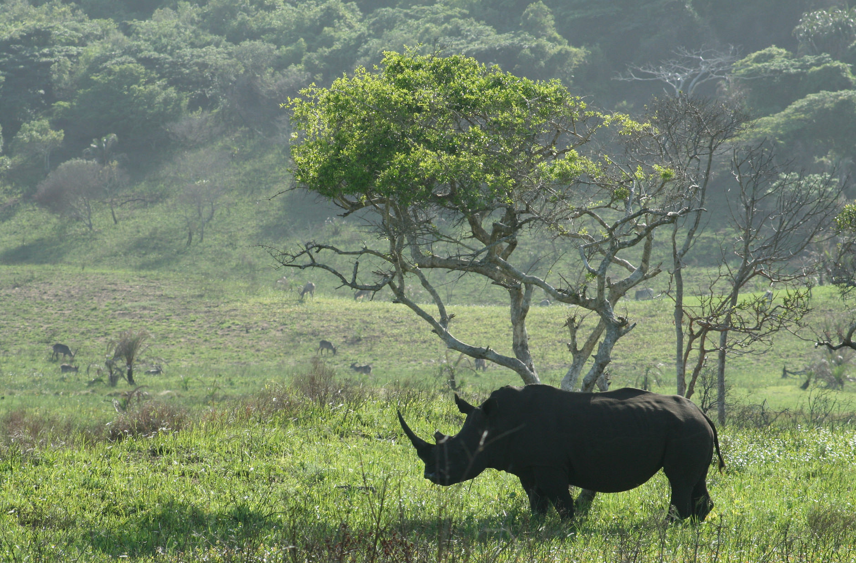
Assessment and improvement of management effectiveness
Notes:
The divider works as an overlay. To change the images in the background, select the main layer (the top shape) and right click “send to back”. Replace/Change the image. Then click “send to back” on the image you have added.

Slide 5

BIOPAMA – IMET, Assessment and improvement of the management
Flux of information and balanced analysis between the elements of management effectiveness
IMET analysis + data from WDPA and DOPA databases =
more detailed analyses (2014 United Nations List of PAs)
Collecting information relevant to the PA improves
reception of a questionnaire (Leverington et al. 2008)
Involving broader set of stakeholders improves validity of the results because some information might be available only at particular levels of management
Teamwork + information and feedback = flow of information and potentially lead to better outcomes in the long run
Balanced analysis of six elements of the management effectiveness cycle = better diagnose management actions and performance of protected areas (Pomeroy et al. 2004)
IMET
–
Flux of information and balanced analysis
Notes:
(Deguignet et al. 2014 – UN list of PAs)
“Enriching the information on protected areas through linking the WDPA to other databases including those on the effectiveness of management activities, habitat cover, species range and abundance, the degree of human use and social benefits of protected areas should be another point of focus. This will enhance the quality of the information and enable more detailed analyses on the impacts, outcomes and benefits of protected areas.”
(Leverington et al. 2008) about METT: “The experience of some people in the field is that the Tracking Tool is better received by field staff if some additional questions specifically relevant to that area and situation are added.”
(Pomeroy et al. 2004)
“Effective management of MPAs requires continuous feedback of information to achieve objectives. The management process involves planning, design, implementation, monitoring, evaluation, communication and adaptation. Evaluation consists of reviewing the results of actions taken and assessing whether these actions are producing the desired outcomes.”

Slide 6
BIOPAMA – IMET, Assessment and improvement of the management
Capacity building, coaching and planning-monitoring-evaluation integrated approach
IMET, by introducing qualified coaches into the process of data collection, aims to reduce bias associated with collection of data from a single person, as reported by Stoll-Kleemann (2010)
IMET adopts all major and synthesis indicators proposed by the analysis of the Global Study using the questions/answers METT methodology, by organizing them according to the cycle of the protected areas management
(Context, Planning, Inputs, Processes, Outputs and Outcomes).
IMET collects combination of quantitative (assessments in numeric format or responses on the Likert scale) and qualitative information (e.g., the goals)
IMET
–
Capacity building, coaching and PME
Notes:
DOPA input to the Aichi Target 11 and 12 country profiles and how they were used in regional CBD workshops to support countries

Slide 7


BIOPAMA – IMET, Assessment and improvement of the management
IMET serves as a decision support system (DSS)
IMET as DSS facilitates = proactive approach - conservation actions targeted on outputs and outcomes
Effective management = constant interaction and feedback of information = adequate planning, design, implementation, monitoring, evaluation, … (Pomeroy et al. 2004)
IMET as DDS = matrices for setting baseline, objectives / expected conditions and reference values (indicators - benchmarks) to ensure follow-up
IMET
–
IMET = DSS
Notes:
DOPA input to the Aichi Target 11 and 12 country profiles and how they were used in regional CBD workshops to support countries

Slide 8

BIOPAMA – IMET, Assessment and improvement of the management
Statistical approach
Responses measured mostly on the Likert scale (change between IMET v1 and IMET v2)
Aggregation of results by averaging over domains and subsequently over dimensions of management
effectiveness
Weighting questions in domains according to their importance
Presentation of results in form of grouping and
ranking
Introducing multiple imputation techniques for
handling non-response issues
Possible use of a cross analysis of data to
    account for inconsistencies in responding
IMET
–
Statistical approach
Notes:
DOPA input to the Aichi Target 11 and 12 country profiles and how they were used in regional CBD workshops to support countries

Slide 9
Protected areas framework analysis
-
Aggregation of results, challenges and solutions
Notes:
The divider works as an overlay. To change the images in the background, select the main layer (the top shape) and right click “send to back”. Replace/Change the image. Then click “send to back” on the image you have added.

Slide 10
BIOPAMA – IMET, Protected areas framework analysis, Aggregation of results, challenges and solutions
IMET
–
Grouping vs ranking
Advantages of grouping | Advantages of ranking
It helps to identify closest neighbours – PAs in similar situation It provides help in determining potential strategic actions to be undertaken It allows to understand what are the reference points for development and how the goals for development should be set | It is simple – no assumptions are needed It is easy to do a ranking and computations are always feasible Each protected area is clearly positioned in terms of management effectiveness and there is no ambiguity
Notes:
DOPA input to the Aichi Target 11 and 12 country profiles and how they were used in regional CBD workshops to support countries

Slide 11
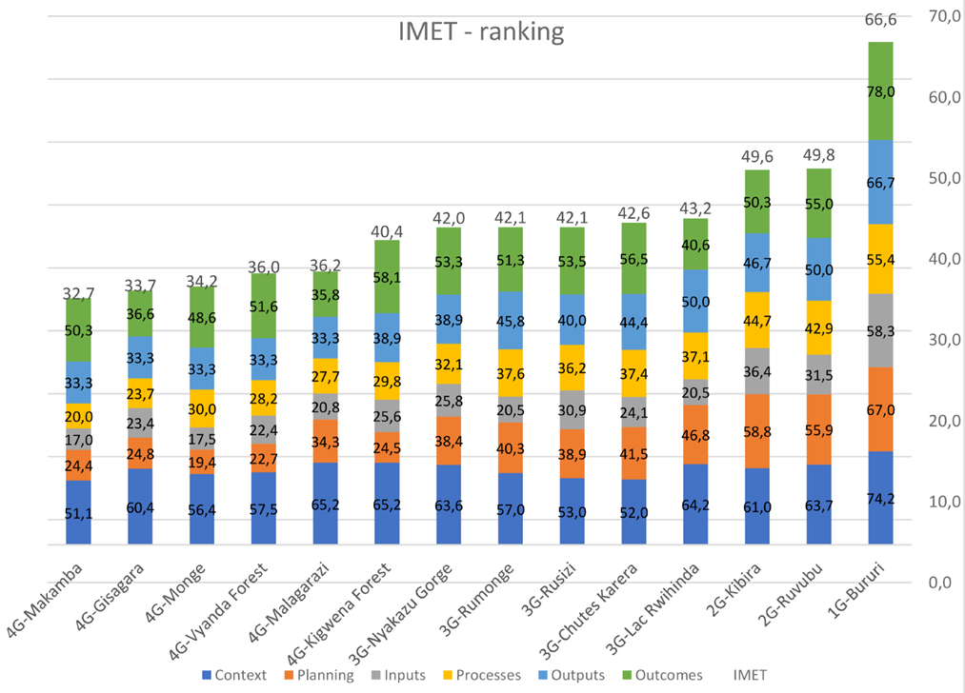
BIOPAMA – IMET, Protected areas framework analysis
BIOPAMA – IMET, Protected areas framework analysis, Aggregation of results, challenges and solutions
IMET
–
Grouping vs ranking
Ranking – Burundi
One clear leader (outperforming other PAs in all dimensions)
Challenges particularly in Inputs, Planning and Processes
Outcomes not always highly correlated with the context
Notes:
DOPA input to the Aichi Target 11 and 12 country profiles and how they were used in regional CBD workshops to support countries

Slide 12
BIOPAMA – IMET, Protected areas framework analysis
BIOPAMA – IMET, Protected areas framework analysis, Aggregation of results, challenges and solutions
IMET
–
Ranking of dimensions of management effectiveness
Notes:
DOPA input to the Aichi Target 11 and 12 country profiles and how they were used in regional CBD workshops to support countries

Slide 13
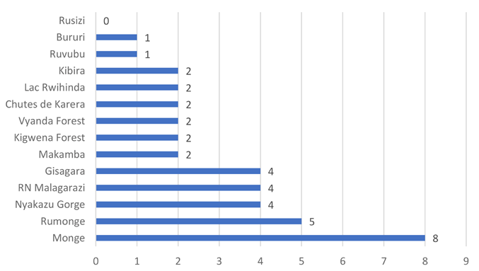
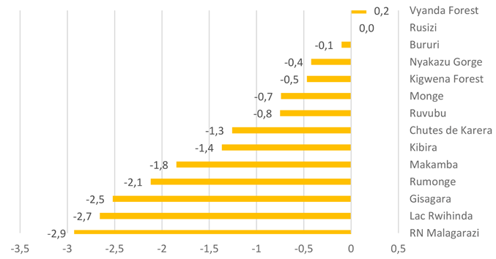
BIOPAMA – IMET, Protected areas framework analysis
BIOPAMA – IMET, Protected areas framework analysis, Aggregation of results, challenges and solutions
IMET – Non-response
Notes:
DOPA input to the Aichi Target 11 and 12 country profiles and how they were used in regional CBD workshops to support countries

Slide 14
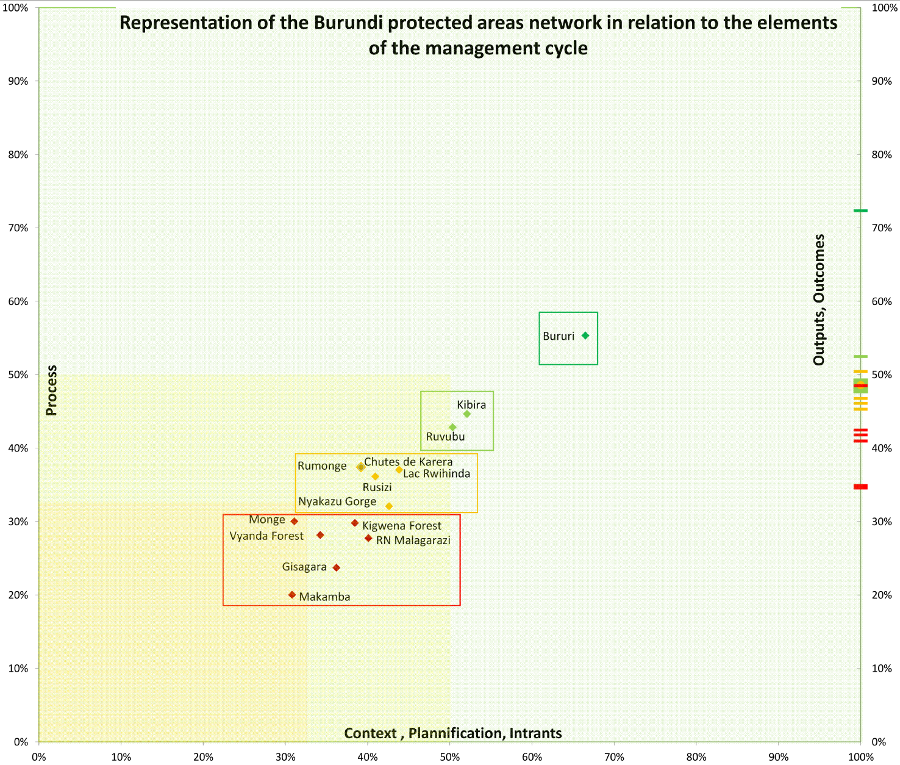
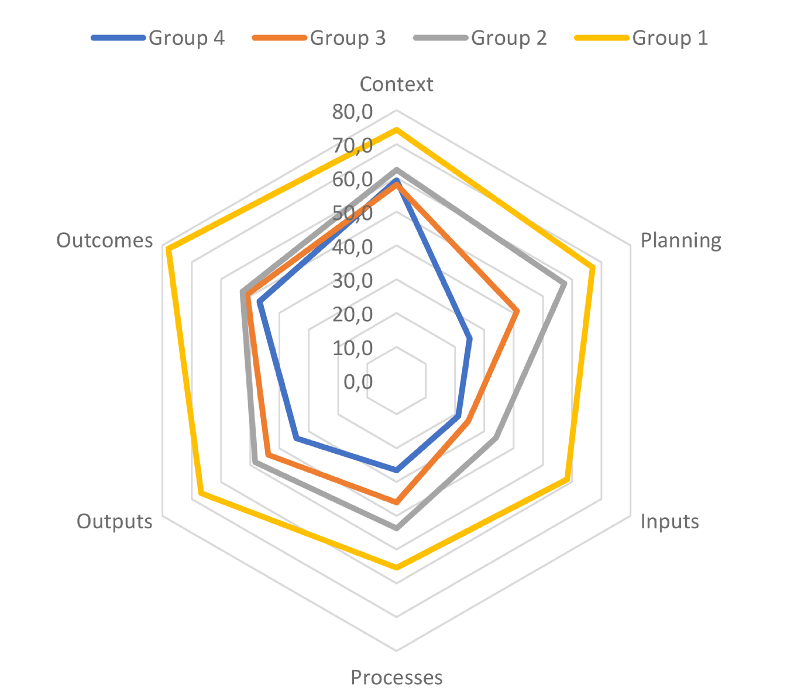
BIOPAMA – IMET, Protected areas framework analysis
BIOPAMA – IMET, Protected areas framework analysis, Aggregation of results, challenges and solutions
Grouping – Burundi
Strategic actions to be undertaken
Reference points for development
IMET
/
Grouping vs ranking
Notes:
DOPA input to the Aichi Target 11 and 12 country profiles and how they were used in regional CBD workshops to support countries

Slide 15
BIOPAMA – IMET, Protected areas framework analysis
BIOPAMA – IMET, Protected areas framework analysis, Aggregation of results, challenges and solutions
Framework – Burundi Actionable guidelines based on grouping exercise
Possible improvement of management within the PAs in Burundi | Group 1 & 2 | Group 3 | Group 4
Refine the analysis to better take into account the potential of the PA and, on this basis, define simple and realistic vision elements and objectives on which management and work plans can be built. | P1 | P2 | P2
Strengthen management skills, mainly for training, aimed at: i. identifying manageable actions, ii. developing a proactive, results-oriented approach iii. internalizing management tools such as: a. planning, monitoring and evaluation b. problem solving, decision making c. prioritization and management with limited resources | FO | P1 | P1
Develop an approach to the management of ecosystem services (knowledge, conservation) to promote: i. the provision of sustainable ecosystem services for people ii. the growth of PAs through the development of environmental education iii. Tourism based on ecosystem services and related to biodiversity | FO | P3 | P3
Strengthen the governance of PAs to: i. improve the management of ecosystem services ii. reduce threats iii. preserve the cultural values of minority indigenous and disadvantaged populations (e.g., pygmies) | FO | FO | FO
IMET
–
Framework analysis and proposals
Legend:
P_Number (1–2–3 in order of decreasing priority) = Priority
FO = Future objective
Notes:
DOPA input to the Aichi Target 11 and 12 country profiles and how they were used in regional CBD workshops to support countries

Slide 17
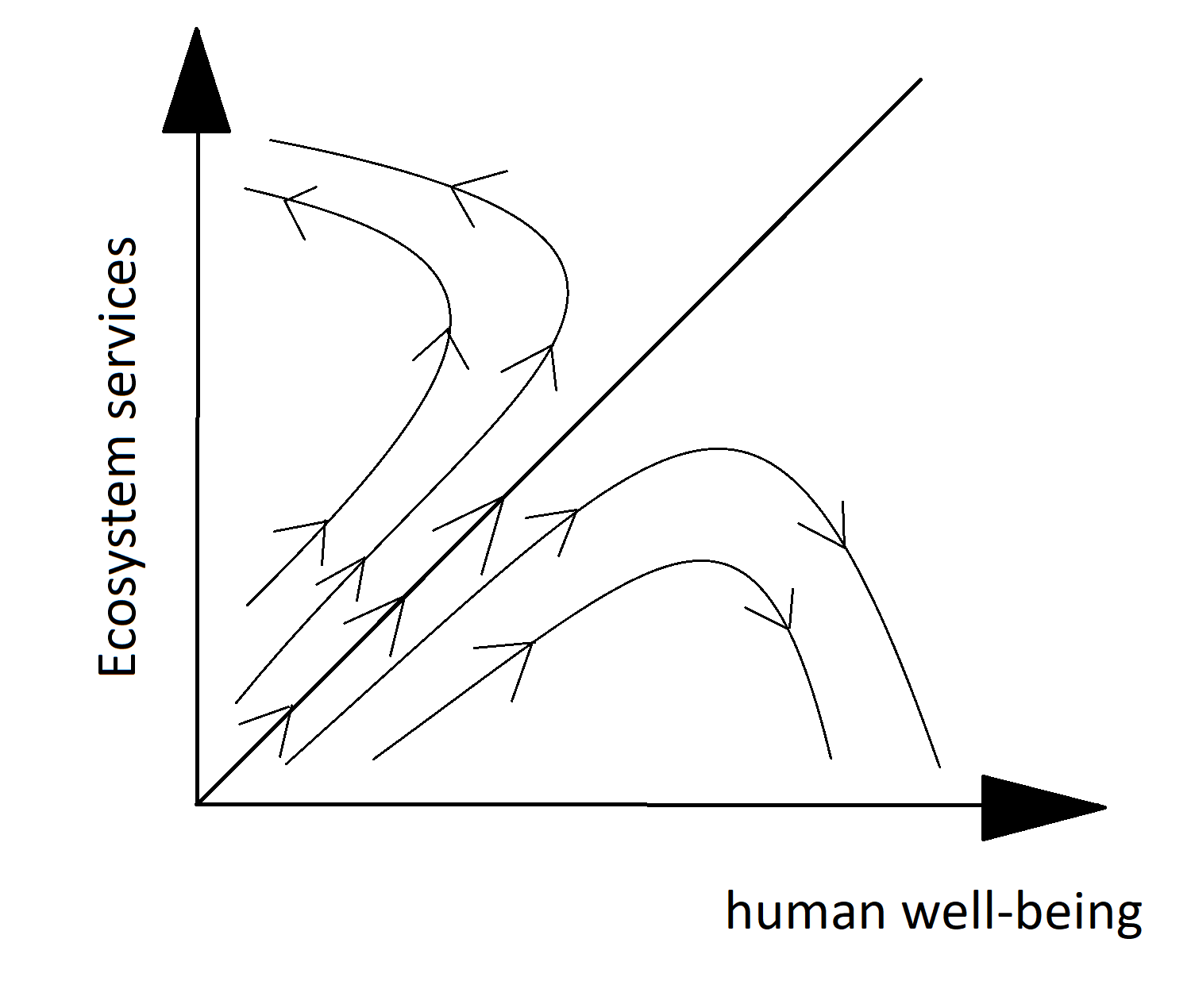
General observation

