Slide 1
L’Observatoire des Forêts d’Afrique Centrale
Quentin Jungers, Florence Palla, Donald Djossi
BIOPAMA - Achieving Fair and Effective Protected Areas
Cogne (Italy), 27th of june 2019

Slide 2
Table of content
Institutional context of the observatory
COMIFAC
CBFP
OFAC
Roles and tasks of the OFAC on the PAs
Data collection, processing, and information flows
Examples at local and national levels
Building an information system (Central African PA portal)
Publications and other tools

Slide 3
Commission des Forêts d’Afrique Centrale (COMIFAC)
« COMIFAC Convergence Plan »
6 priority axes:
Harmonization of forest and environmental policies
Management and sustainable development of forest resources
Conservation and sustainable use of biological diversity
Combating the effects of climate change and desertification
Socio-economic development and multi-stakeholder participation
Sustainable financing
3 transversal axes :
Training and capacity building
Research and Development
Communication, Awareness, Information and Education
♦ Summit of heads of state
♦ Council of Ministers
♦ Presidency-in-Office
♦ Executive Secretary
♦ National coordinations
Institutional arrangements:
COMIFAC is the body for orientation, decision and coordination of sub-regional activities and initiatives in terms of conservation and sustainable management of forest ecosystems
Notes:
La COMIFAC assure le suivi de la Déclaration de Yaoundé
Le Sommet arrête les orientations de l’organisation pour la mise e
COMIFAC is the body for orientation, decision and coordination of sub-regional activities and initiatives in terms of conservation and sustainable management of forest ecosystems
n œuvre des engagements tels que définis par le Traité constitutif.

Slide 4
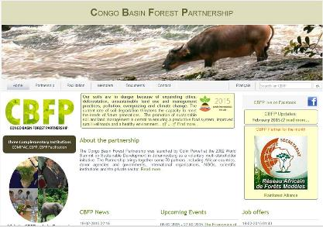
Congo Basin Forest Partnership (CBFP)
www.pfbc-cbfp.org
♦ Volountary multi-stakeholders
♦ Launch in 2002 by Colin Powell at WCDD
♦ Biannual meetings
♦ 100+ members
♦ Partnership management : rotating facilitation
♦ Role :
- Identification and coordination of priority interventions
- Information sharing
- Actions emerging issues
Notes:
Volountary multi-stakeholders
Lancé en 2002 par Colin Powell au Congrès Mondial sur le développement durable à Johannesbourg comme initiative volontaire multi- »stakeholder » (sectoriel). Les membre du partenariat se rencontrent deux fois par an pour coordonner les activités prioritaires, proposer des actions sur les problématiques émergentes et partager l’information avec les partenaires et les réseaux actifs dans la région.
Le PFBC fut iniatiallement facilité par les Etats-Unis en 2003-2004, par la France en 2005-2007, par l’Allemagne en 2008-2010, par le Canada en 2010-2012, à nouveau les Etats-Unis en 2013-2015 et est actuallemment co-facilité par l’Union Européenne et la COMIFAC qui en est le principal bénéficiaire.
Le focus de l’Union Européenne est mis sur la coordination des acteurs et initiatives sur la conservation et le développement durable des écosystèmes forestiers en Afrique Centrale.

Slide 5
Technical and scientific COMIFAC (2011)
10 countries
Based in Yaoundé (COMIFAC) + AT Kinshasa + Italie (JRC) + National Coordinations
Key part of the COMIFAC “Convergence Plan”
=> Ensures the permanent availability of information on forest ecosystems
Notes:
COMIFAC is the body for orientation, decision and coordination of sub-regional activities and initiatives in terms of conservation and sustainable management of forest ecosystems

Slide 6
OFAC’s network
Secteur privé
ONGs
Partenariat des Forêts du Bassin du Congo
Recherche
Public
Tchad
Sao Tome
Principe
Rwanda
Burundi
DATA Base
COMIFAC
RDC
Guinée équatoriale
Donneurs
NU
Congo
Gabon
RCA
OFAC
Cameroun
Technical support
Financial support

Slide 7
Table of content
Institutional context of the observatory
COMIFAC
CBFP
OFAC
Roles and tasks of the OFAC on the PAs
Data collection, processing, and information flows
Examples at local and national levels
Building an information system (Central African PA portal)
Publications and other tools

Slide 8
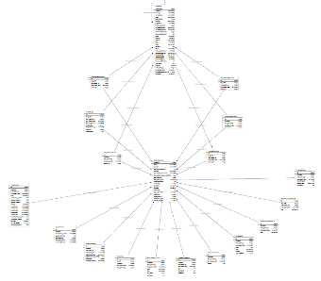
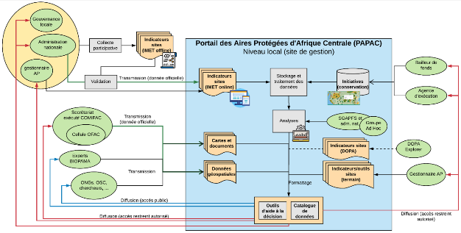
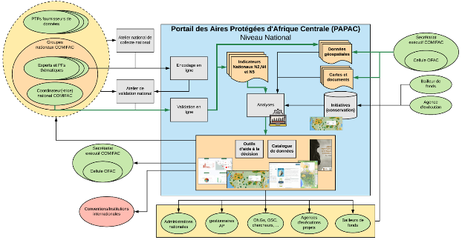
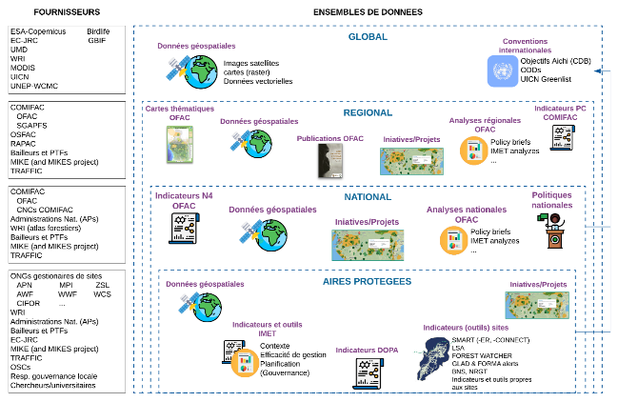
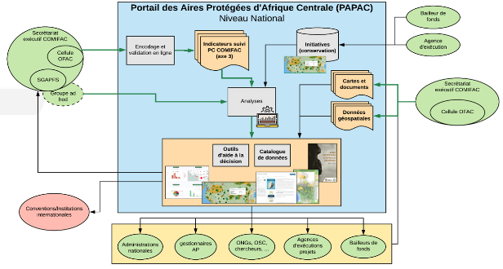
Data collection
Types and sources
Which data? What for ? What sources ?

Slide 9
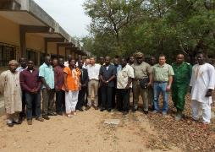
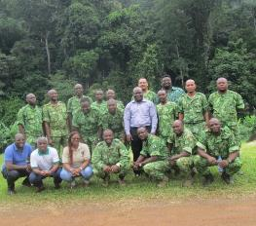
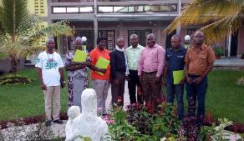
Data collection
Local level (protected areas)
IMET development and field campaigns
Started in 2015, implemented by OFAC with the help of BIOPAMA
2016 : Institutional agreements (COMIFAC-RAPAC-National agencies) – Gabon, DRC, Congo
2017 : automated uploadind tools, data/knowledge sharing with JRC, production of analyzes

Slide 10
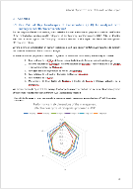
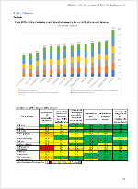
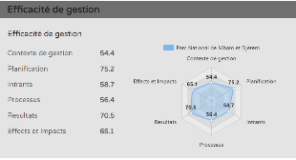
Data collection
Local level (protected areas)
IMET development and field campaigns
2017-2018 : appropriation by NGOs and partners (GIZ, PNUD, WWF, ZSL, AWF, IUCN, …)
Diversification of the needs through understanding
Management plans revision
Analyze transborder issues
Define baselines to evaluate futur actions
Assess management effectiveness
2018 : scaling-up analyzes (Burundi)

Slide 11
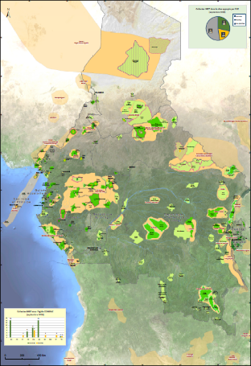
Data collection
Local level (protected areas)
IMET development and field campaigns
2016-2019 :
Progressive engagement of 10 countries
42 validated sites (IMET v1) – 5 countries
17 sites planned (+5 countries)
~15 sites partners
IMET V2 tested in 5 sites

Slide 12
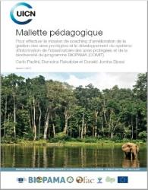
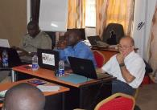
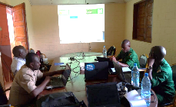
Data collection
Local level (protected areas)
IMET capacity building
16 Coaches
Publication of the COMIT (Coach Observatory Mission Information ToolKit) – FR/EN
Training workshops
First training of 16 IMET coachs in Central Africal (2016)
Regional workshop for PAs managers and institutions (GEQ, RCA, TCD, STP and RWA) (01/2019)
Training of TRIDOM landscape stakeholders (02/2019)
Training of WWF monitoring experts (03/2019)
Training of Chad and BSB landscape stakeholders (03/2019)
CAR national training (03/2019)
DRC national training (03/2109)

Slide 13
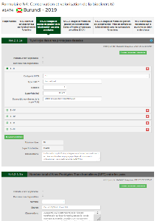
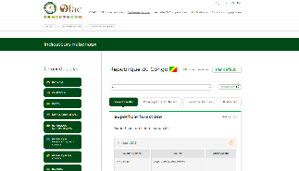
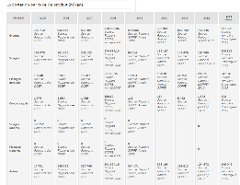
Data collection National level
National forms (indicators)
10+ years of data collection
Iterative process (2008, 2012, 2018, …)
Evaluation national and regional policies on biodiversity conservation and sustainable management

Slide 14
Collecte de données National level
Common workshops sectorial ministries Focal points (CBD, …) Technical and financial Partners
Data identification and collection
Online encoding
Update, corrections and validation by the CNC
Online publication , reports and other publications
Quality control / assessment
Validation workshops
Supervision by CNCs

Slide 15
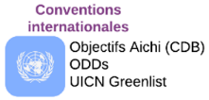
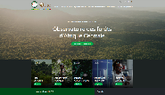
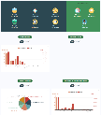
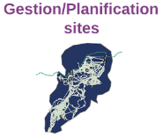
OFAC as
« information broker »
PAPAC

Slide 16
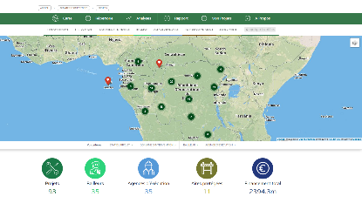
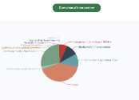
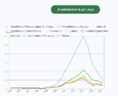
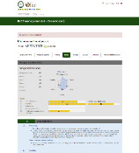
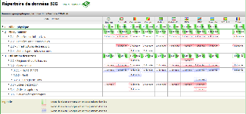
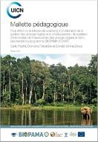
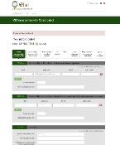
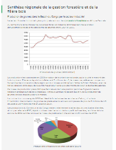
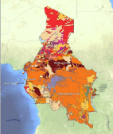
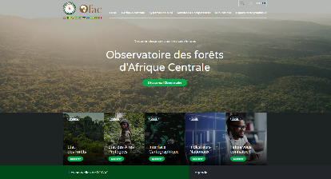
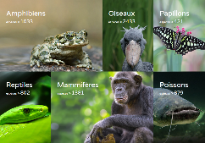
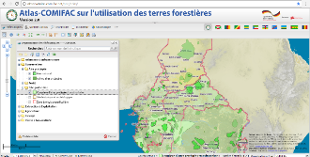
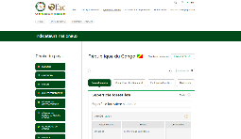
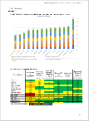
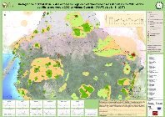
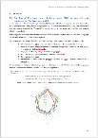
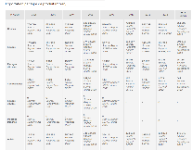
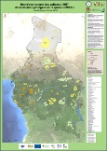
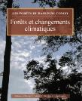
OFAC IS : current tools
Initiatives portal
GIS repository
IMET OFFLINE/ONLINE
Base de connaissances
Geoportal and Land Use atlas
COMIFAC indicators
Thematic analyzes

Slide 17
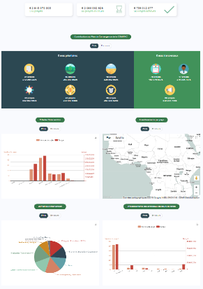
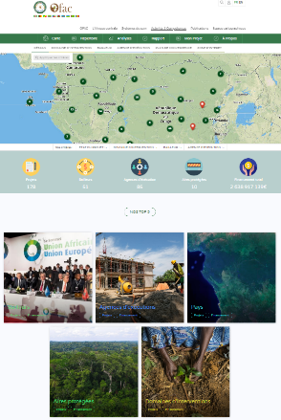
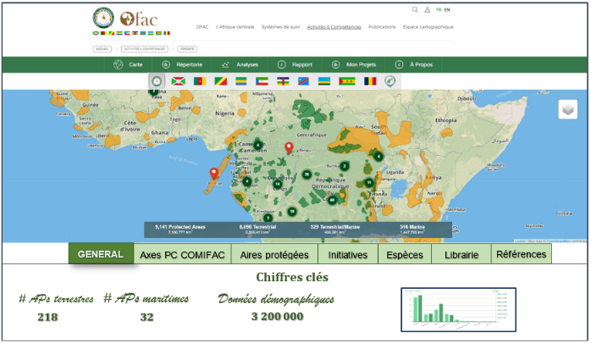
… Towards a dedicated
Protected Areas Portal

Slide 18
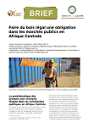
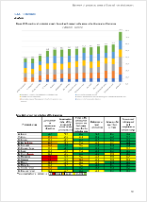
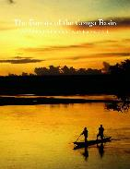
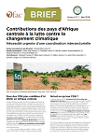
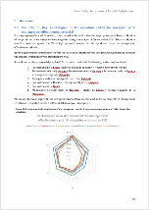
OFAC publications
SoA
2020
Notes:
Slide 2: emphasis on the 2 main final product and the reason why we are focussing on web-applications.

Slide 19
Green list in Central Africa
Next challenges
Papers parcs vs Aichi target 11 vs Green list
Typology of state governance for the majority of PAs in CA : Commitment of the administration / Advocacy to make
Managers turnovers likely to compromise Step 2 of the nomination process (which is based on continuous improvement of management effectiveness) : need for political will

Slide 20
www.observatoire-comifac.net
THANK YOU
for your attention !

