Slide 1
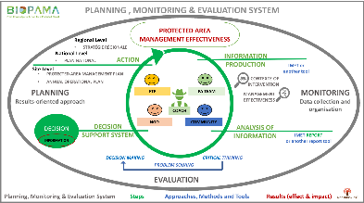
BIOPAMA - IMET
Overview and case studies

Slide 2
Table of Content
IMET – Overview
IMET – Case studies
IMET – Application

Slide 3
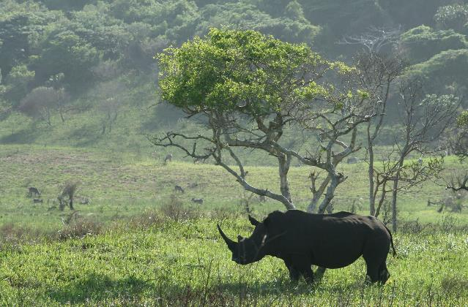
IMET - Overview
Notes:
The divider works as an overlay. To change the images in the background, select the main layer (the top shape) and right click “send to back”. Replace/Change the image. Then click “send to back” on the image you have added.

Slide 4
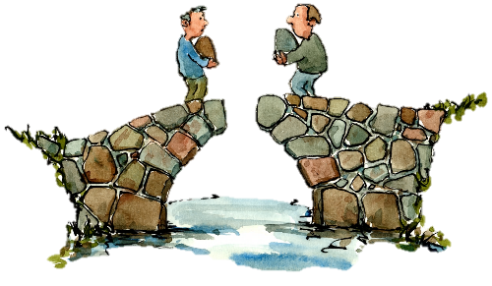
BIOPAMA – IMET Overview
What is it IMET?
IMET
uses (METT, EoH, etc.) and promotes tools (Open standards, Decision support systems, etc.) from other disciplines
is easily customised for each protected area helping future planning, monitoring and evaluation processes
has statistics internal analysis allowing scaling up of common values, elements, etc. supporting specific approaches and strategies at national and regional level.
could be strongly linked with the Regional Observatories allowing for a bottom-up and top-down information flows
OBSERVATORIES
IMET
Notes:
DOPA input to the Aichi Target 11 and 12 country profiles and how they were used in regional CBD workshops to support countries

Slide 5
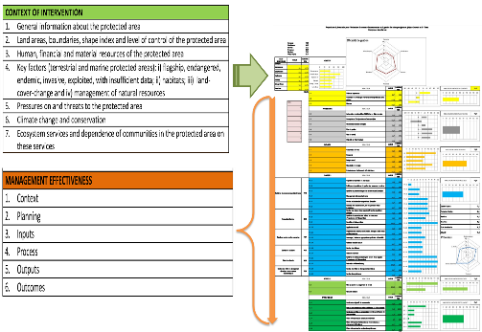
BIOPAMA – IMET Overview
IMET
Embrace a culture of evaluation in which decision-makers use a results –based management/governance for a better conservation planning and monitoring processes
Identify in the context of intervention seven categories of key values and elements of the protected area: key animal species, key plants, habitats, land cover – use – take, threats, ecosystem services and climate change effects
uses information from the digital observatories.
Why integrated tool?
Notes:
DOPA input to the Aichi Target 11 and 12 country profiles and how they were used in regional CBD workshops to support countries

Slide 6
IMET-Case Studies

Slide 7
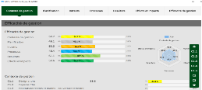
IMET – Cases study 1: Capacity building and coaching
IMET and Capacity building
IMET - Feedback sessions
Analysis prioritising decision-making in managing and planning
Exploitation of IMET in DRC:
PN Virunga, as training in management of protected area
PN Garamba, for training of the staff of M&E
ERAIFT, in masters and nonstop training in critical thinking, problems solving and decision-making for analysis, evaluation and planning on landscape and PA management
IMET - Workshop
Share of information and common discussion on evaluation for PA staff and stakeholders
IMET – On-Site Exercise
Greater understandings of key concept of PA management and evaluation of effectiveness
IMET tool
Notes:
DOPA input to the Aichi Target 11 and 12 country profiles and how they were used in regional CBD workshops to support countries

Slide 8
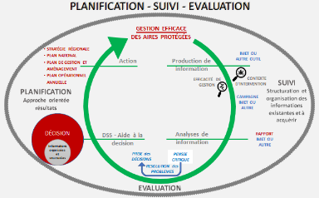
Coaching:
25 + 52 coaches trained in IMET
12 coaches trained in critical thinking, problems solving and decision-making for analysis, evaluation and planning in conservation
IMET – Cases study 1: Capacity building and coaching
IMET and Coaching
Notes:
DOPA input to the Aichi Target 11 and 12 country profiles and how they were used in regional CBD workshops to support countries

Slide 9
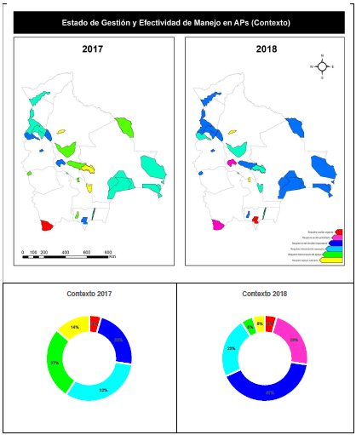
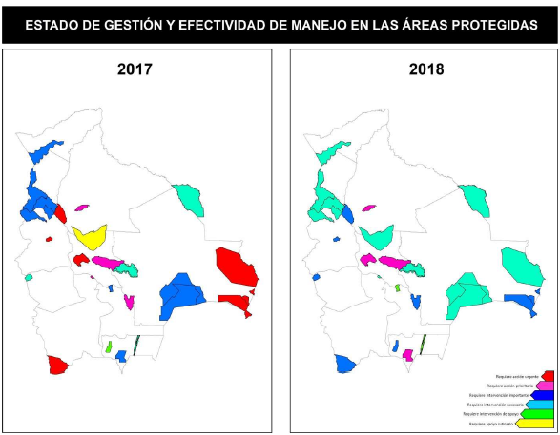
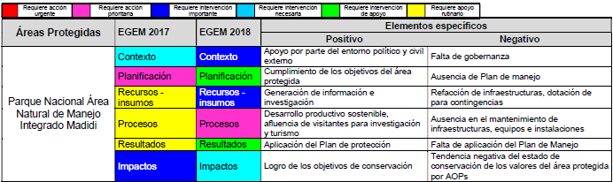
IMET – Cases study 2: Analysis (ex. Bolivia)
Countries analysis :
Burundi
Gabon
Bolivia
Network
RAMPAO in WA
IMET and Analysis
Notes:
DOPA input to the Aichi Target 11 and 12 country profiles and how they were used in regional CBD workshops to support countries

Slide 10
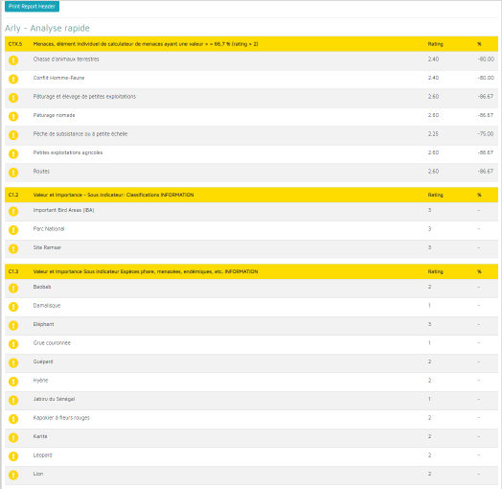
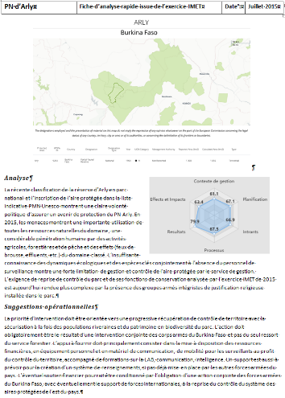
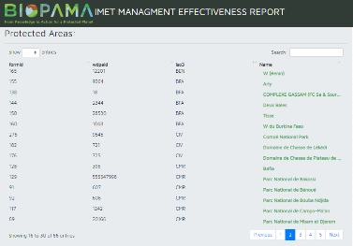
IMET –Case study 3: From evaluation to proposals IMET and the planning-monitoring-evaluation approach)
IMET and PME
IMET and planning:
In DRC elaboration of management plans, working plans, antipoaching plans, etc.
PN Garamba, supporting the management plan 2020-2014
Burundi elaboration of the national strategies on conservation
Notes:
DOPA input to the Aichi Target 11 and 12 country profiles and how they were used in regional CBD workshops to support countries

Slide 11
IMET – Updated application

Slide 12
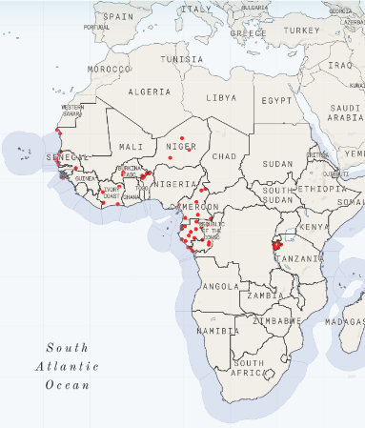
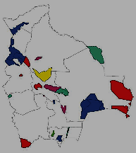
IMET – Application
IMET – Application
Tests 2014 & 2015 : Gabon (6 PAs), DRC (7 PAs), Bolivia 2015 (4 PA)
Implemented after 2016:
Bolivia (25 PAs x 2 times) Burkina-Benin-Niger (7 PAs) Burundi (13 PAs), Cameroon (6 PAs) Congo (5 Pas) Côte d’Ivoire (4 PAs) Democratic Republic of Congo (5 PAs) | Gabon (14 Pas) Guinee Bissau (3PAs) Kenya (1 PAs) Kenya – Uganda (1 PA) Mauritania (3PAs) Niger (3 Pas) Senegal (9 PAs) Tchad & North Cameroon (5 PAs)
Some protected areas use IMET many time
Bolivia
Notes:
DOPA input to the Aichi Target 11 and 12 country profiles and how they were used in regional CBD workshops to support countries

Slide 13
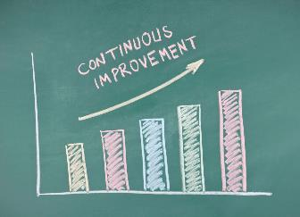
IMET – PERSPECTIVES (Improving Management Effectiveness and more)
To recommend managers, stakeholders, donors, etc. to use data and integrated approach in Planning –Monitoring – Evaluation
From better diagnostic and action to outcomes
Data gap to be addressed:
Stronger focus on specific areas of concern
Capacity building
Linkages with research
Funding
Better knowledge Better use
To use information potentialities (RIS, DOPA, Copernicus services, etc.)
To compare key elements and data for specific analysis from PA to higher level (landscape, framework, regional)
IMET
–
ME and more
data
analysis
capacity
evaluation
Notes:
DOPA input to the Aichi Target 11 and 12 country profiles and how they were used in regional CBD workshops to support countries

Slide 14
IMET – IMET release V2, IMET introduction, use, etc. - Presentation and discussion of case studies
Studio in the building in front the meeting room
IMET evaluation for planning and monitoring in conservation (capacity building and coaching) - elements and case studies: Cameroon/Bertille; Léonidas/Burundi; Omer/Gabon; Domoina/coaching; Carlo/DRC
IMET analysis from local to higher level - elements and case studies : Rodrigo+Rosa/Bolivia; Léonidas/Burundi; Piotr/general analysis
Tuesday June 25th 6,30 pm – 7,30 pm
Wednesday June 26th 8am – 9 am
Thursday June 27th 8am – 9 am;
12,30am – 1,30 pm (at lunch)
6,30 pm – 7,30 pm
IMET
–
Release,
Use
Case studies
Notes:
DOPA input to the Aichi Target 11 and 12 country profiles and how they were used in regional CBD workshops to support countries

Slide 16
BIOPAMA – IMET Overview
IMET and Green List
IMET can support the Green List Standards by:
identifying values and elements in the intervention context
prioritising key element of management or governance (the last one for few elements)
supporting monitoring and planning for a better achievement of outputs and outcomes
picking out common elements from a scaling-up analysis
Waiting the decision on the matrix for the clinic section
Notes:
DOPA input to the Aichi Target 11 and 12 country profiles and how they were used in regional CBD workshops to support countries

