Slide 1
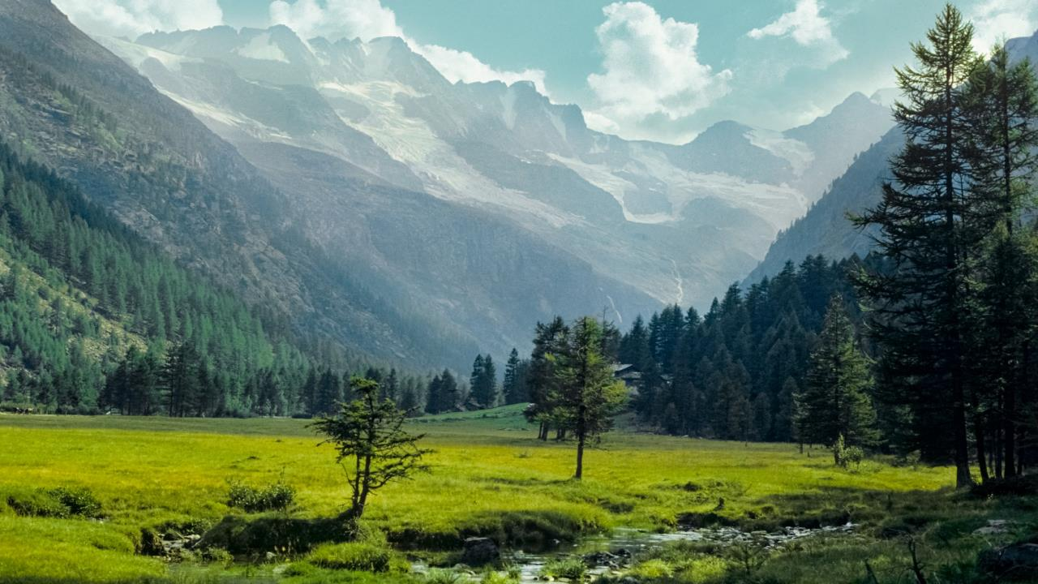
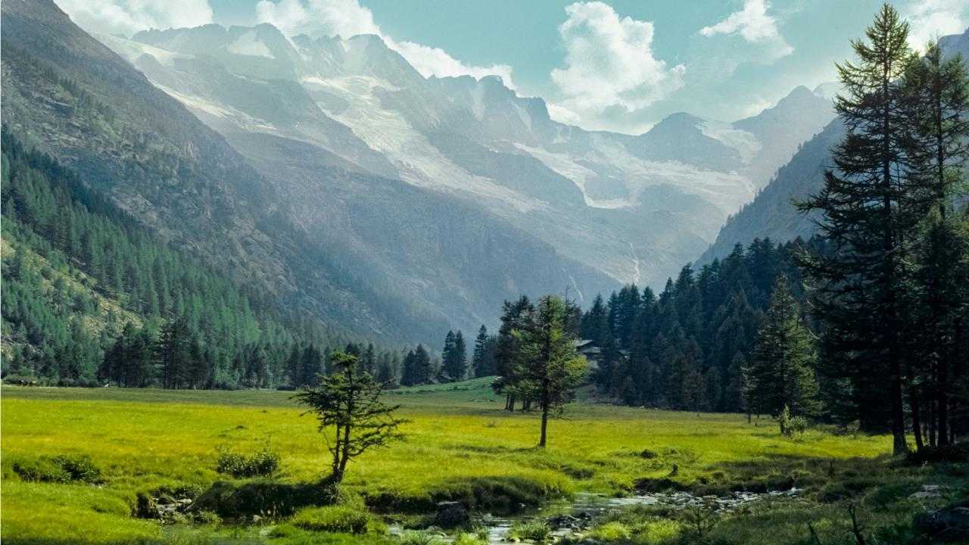
THE GRAN PARADISO NATIONAL PARK
A short overview
© PNGP
Antonio T. MINGOZZI (GPNP director)

Slide 2
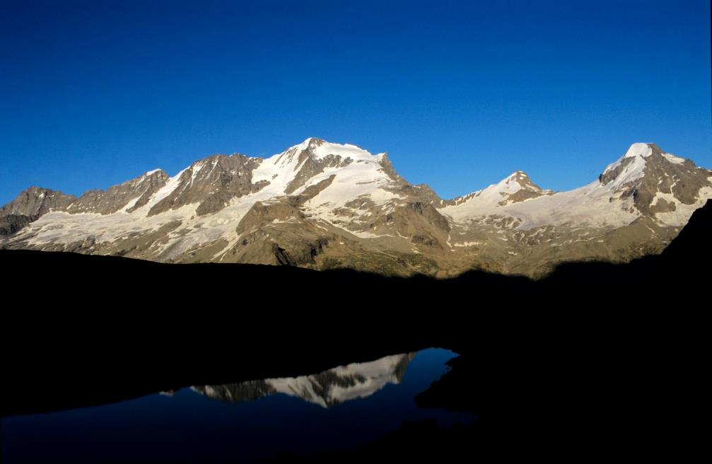
The «Great Paradise»
The Gran Paradiso Massif (4,061 m asl), the only 4,000 m totally included in the Italian territory.

Slide 3
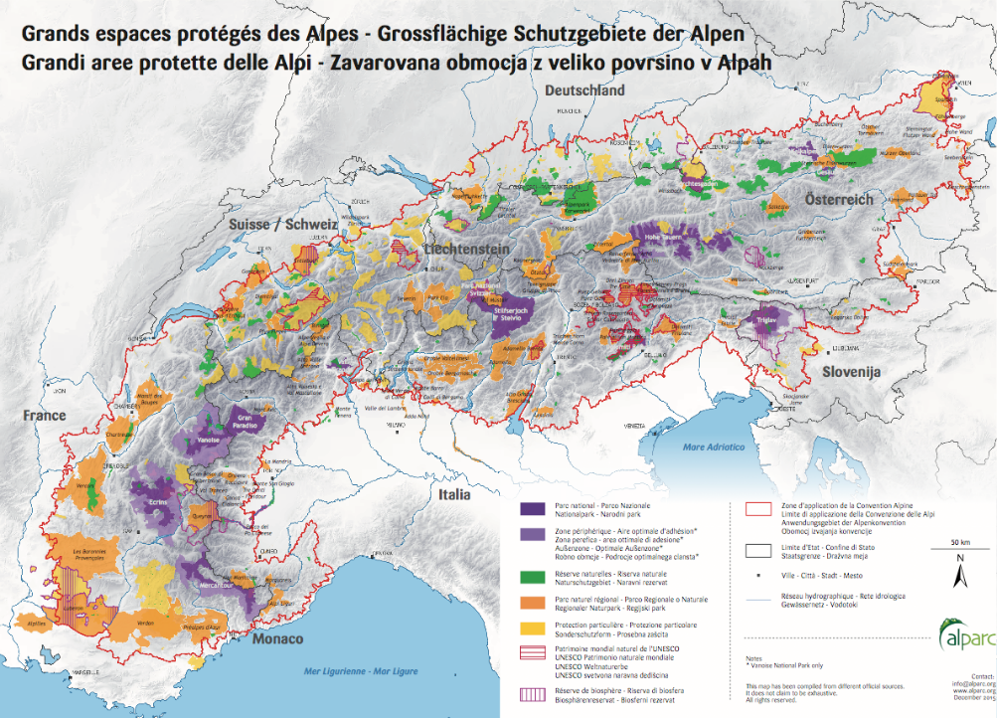
Where we are?
The GPNP is located in the Western Alps.

Slide 4
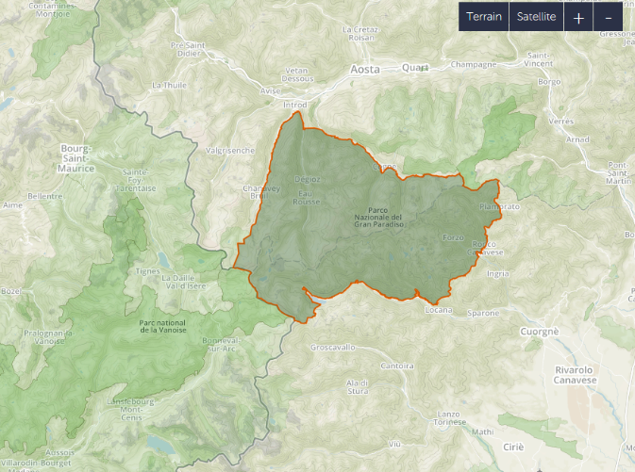
Where we are?
The park spans in a similar way over two Italian regions (for an overall extension of about 710² km)
The Gran Paradiso and the Vanoise NP (Savoie, F) border for 14 km.
Aosta Valley (I)
Savoie (F)
The two NP represent one of the largest PA of Western Europe (about 1250² km).
Piedmont (I)

Slide 5
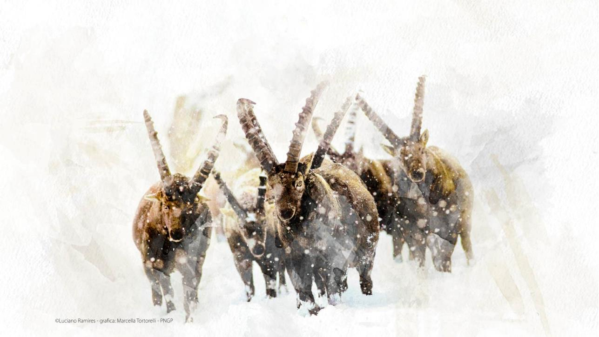
The ibex Capra ibex is the icon species for the Park.
There is good reason…

Slide 6
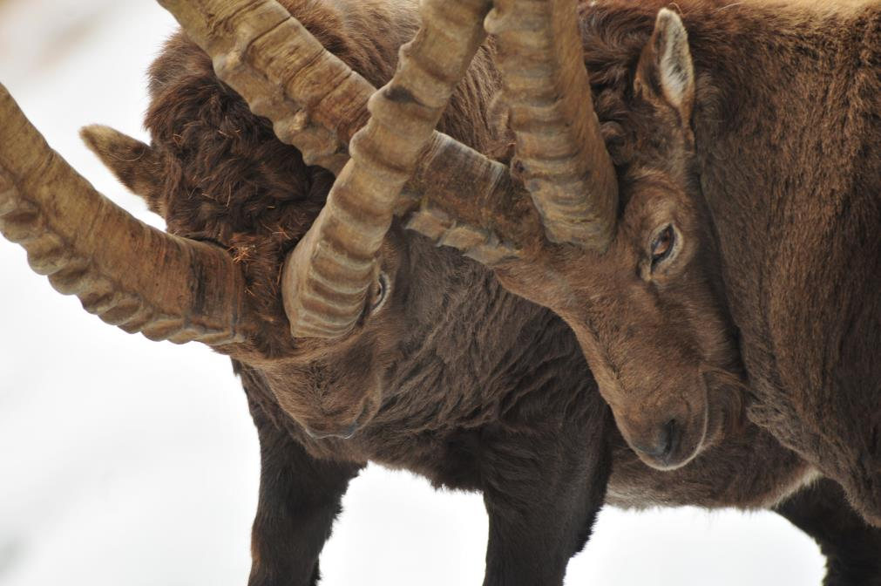
Park creation
Originally, the park was one of the game reserves of the Royal House of Savoy (Kingdom of Sardinia)
At the beginning of the ‘800s,
the ibex was on the brink of extinction.
No more than 100 animals
were still surviving in the Gran Paradiso Massif in 1821

Slide 7
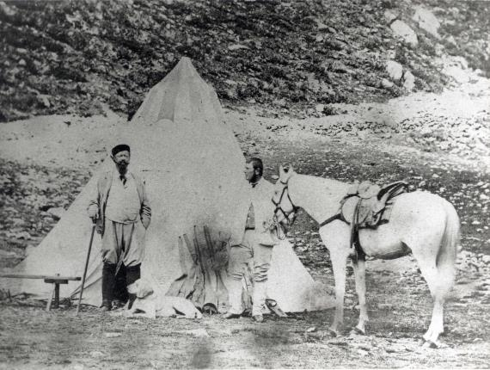
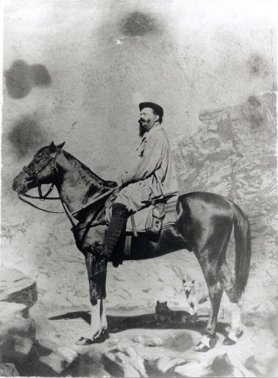
Park creation
At that time, the Park was a hunting reserve
of the Royal House of Savoy (Kingdom of Sardinia).
King Victor Emmanuel II, “le roi chasseur”.

Slide 8
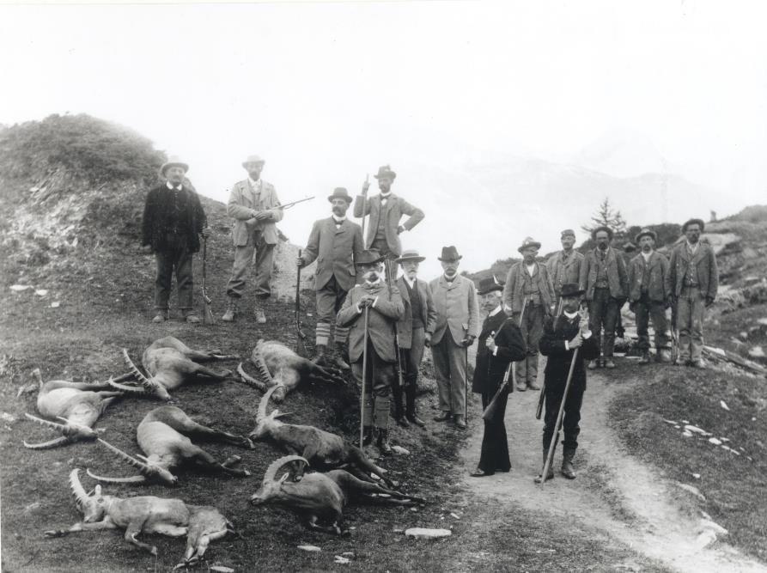
Park creation
The historical documents show how the massacres
continued until 1913.

Slide 9
Park creation
On December 3, 1922, Gran Paradiso became the first Italian National Park:
“In order to preserve the fauna and flora and to preserve the special geological formations, as well as the beauty of the landscape, the lands included in the actual Gran Paradiso Hunting Reserve are declared National Park, whose boundaries are those indicated in the annexed map.”
(as enshrined in Royal Law December 3, 1922, n. 1584, par. 1)
1922 (2022)… so we're getting closer to our centennial!

Slide 10
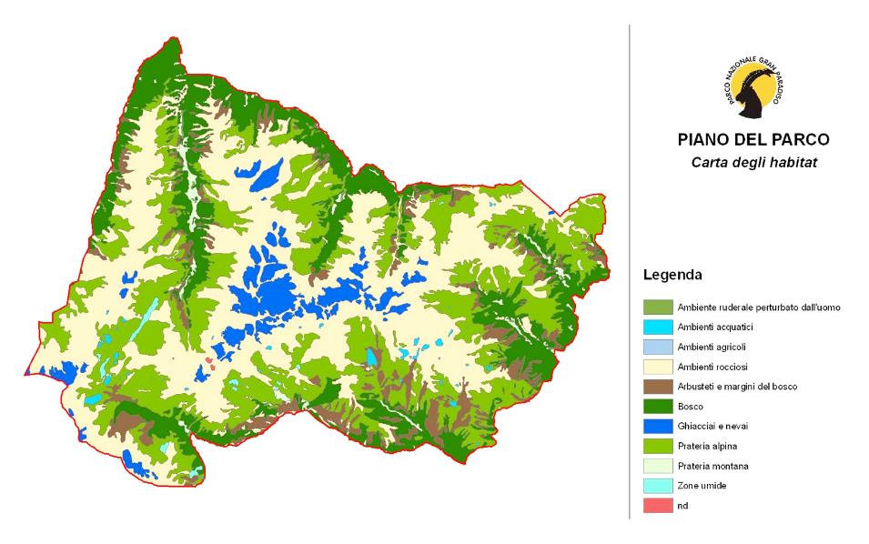
Natural features
Altitudinal range: 800 - 4061 m asl (average altitude: about 2400 m)

Slide 11
Natural features
Rocks, moraines, glaciers = 62%
Pastures, grasslands = 17%
Woods, shrubs = 20%
Cultivated and urbanized areas = 0.8%

Slide 12
Mission
The Park aims to:
Preserve biodiversity and uniqueness of the natural heritage
Promote scientific research
Promote education and environmental awareness
Preserve historical and cultural heritage
Promote sustainable tourism

Slide 13
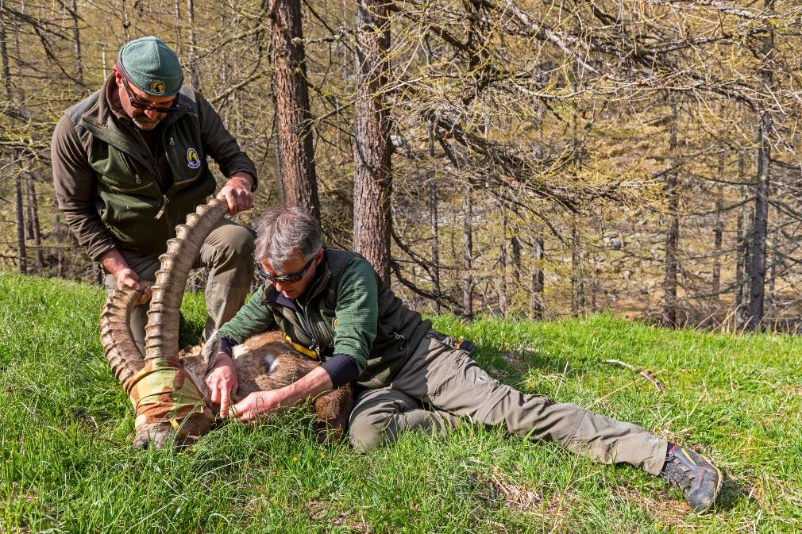
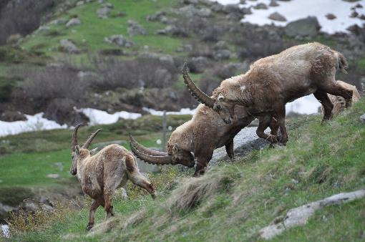
Park Staff
At present, the park's staff includes 76 people (25 officers and 50 park guards)
Since 1947, a unique and very special body of park guards.

Slide 14
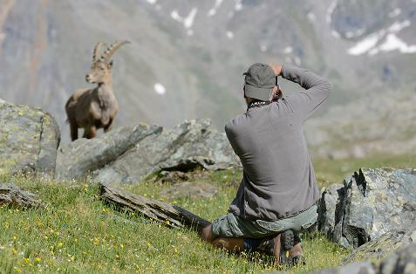
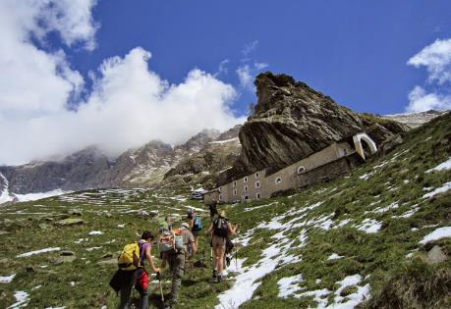
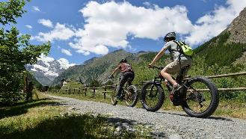
Tourism
The park is a favorite destination for a number of visitors
with various interests.

Slide 15
Tourism
Some estimates:
is the average annual visitors in the Park according to IRES (Institute for Economic and Social Research) estimates.
1,800,000
are the visitors calculated (May to October 2015) through “Big Data” (Vodafone service provider), with respect to only the Aosta Valley side.
690,000
356,000
overnight stays per year

Slide 16
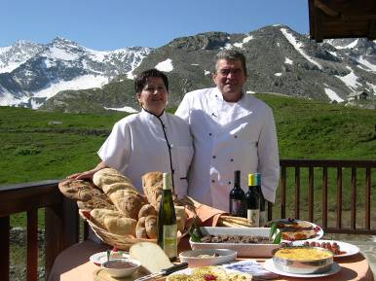
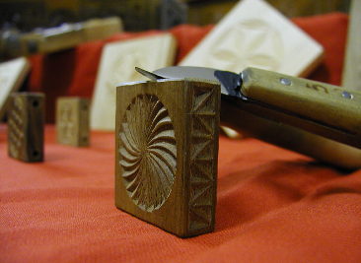
The Quality Label Gran Paradiso
Promoting the Park Quality Label
for local food producers and craftsman
54 operators
(from 2010 to the present)

Slide 17
Acknowledgements
The Park achieved some important acknowledgement
in recent years.
2007
2012
2014
European Diploma of Protected Areas
EMAS registration
IUCN Green List

Slide 18
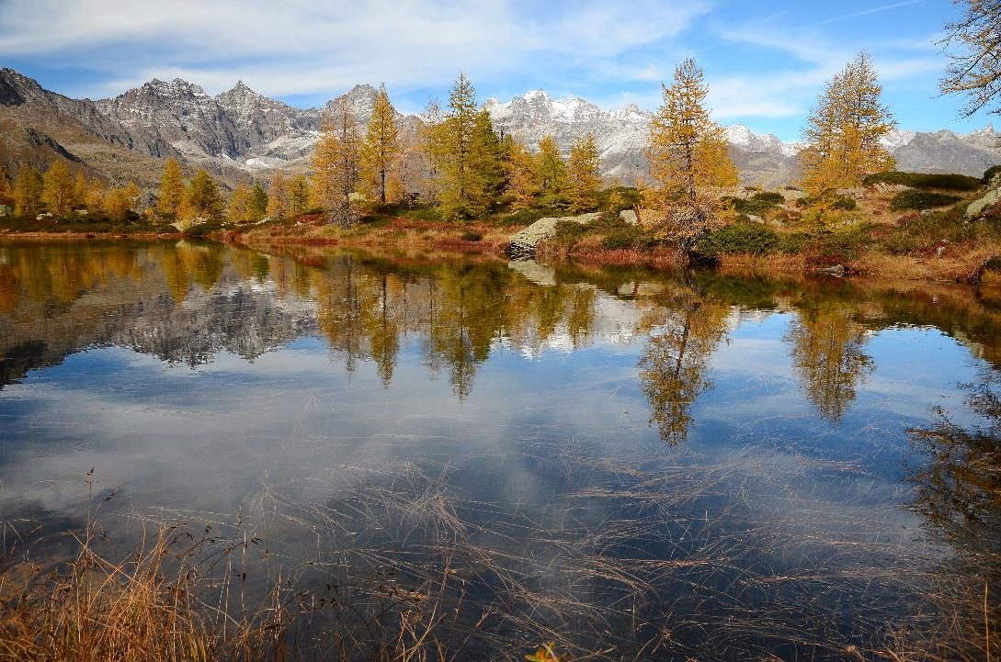
Thanks for your attention!
www.pngp.it
antonio.mingozzi@pngp.it
© L. Genin

