Slide 1
Achieving Fair and Effective Protected Areas Workshop
COGNE, 24 – 28 June 2019

Slide 2
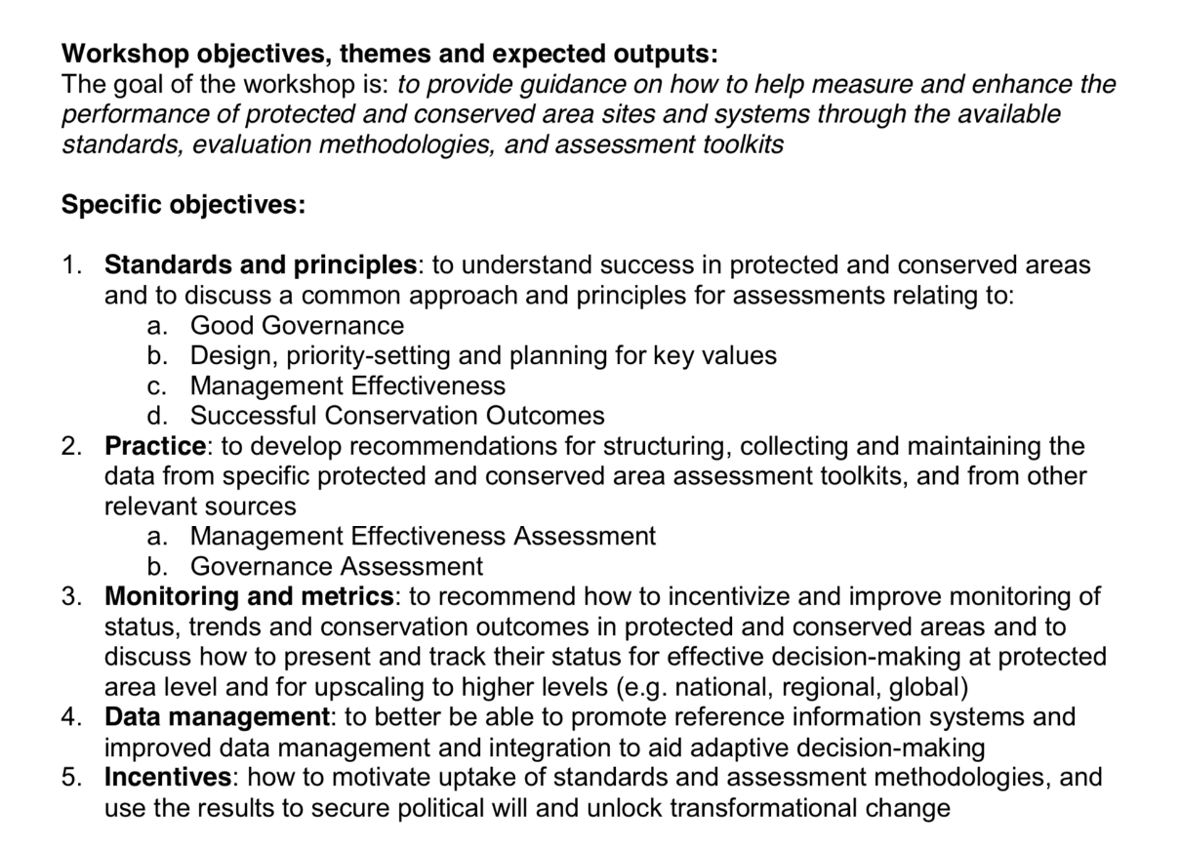
Achieving Fair and Effective Protected Areas Workshop
COGNE, 24 – 28 June 2019

Slide 3
Achieving Fair and Effective Protected Areas Workshop
COGNE, 24 – 28 June 2019
Day 1- Keynote, Introduction, Group Dinner
Day 2- Introducing the substance, experiences
Day 3- 5 x Breakout sessions AM/field trips PM
Day 4- Breakouts continue, Group Dinner
Day 5- Taking stock of results, way forward

