Slide 1
Achieving targets by 2020 and beyond
TREVOR SANDWITH
IUCN GLOBAL PROTECTED AREAS PROGRAMME

Slide 2
Quantitative and qualitative outcomes:
Aichi Target 11:
At least
17 % of terrestrial and inland water, and
10 % of coastal and marine areas,
especially areas of particular importance for biodiversity and ecosystem services, are conserved
through effectively and equitably managed,
ecologically representative and well-connected systems of protected areas, and
other effective area-based conservation measures,
and integrated into the wider landscape and seascape.
Notes:
The good news: conservation works! When we try, targeted action is successful; At species, ecosystem and genetic level

Slide 3
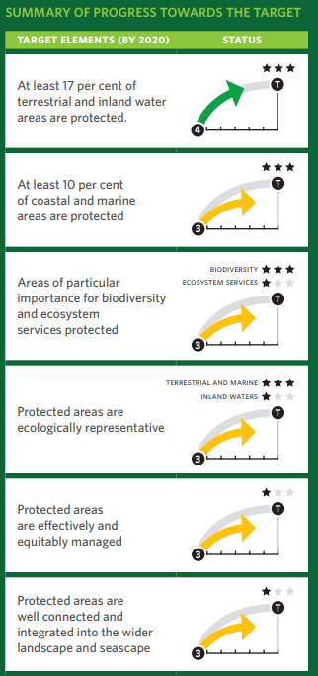
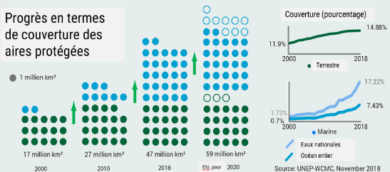

Slide 4
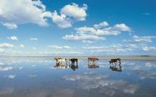
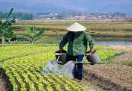
Status, gaps and opportunities
1400 National Priority Actions
(road maps)
The CBD’s Phase 1 Strategy to facilitate implementation of Target 11 by 2020

Slide 5
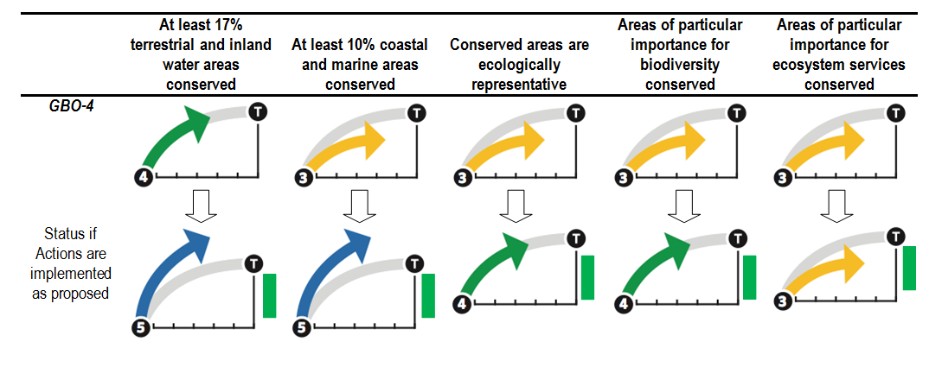
Summary of the estimated change in Target 11 component achievement by 2020 as a result of commitments and priority actions versus GBO4 outlook (2014)

Slide 6
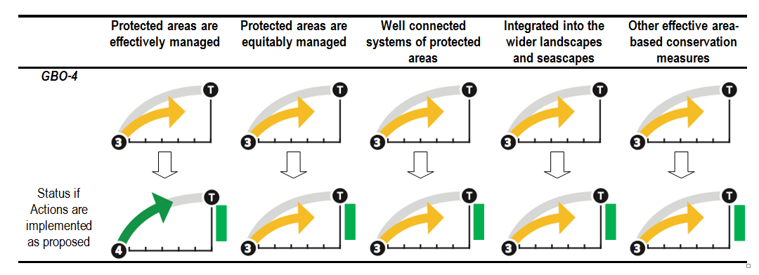
Summary of the estimated change in Target 11 component achievement by 2020 as a result of commitments and priority actions versus GBO4 outlook (2014)

Slide 7
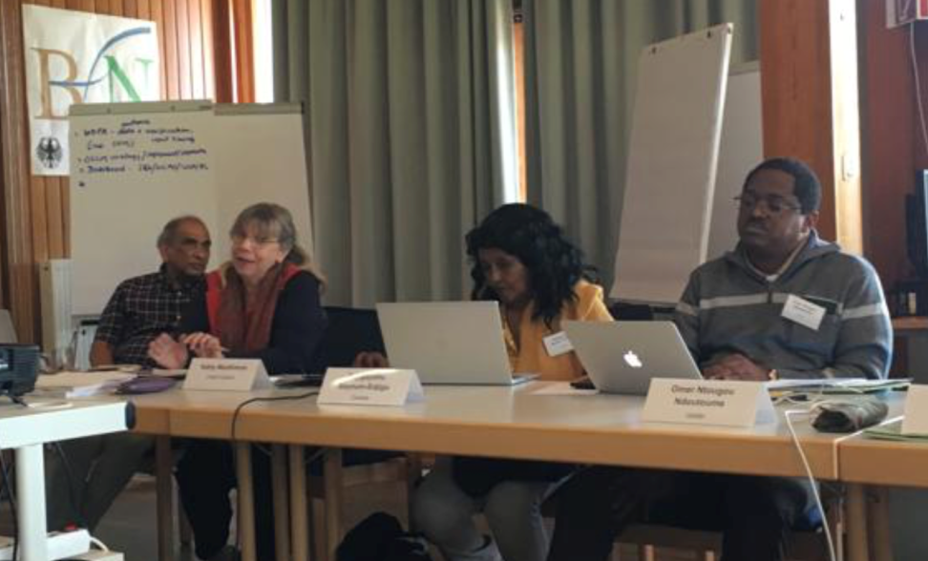
The CBD’s Phase 2 Strategy to facilitate implementation of Target 11 by 2020
CBD Workshop 24-25 April 2019 Omer Ntougou Ndoutoume representing the region

Slide 8
The CBD’s Strategy to facilitate implementation of Target 11 by 2020
Clear knowledge and identification of what needs to be done between now and 2020
What actions need to be taken to get there?
Putting these actions into place
Terrestrial PA coverage
Marine PA coverage
Ecoregion representation
KBA coverage
Connectivity index
PAME Assessments
National priority actions
GEF projects
OECMs

Slide 9
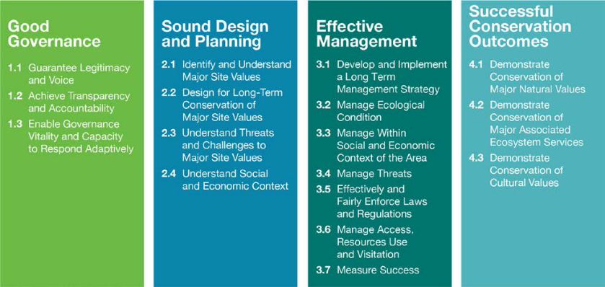
The IUCN Green List Global Standard
Notes:
Application of IUCN Best Practices
Application of IUCN Knowledge Products

Slide 10
especially areas of particular importance for biodiversity and ecosystem services ….
2.1 Identify major site values
2.2 Design for long-term conservation
2.3 Understand threats and challenges
2.4 Understand social and economic context

Slide 11
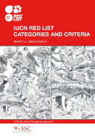
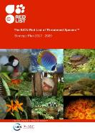
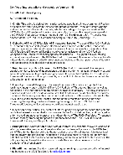
The IUCN Red List of Threatened Species™
Coverage
Contains assessments for 91,523 species.
By 2020 it contains 160,000 species so that The IUCN Red List becomes a ‘Barometer of Life’

Slide 12
KBA Partnership and Standards
First time conservation community has agreed on a common approach to identifying sites
Identification of the most important sites globally for conservation
Sites that make significant contributions to the global persistence of biodiversity
Notes:
The consultations led to the publishing of “A Global Standard for the Identification of Key Biodiversity Areas” in 2016 which describes the standards and criteria to identify KBAs

Slide 13
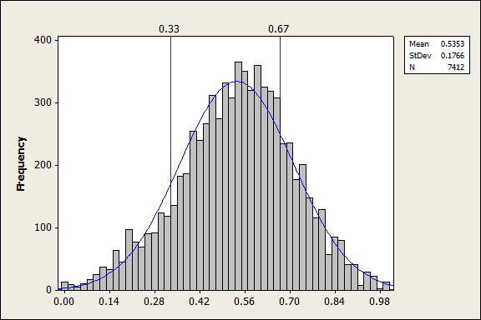
… effectively managed ….
3.1 Long-term management plan
3.2 Manage ecological conditions
3.3 Manage within social and economic context
3.4 Manage threats
3.5 Effectively enforce laws
3.6 Manage access and use
3.7 Measure success

Slide 14
The IUCN - WCPA
PAME Framework

Slide 15
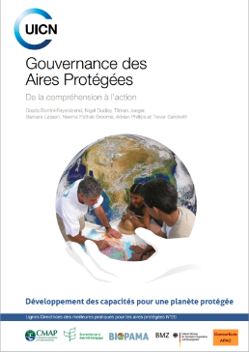
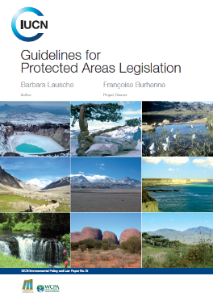
…. equitably managed ....
1.1 Guarantee legitimacy and voice
1.2 Achieve transparency and accountability
1.3 Enable governance vitality and capacity to respond adaptively

Slide 16
Governance diversity: 4 governance types
Type 1
Governance by single sector entity/government
Type 2
Governance by Indigenous peoples and communities
Type 3
Type 4
Shared governance
From national to local levels
Private governance
Land owners, NGOs, religious groups, for-profit entities..
Transfrontier, multi party governing bodies
(e.g. ICCAs)
Notes:
The IUCN and the CBD recognises four legitimate types of governance that are fully compatible with the definition of protected area by CBD or IUCN

Slide 18
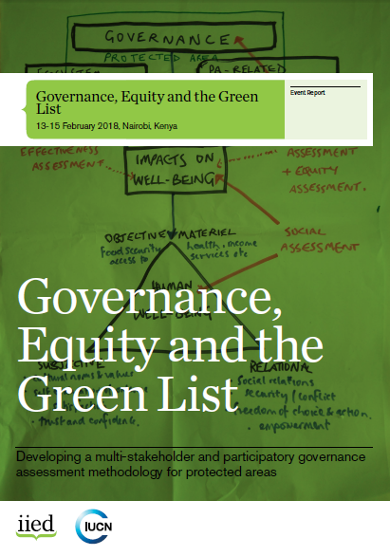

Slide 19
Other effective area-based conservation measures
Autre mesure de conservation efficace par zone » signifie « une zone géographiquement délimitée, autre qu’une aire protégée, qui est réglementée et gérée de façon à obtenir des résultats positifs et durables à long terme pour la conservation in situ de la diversité biologique, y compris des fonctions et services écosystémiques connexes et, le cas échéant, des valeurs culturelles, spirituelles, socioéconomiques et d’autres valeurs pertinentes localement
A geographically defined area other than a Protected Area, which is governed and managed in ways that achieve positive and sustained long-term outcomes for the in situ conservation of biodiversity, with associated ecosystem functions and services and where applicable, cultural, spiritual, socio–economic, and other locally relevant values

Slide 20
PAs
Primary objective is conservation
OECMs
Outcome is conservation even if objective is something else

Slide 21
SPECTRUM OF OECMs
Other effective area-based conservation measures
Achieves the in situ conservation of biodiversity
Less intention to conserve biodiversity
More intention to conserve biodiversity
Ancillary
- ‘No-disturbance’ areas
Secondary
- Areas that are protected through very low-impact use
- Watershed protection areas
- Medicinal plants sustainable use areas
Primary
- ICCAs or privately governed areas with a primary conservation objective…
... but the governance authority is unable to secure PA designation or prefers not to be recognised as a PA
- Sacred natural sites
- Military areas
- War graves

Slide 22
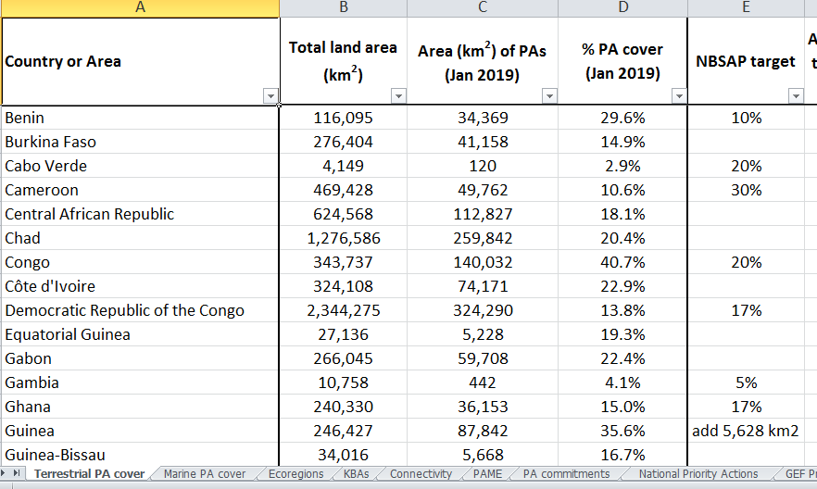

Slide 24
2020 is a Policy Super Year
IUCN WCC
Renewal’ of the Strategic Plan for Biodiversity
COP15, China, 2020
Agenda 2030 integration
Unparalleled opportunity to secure life support system of the planet
Notes:
5 things happening

Slide 25
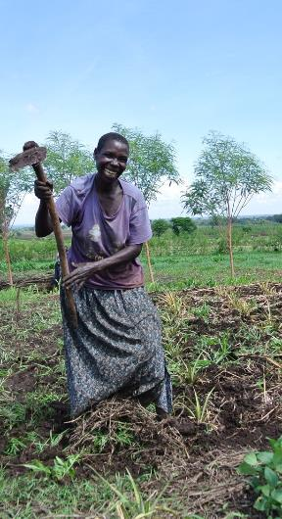
Five Strategic Goals
Tackling the underlying causes of biodiversity loss
Alleviating the direct pressures
Improvement of biodiversity status
Enhancing benefits to all
Supporting implementation of responses
Align with Drivers, Pressures, State, Impacts, Responses framework
Robust and coherent; buy in
Transformational change is required to achieve them
Notes:
The new 2030 Mission:
• Such a Mission needs to be able to be disaggregated nationally and sectorally (into targets and commitments).
• Success will depend on contribution of state and non-state actors. Specific science-based targets for individual sectors are needed in ways that “add up” to the overall Mission.
• Above all, the Mission must express necessity as well as feasibility.
Current Mission is too long and unmemorable
A new and simple Mission for 2030 (to link to the 2030 Agenda) is essential to galvanise the action necessary to deliver the 2050 Vision of Living in Harmony with Nature (equivalent of the 2°C/1.5°C temperature rise cap agreed under Paris).
IUCN is working on some options for a new Mission
Such a Mission needs to be able to be disaggregated nationally and sectorally (into targets and commitments).
It must be measurable (e.g. by focusing on biodiversity: species, ecosystems, genetic diversity) and could include the phrase “contributing to achievement of all Sustainable Development Goals”.
Unlike the current Mission (long and unmemorable), a new Mission should be a ‘call to action: ambitious, succinct, specific, forward looking, action-oriented, bold, communicate why this matters to people and quotable!
Success will depend on contribution of state and non-state actors. Specific science-based targets for individual sectors are needed in ways that “add up” to the overall Mission.
Current Mission 2020: Take effective and urgent action to halt the loss of biodiversity in order to ensure that by 2020 ecosystems are resilient and continue to provide essential services, thereby securing the planet’s variety of life, and contributing to human well-being, and poverty eradication;
To ensure this, pressures on biodiversity are reduced, ecosystems are restored, biological resources are sustainably used and benefits arising out of utilization of genetic resources are shared in a fair and equitable manner; adequate financial resources are provided, capacities are enhanced, biodiversity issues and values mainstreamed, appropriate policies are effectively implemented, and decision-making is based on sound science and the precautionary approach.

Slide 26
Post-2020 global ‘Aichi’ targets for 2030
Measurability of all targets to be improved
Science-based
Address commitment gaps (necessary action not encapsulated in a target)
Implementation gaps (target not implemented)
Targets should have clear outcomes that demonstrably contribute to 2030 Mission (and SDGs), and 2050 Vision
Current targets have buy in; gaps
Better articulate benefits to people
Notes:
JS: i.e. targets need to speak to the Mission;
CPP: Achievable and implementable not too ambitious
The term “science-based targets” is being used in widely different ways, which is generating substantial confusion.
Setting targets for addressing major planetary concerns is an essential pre-requisite for concerted global action (both inside and outside multilateral environmental agreements) and is necessarily a societal and political process, requiring negotiation and convergence among often-conflicting interests (Maxwell et al. 2015).
There is no such thing as a “scientific target” – targets are socio-political choices.
Key highlights:
Understand what “science-based” means in relation to “science-based targets”, and to differentiate between “overall science-based targets” and “specific science-based targets”
Characteristics:
For a target to be science-based, it must be theoretically achievable.
The target should be quantified, such that progress towards it is measurable.
The target should be supported by a clear, analytical rationale for why the target is set at this particular level.

Slide 27
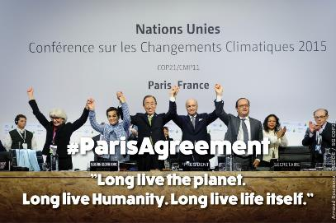
Voluntary commitments: beyond States
Analogous to UNFCCC COP21, Paris (Action Agenda)
Voluntary biodiversity commitments to COP15
Huge opportunity for business, cities…
‘Global stocktakes’ to monitor progress: to enable countries (and non state actors) to ‘ratchet up’

Slide 28
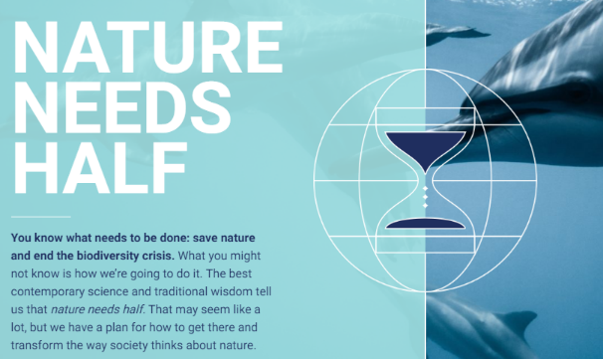
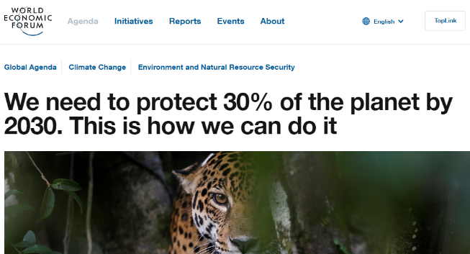

Slide 29
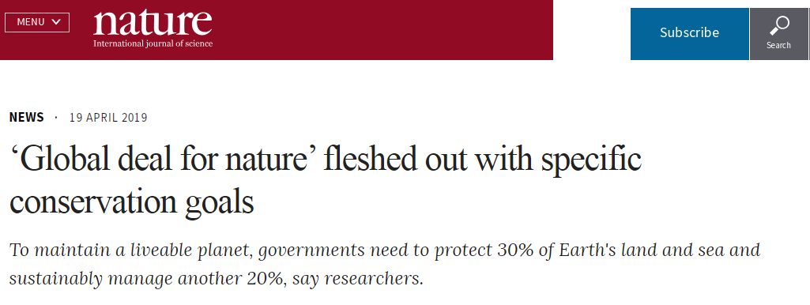
This week in Nature:
“To maintain a liveable planet, governments need to protect 305 of Earth’s land and sea and sustainably manage another 20%”

Slide 30
BIOPAMA can make a significant contribution
MercI pour Votre Attention

