Slide 1
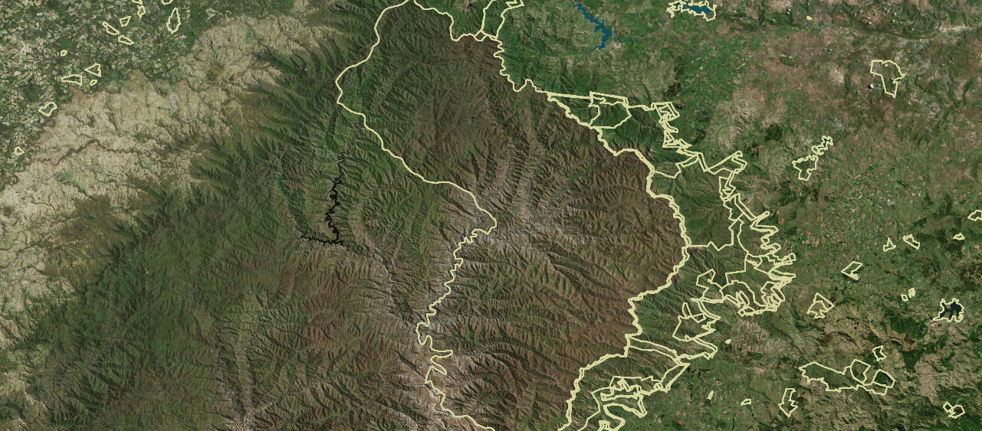
BIOPAMA Phase 2
Information Tools for Protected Areas
Steve Peedell
European Commission
Joint Research Centre (JRC), Directorate for Sustainable Resources
European Commission
Joint Research Centre

Slide 2
    JRC – the European Commission Joint Research Centre
"
As the science and knowledge service
of the Commission our mission is to support
EU policies with independent evidence
throughout the whole policy cycle
"
Science supporting policy
Knowledge driving decisions
World leader in geospatial applications for policy

Slide 3
JRC Objectives
Standardised tools, indicators and metrics on protected areas globally – Digital Observatory of Protected Areas
Delivered as web services and specific tools like DOPA Explorer
A dedicated information system focused on the protected areas of Africa, Caribbean, Pacific– BIOPAMA Reference Information System
Regional systems, within operational observatories
A comprehensive approach to the issues of protected area management effectiveness and governance
Bringing the results of these systems closer to the decision making process, at all levels
https://dopa-explorer.jrc.ec.europa.eu/
http://rris.biopama.org/
http://geonode-rris.biopama.org/ https://pipap.sprep.org/ https://www.observatoire-comifac.net/

Slide 4
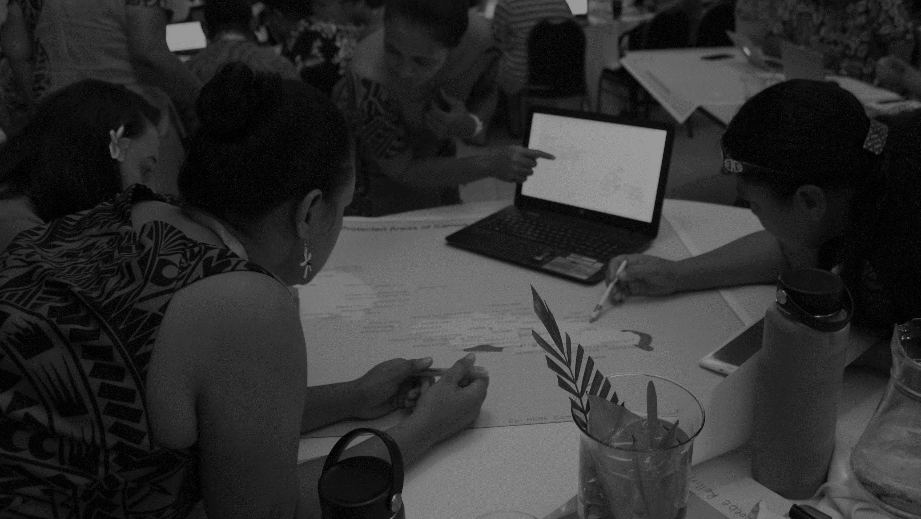
Make the link between biodiversity and development
Provide evidence of progress towards targets
Improve knowledge of what works and doesn’t work in PA management
Support, train and learn from PA practitioners in the ACP regions
Show how geospatial technology can make a genuine difference
Prove that better data leads to better decisions
Build partnerships that last and that have impact

Slide 5
DOPA – Global Scale
Global metrics and indicators for protected areas based on harmonised reference datasets
Open source and open services
Used as a data source for BIOPAMA
https://dopa-explorer.jrc.ec.europa.eu/

Slide 6
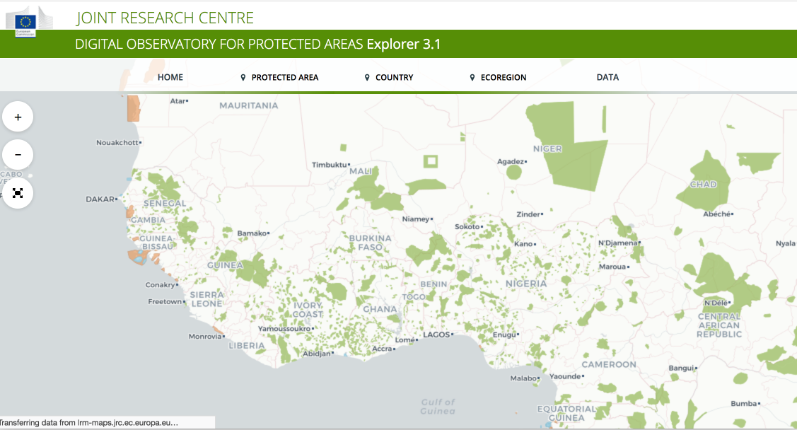
Digital Observatory of Protected Areas
>400 metrics, 30000 PAs, >25km2, 95% coverage Globally
Notes:
DOPA is a global system but also fundamental in providing robust comparable data for ACP
Metrics are endorsed by CBD, being discussed this week in Vilm, in light of Post 2020 targets
BIOPAMA provides resources for ongoing development
Integrity of WDPA as a baseline
New release November 2018 CoP CBD – increased update cycle, PAs >25km2

Slide 7
BIOPAMA – Regional Scale Information System
Covers the 79 ACP countries
Open source and open services
Evolution from a ”dashboard” to a means of measuring conservation progress and targets
Components can be used as needed in sub-regional systems
Additional modules – IMET, GeoNode, Yammer, Analysis
http://rris.biopama.org/

Slide 8
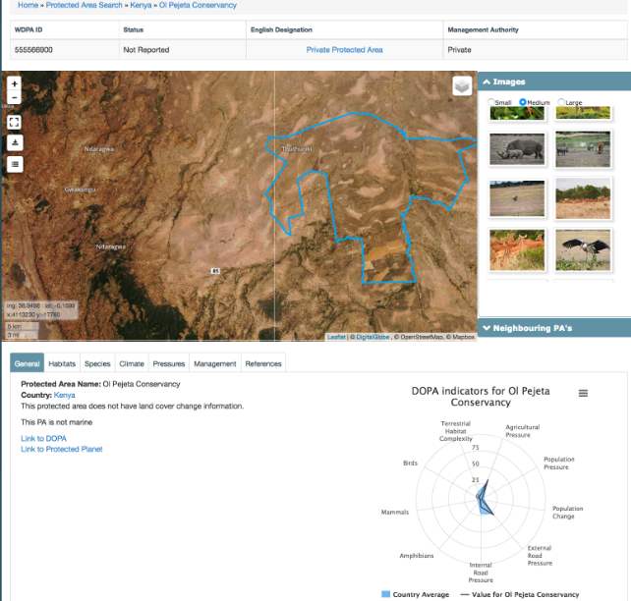
Reference Information System (RIS) 2015-2018
Aggregation including 3rd party content
Embedded map interface
Reuse of DOPA indicators
http://rris.biopama.org/
Notes:
RIS 1.0 – 2015-18
A dashboard style “one-stop shop” of maps, images, data, indicators
Open source, based on drupal content management system
Most content originating from web services, automatically aggregated. Limited curation and not focused on specific targets or policy questions
Here are the stats for DOPA and the RIS (using the July 2018 WDPA which is the version in the DOPA and RIS):
Number of protected areas 228,751
Number of protected areas in ACP region 8,565
Number of protected areas > 50Km2 23,044
Number of protected areas > 50Km2 in ACP region 3,217
The following total areas are not on the dissolved areas (i.e. no account is made where PAs overlap):
Total area of protected areas 52,482,385 Km2
Total area of protected areas > 50Km2 51,775,240 Km2
Total area of protected areas > 50Km2 in ACP region 8,418,794 Km2

Slide 9
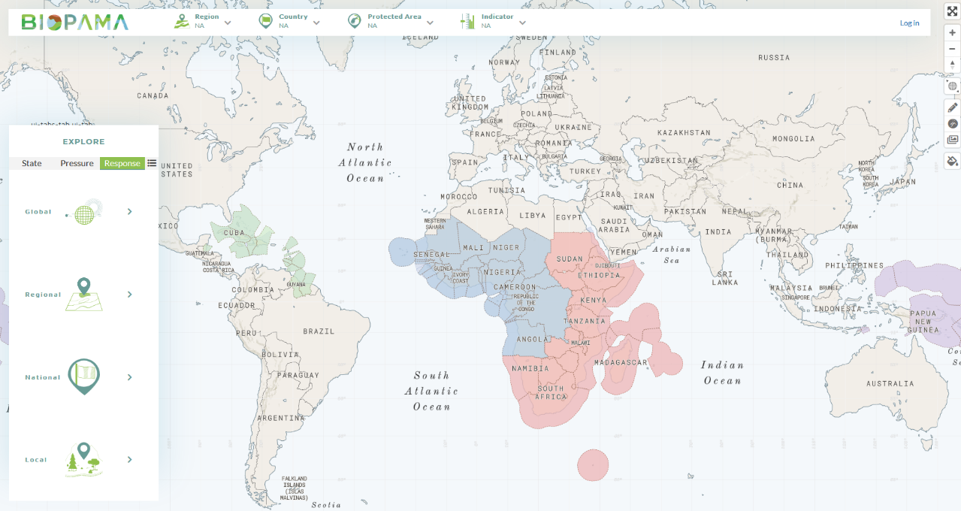
ACP Reference Information System 2018-
All PAs in ACP (>9000)
Notes:
A dedicated system for BIOPAMA, at ACP level
Major shift from a dashboard system to a target based system for measuring PA performance and objectives
Highlights inconsistencies and incompleteness of WDPA (more detail on this in discussion on regional observatory
Major changes to interface, design, user experience, performance
Vector tile technology completely revolutionises the map interactions
PostGIS (spatial database for handling geographic and related features)
GeoNode (off the shelf standards-compliant geodata publishing)
Drupal (Content Management Framework)
GeoServer (web mapping engine)
Leaflet

Slide 10
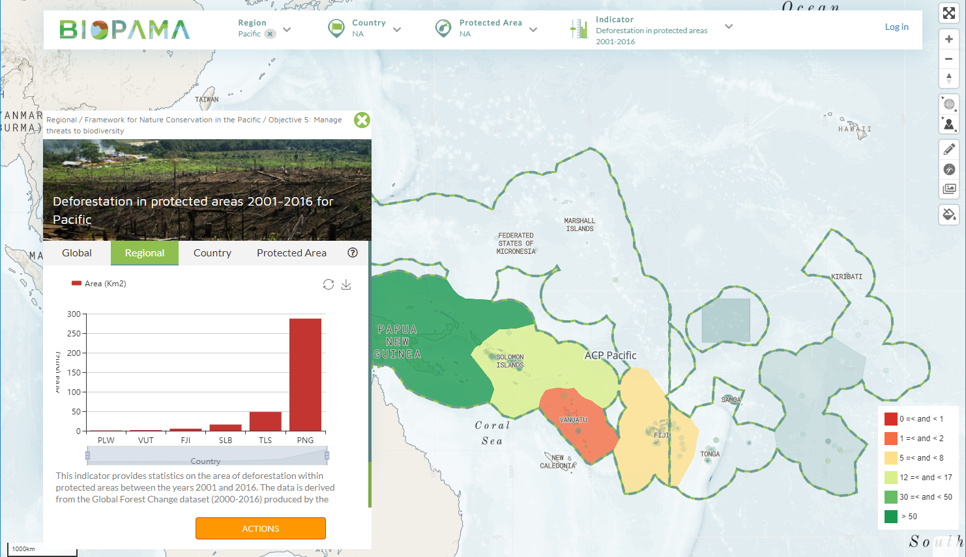

Slide 11
Launch 2019
Dashboard style with PA & country profiles
Covers basic PA & biodiversity information
Links to DOPA, IMET, PANORAMA, etc.
IMET Interface
ACP RIS
PA Dash-board
PAGE Module
‘Toolbox’
Policy Module
PAME Module
Launch 2019
Links to IMET,
GD-PAME, etc.
Launch 2020
Links to IMET, SAPA, GAPA &
governance assessment scorecard
Launched 2018
Tracks progress using
policy – target –
indicator framework
(e.g. NBSAPs)
Ongoing
Includes Marxan, mapping, Earth Observation (e.g. eStation & Copernicus services), etc.

Slide 12
Regional Reference Information Systems
Caribbean Gateway
Pacific Islands Protected Areas Portal
SADC TFCA Portal
IGAD and Biodiversity Management Programme legacy
OFAC
RCMRD
BIOPAMA2 – technical support contracts
Notes:
Synchronised with RIS, but with own identity, priorities, focus
Strong JRC presence and involvement in regional inception workshops
i.e. common architecture, regionally owned
Purpose of having dedicated web developer – 3 contracts to run 2018-19 for Caribbean, C. Africa and Pacific
Move away from “child site” concept
We have already built some regional versions of the RIS, either as a “cookie-cut” of the region (so called “child site” with same functions but just minor styling and selection of PAs just for that region) or supporting an existing PA regional portal (e.g. PIPAP) or a dedicated thematic site (OFESA, SADC TFCA….). The new contracts will increase and accelerate these developments. Plus there are many legacy databases and platforms that come from projects which have ended, which the regional observatories could take over (e.g. BMP in the IGAD region)

Slide 13
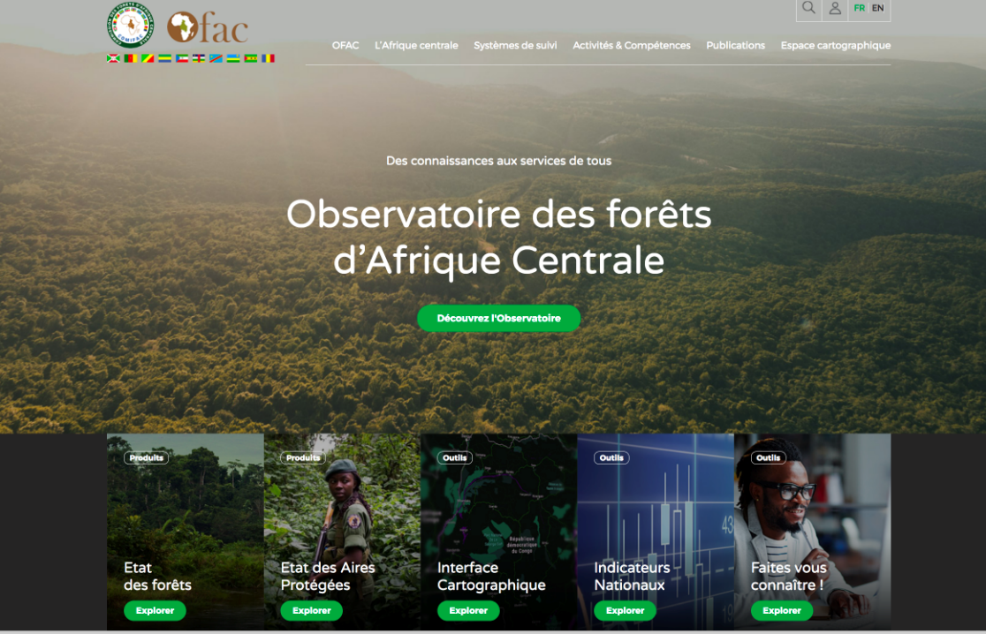
Notes:
OFAC – restyled and extended to include protected areas. Also highlights the need to build multi-lingual sites

Slide 14
Ecosystem Services
Review scientific ecosystem service literature for the ACP-countries
  Paper draft for the Pacific region finalized, to be submitted
  Evaluation of the literature for the Caribbean and African region, to be summarized in a paper draft
Contribution to a guideline on PA economic impact assessment
  Full draft of the guideline book
  Internal review of the single chapters
  Publication planed for end of the year
Global Database Protected Areas Visitors (GD-PAVIS)
  Finalized database schema
  Filling the database with participating countries
  Presenting the database structure on MMV conference
Ecosystem service assessment of case study PAs in the ACP countries
  Collaboration with researchers on elaborating ES assessment approaches
Notes:
Focus on tourism
GD-PAVIS – TAPAS
Need to re-use the other ESS related data and indicators, especially EO-derived, that we had experimented with in Phase 1.

Slide 15
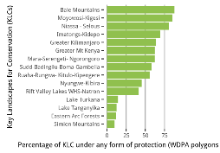
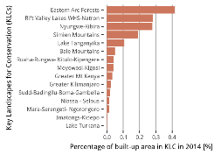
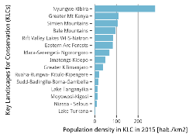
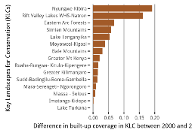
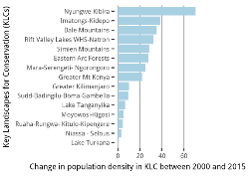
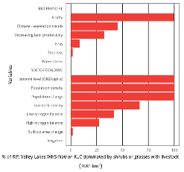
Terrestrial PAs
Example KLC: Rift Valley Lakes WHS - Natron
Pressures in Africa’s Key Landscapes for Conservation
Aims and scope of tasks
Visualize and quantify global change issues at KLC level
Impact and next steps
Comparison to other KLCs in East Africa
Information on global change issues (WAD3)
Notes:
We are now able to start generating indicators not just at DOPA WDPA level, but also other landscape level indicators. This could include KLC’s in Africa, TFCAs or other definitions

Slide 16
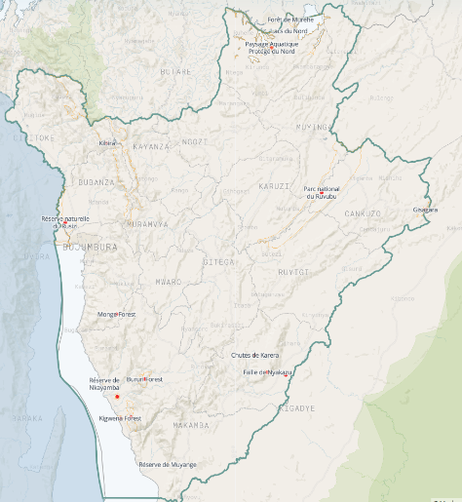
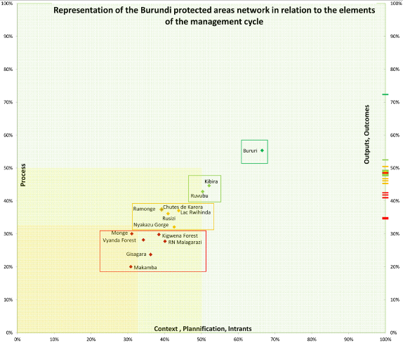
IMET
Notes:
Database setup a key achievement of Year 1, forms basis for effective data management and analysis
Statistical analysis, upscaling. E.g. country level analysis such as Burundi example
Simulation of Zakouma for all JRC staff – increase awareness amongst team of PAME in general, IMET in particular
Visualisation and tracking of results
Basis for additional and repeat assessments in W & C Africa, plus the other BIOPAMA regions. KWS Kenya interested in particular.
IPR issues are still to be resolved – who can have access to what information? Specifically, how does this link to the Action Component process?

Slide 17
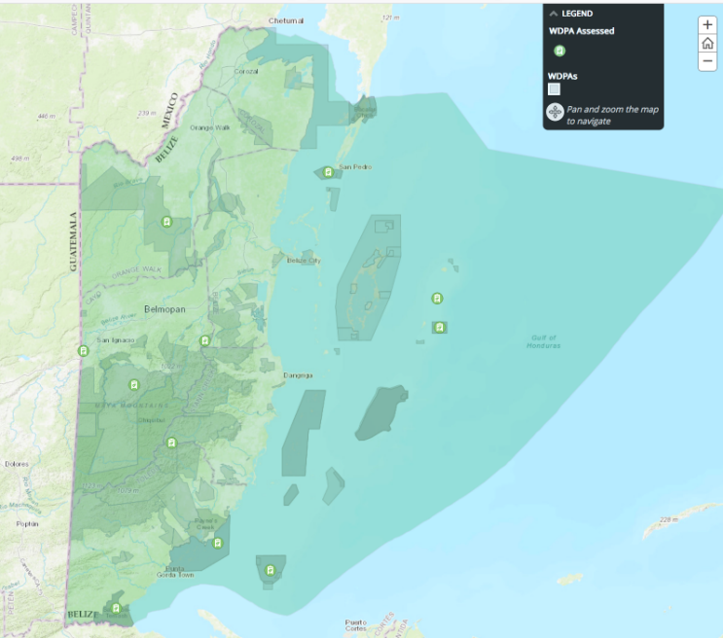
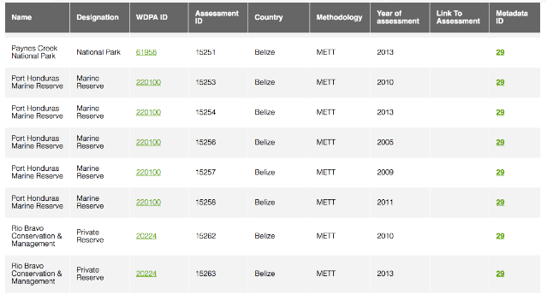
PAME
Notes:
Example where we have been able to compile geographically the various Protected Area Management Effectiveness (PAME) assessments. Need to engage with WCMC to ensure access to the PAME data and metadata. IMETs have been included in GD-PAME

Slide 18
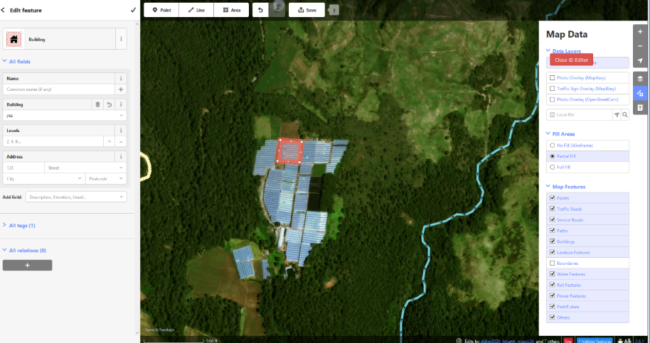
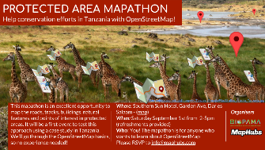
PA Mapping Tools and Campaigns
Notes:
Many PAs are simply not mapped very well. This example shows high intensity agricultural development in Valle Nuevo Dominican Republic. We have embedded widely used community mapping tools from OpenStreetMap in the RIS2.0, so these unmapped areas can be digitised from high resolution imagery. This can be promoted through specific targeted events (“mapathons”), supported by the regional observatories.

Slide 19
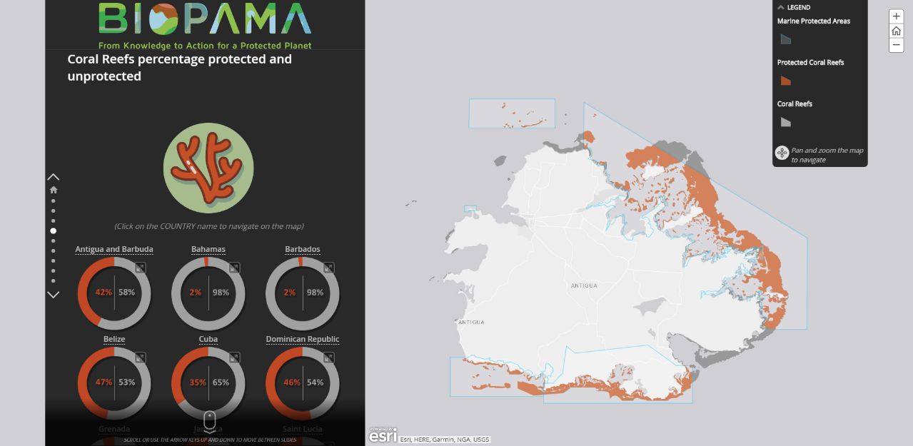
StoryMap Narratives and Visualisations
http://rris.biopama.org/storymaps/Caribbean-Marine-Protected-Areas
Notes:
1. First slide on Key ongoing and 2019 activities/ deliverables
2. Second slide on key opportunity and challenge (one of each). Example of challenge from EO: integrating CAP.

Slide 20
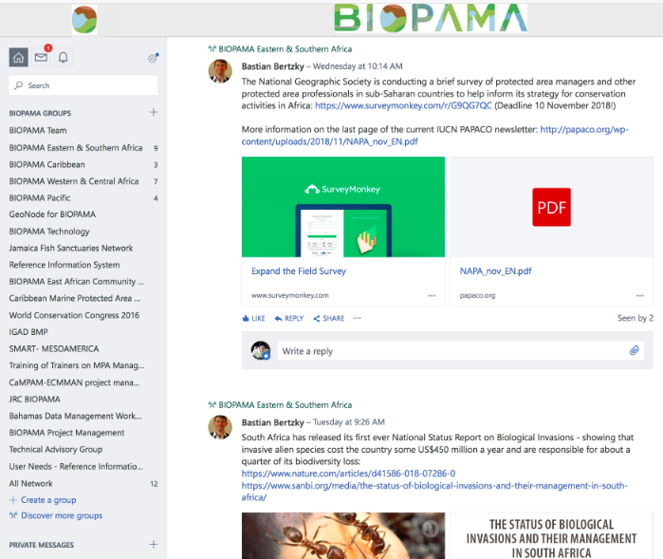
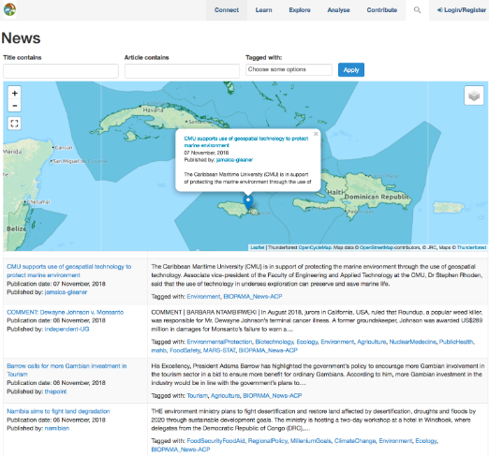
Other Information
Notes:
BIOPAMA RIS components still play a strong role :
Yammer – was under threat but now assured continuity. 700 members. Active, but only a limited number of active contributors.
News – we have improved the link to the Europe Media Monitor service. Georeferenced news on PAs and environment in ACP, updated daily

Slide 21
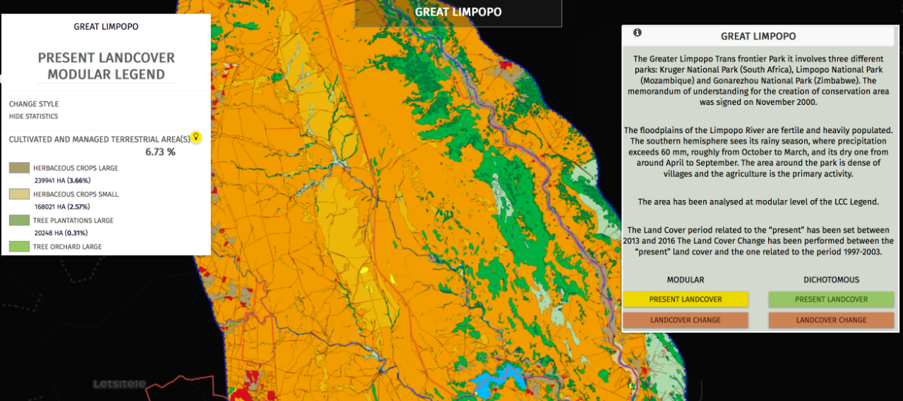
Copernicus HotSpot Monitoring
Notes:
Copernicus hot spot monitoring is an independent activity, but we have been successful in requesting the identification of hot spots based on BIOPAMA needs, ie focus on protected areas in ACP and the Key Landscapes for Conservation in Africa.
First lot – 380000km2. (Greater Limpopo is 65000). Also Salonga, Greater Virunga,
Second lot (end 2018) – including Timor Leste
Third Lot (2019) includes 96000km2 Caribbean

Slide 22
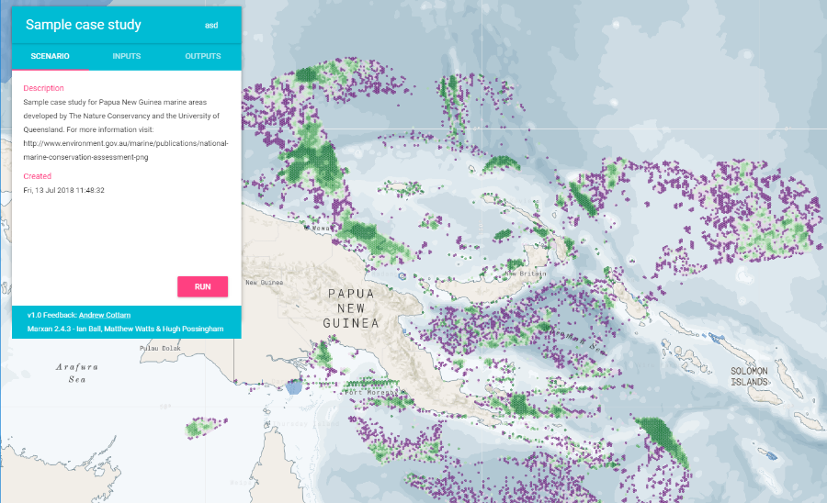
Analysis
Notes:
Marxan example – take a widely used and accepted tool but build a simpler user interface

Slide 23
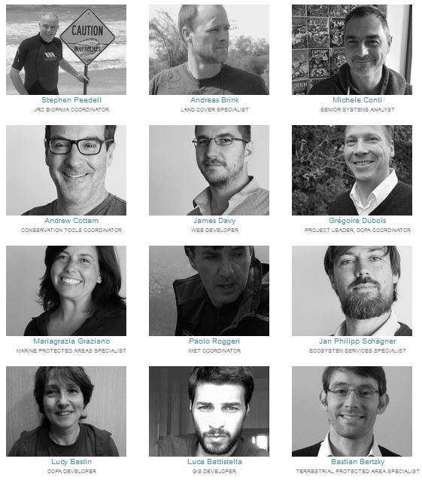
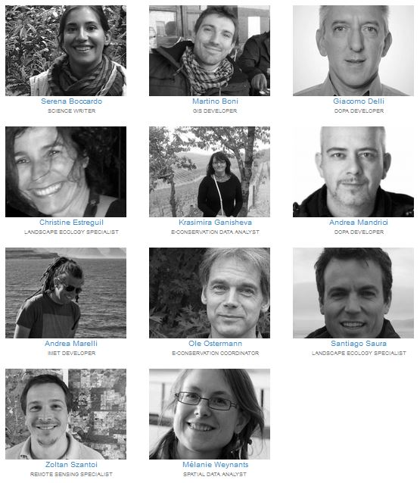
Connect to the JRC BIOPAMA Team – at your service! jrc-biopama@ec.europa.eu

Slide 24


Rris.biopama.org
rris.biopama.org

